Slide 1
Seminar presentation
Group 7
“Robot-assisted steady ultrasound imaging enabled by deep learning”
Tian Xie

Slide 2
Project
Robot-assisted steady ultrasound imaging enabled by deep learning

Slide 3
Papers
Laporte, C., & Arbel, T. (2011). Learning to estimate out-of-plane motion in ultrasound imagery of real tissue. doi://doi.org/10.1016/j.media.2010.08.006
Salehi, R. M., Sprung, J., Bauer, R. & Wein, W. (2017). Deep Learning for Sensorless 3D Freehand Ultrasound Imaging. In: Medical Image Computing and Computer-Assisted Intervention − MICCAI 2017. MICCAI 2017.

Slide 4
Speckle decorrelation

Slide 5
Learning to estimate out-of-plane motion in ultrasound imagery of real tissue
Laporte, C., & Arbel, T. (2011)

Slide 6
Summary
Problems to solve:
Micro-structure of real tissue may not be densely packed as phantoms and may exhibit non-random scatterer configurations
US signals decorrelate more slowly and differently with different medium
Nominal decorrelation model from the reference phantom cannot provide accurate estimation for real tissue
Solution:
Gaussian Process

Slide 7
Approach
Training:
Motion estimation:

Slide 8
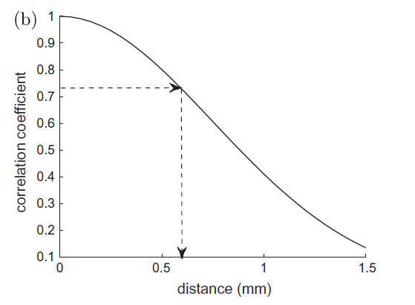
Approach
Decorrelation curve is represented by a Gaussian function of distance δ
Medium dependent
Stretching of the curve along δ axis
Find out the relationship of deviation between two models

Slide 9
Approach
Features in the calibration phantom → nominal curve
Features in other medium

Slide 10
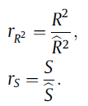
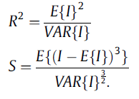
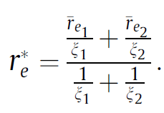
Approach -- Training
Sparse Gaussian process regression(Snelon and Ghahramni, 2006)
Features:
Estimate:
Probabilistic predictions: mean and variance of
When the regression is learned,
Two corresponding image patches
A global estimate:
A locally adapted piecewise curve:

Slide 11
Approach – Motion estimation
A rigid body transformation then fitted to those patch-wise estimations by least-median-of-squares (Rousseeuw and Leroy, 1987)):
(x,y) : center of patch in the image
z: estimated elevational distance

Slide 12
Experiment
Data Acquisition
Synthetic US images of speckle phantom (nominal curve)
Synthetic US data sequences in 15 virtual phantoms (training data sets)
US scans of pork tenderloin, turkey breast and beef brisket
Images:
0.01 – 0.1 mm elevational intervals
Patches around 50x30 pixels

Slide 13
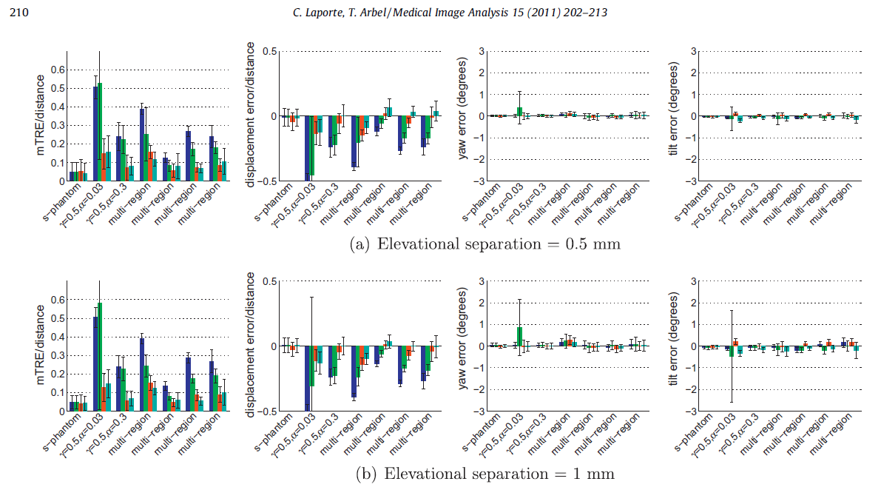
Results
Base-methods:
Direct use of nominal speckle decorrelation curve
Speckle detection (Prager et al, 2002)
Locally adaptive heuristic method (Gee et al, 2006)

Slide 14
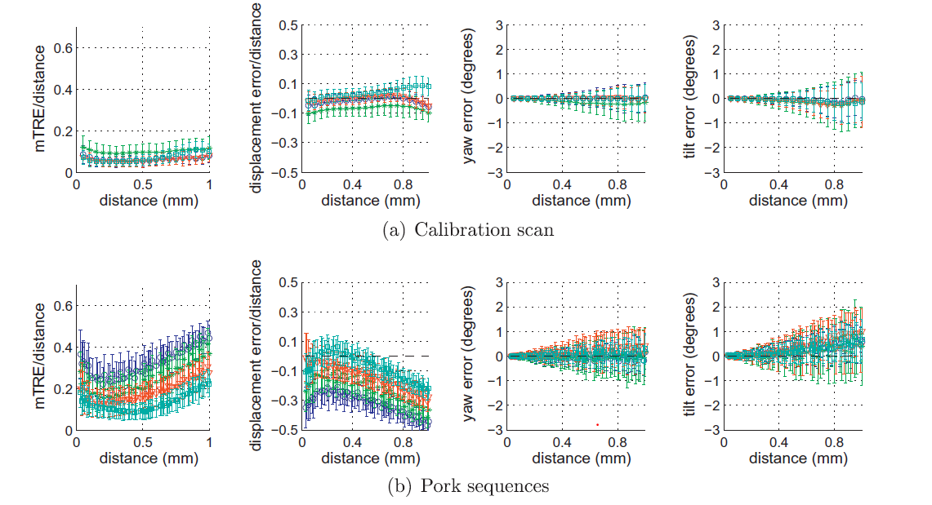
Results

Slide 15
Deep Learning for Sensorless 3D Freehand Ultrasound Imaging.
R. Prevost, M. Salehi, J. Sprung, R. Bauer & W. Wein. (2017)

Slide 16
Summary
Objectives:
Estimate the transformation between two B-mode ultrasound images
Realize sensorless 3D freehand ultrasound imaging
Problem:
Out-of-plane motion estimation
Current models (developed on fully developed speckles) cannot generalize to real clinical data
Solution:
End-to-end deep learning to circumvent the problems

Slide 18
Experiments
Equipment:
128-element probe at 9MHz, 256 scan-lines
Depth 5cm, focus 2cm
B-mode images resampled with an isotropic resolution of 0.3mm
Optical target on the probe (accuracy around 0.2mm)
Dataset:
20 sweeps (7168 frames) on a BluePhantom US biopsy phantom
88 in-vivo sweeps (41869 frames) on forearms
12 in-vivo sweeps (6647 frames) on lower legs

Slide 19
Result

Slide 20
Result

Slide 21
Critique
Cons:
The paper sees CNN an analogy for speckle correlation, but I doubt the network is actually trained on anatomical features.
Pros:

