Slide 1
Deep Learning for CT Scan Identification of Temporal Bone, Maxillofacial and Skull Base Landmarks for Facial Transplantation and Robotic Skull Base Surgery
The temporal bone, maxillofacial region and skull base are complex areas that have multiple nerves, arteries, veins and other important structures encased in bone
Operating in this area is challenging and understanding the relationship between important landmarks is critical for successful surgery
Hopkins is currently pioneering a novel face transplantation method which includes transferring the skull base, we need automated processes to identify donor matches
Hopkins is also pioneering semi-autonomous temporal bone surgery using a cooperative control robot and we need autonomous methods of segmenting out temporal bone anatomy
Identifying these relationships on CT imaging preoperatively can greatly improve the speed, safety and efficiency of surgery

Slide 2
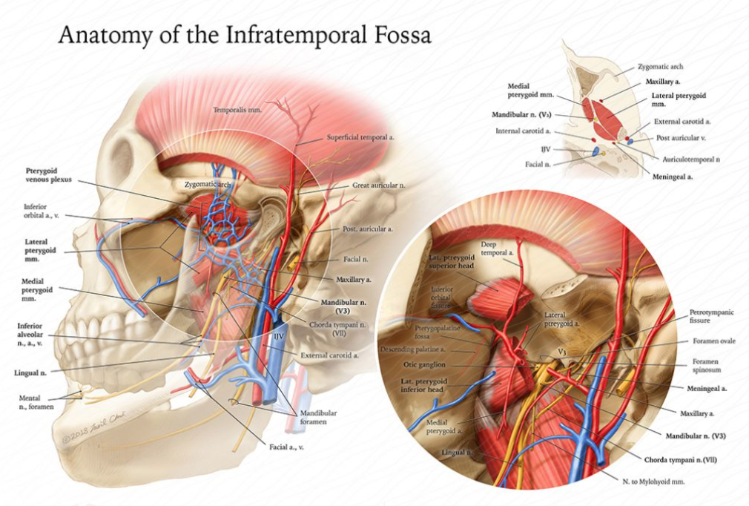
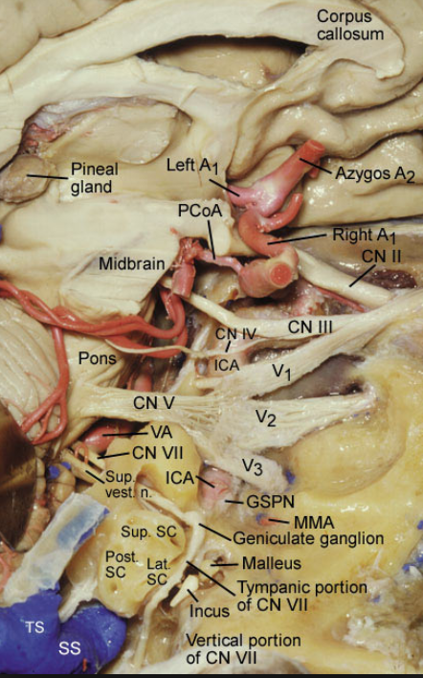
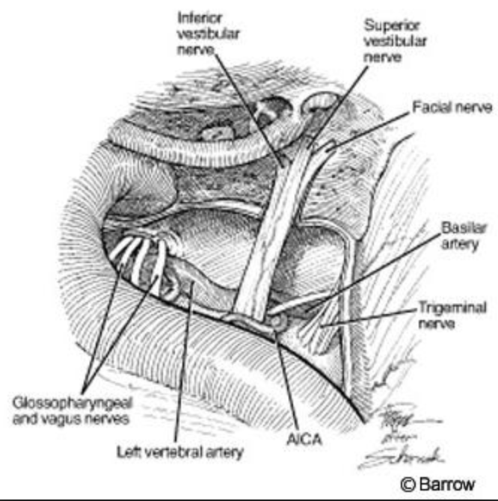

Slide 4
Deep Learning for CT Scan Identification of Temporal Bone and Skull Base Landmarks
Goal
To use a machine learning system to automated identification of CT landmarks of the skull base and temporal bone
To teach that system to measure and detect anatomical relationships between these landmarks
To integrate this project with the face transplant team at Johns Hopkins to better assess donor candidates

Slide 5
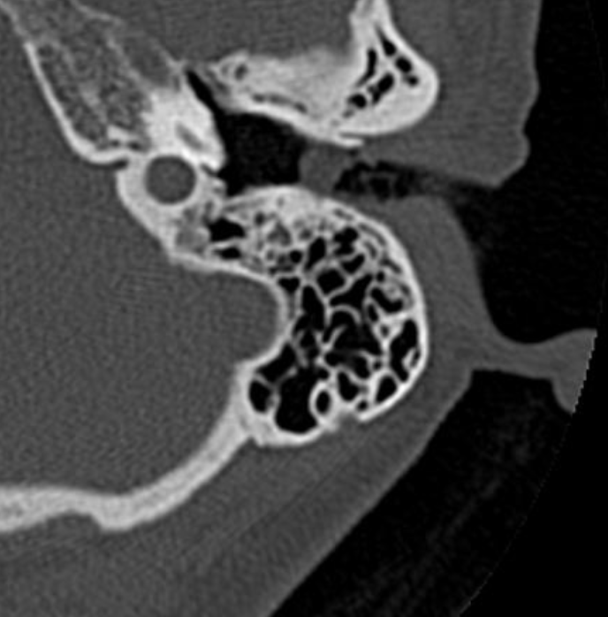
Deep Learning for CT Scan Identification of Temporal Bone and Skull Base Landmarks
Goal
Jugular Bulb

Slide 6
What Students Will Do
Learn to segment out Basic CT Landmarks of the temporal bone
Use publicly available datasets of the temporal bone and deep learning algorithms to automate identification and segmentation of common temporal bone landmarks
https://www.smir.ch/objects/204388
https://www.radrounds.com/profiles/blogs/list-of-open-access-medical-imaging-datasets

Slide 7
Deliverables:
Minimum: Develop prototype system that can identify and automate segmentation of at least one landmark in the temporal bone
Expected: Identify and segment common temporal bone land marks (facial nerve, carotid, cochlea, semicircular canals, ossicles) resulting in a usable .stl file
Maximum: Automate measurements of anatomical relationships between these landmarks
Group Size: 1-2
Skills:
Programming skills such as Python/Tensorflow/PyTorch
Knowledge of image segmentation and deep/machine learning
Prior experience with DICOM datasets is a plus
Mentors: Dr. Russell Taylor, Dr. Francis Creighton, Dr. Robin Yang, MD DDS
Contact: unberath@jhu.edu rht@jhu.edu, francis.creighton@jhmi.edu, crazavi1@jhmi.edu

