Slide 1
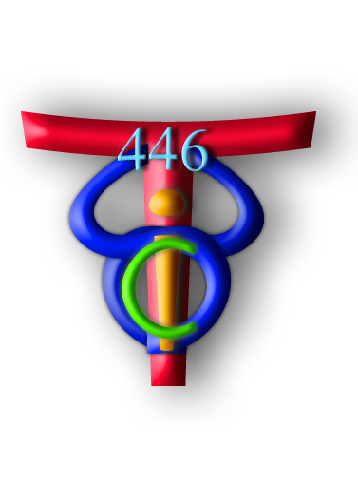
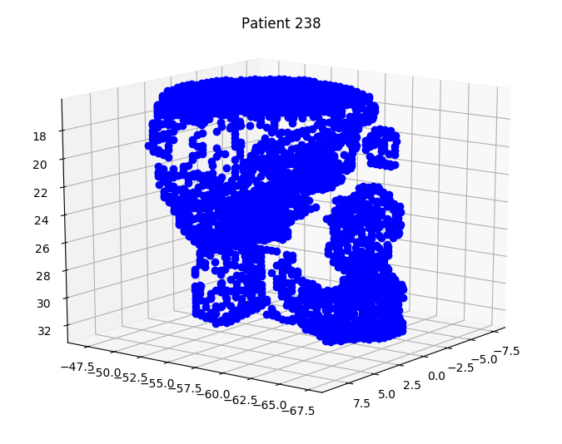
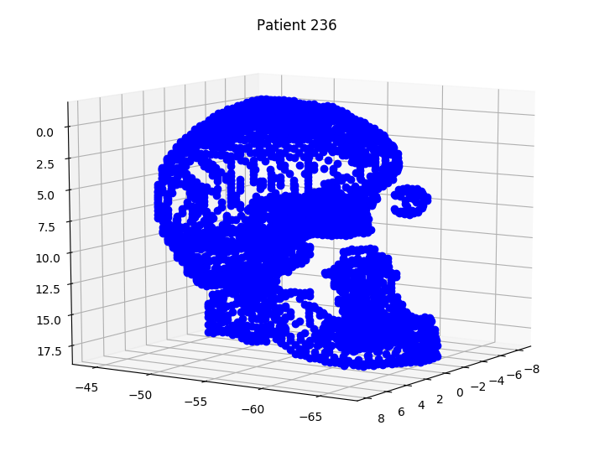
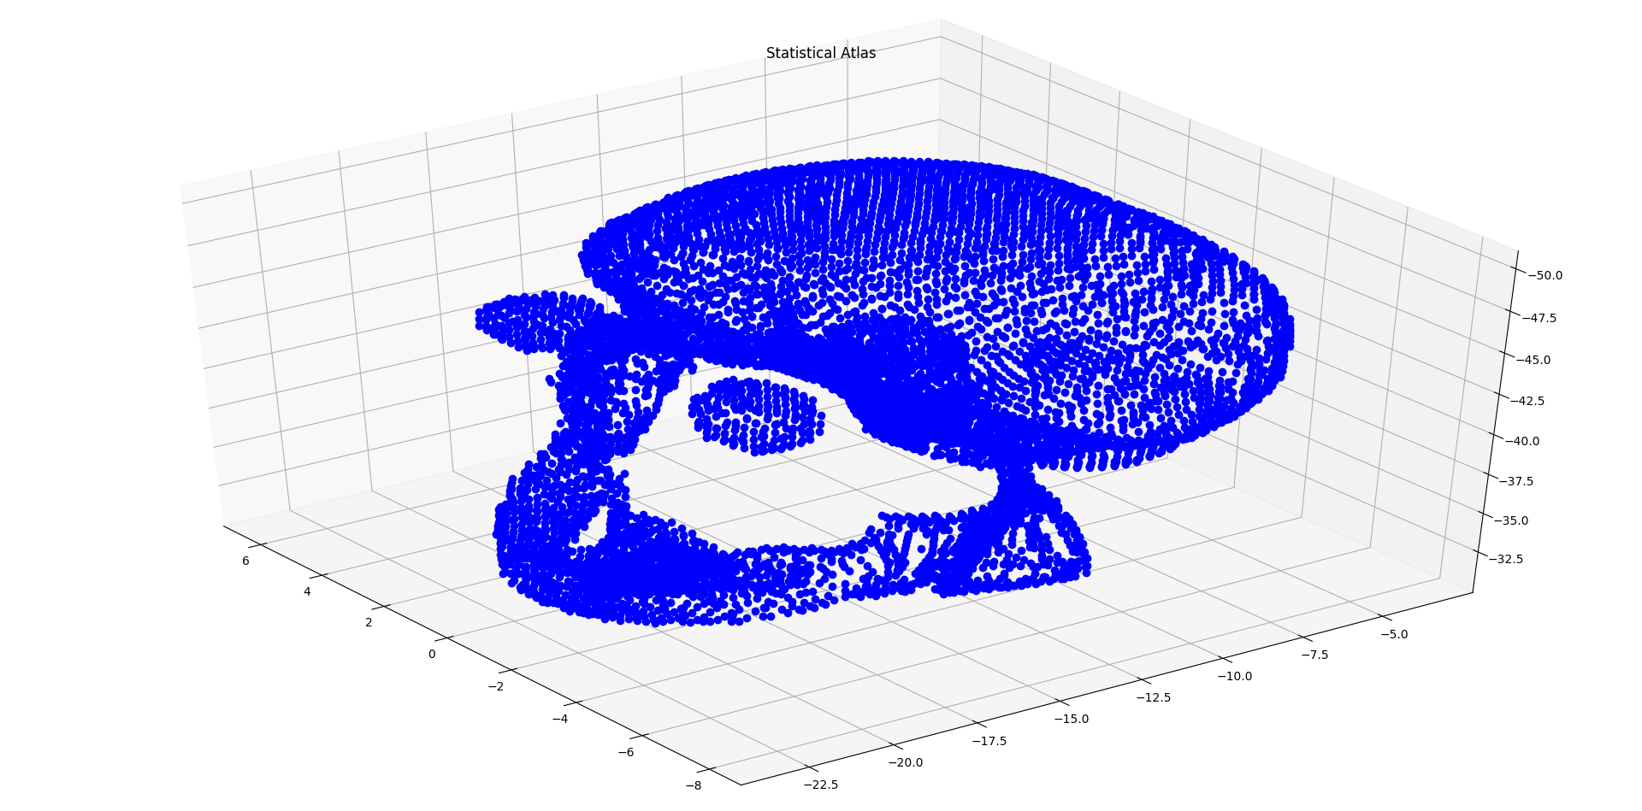
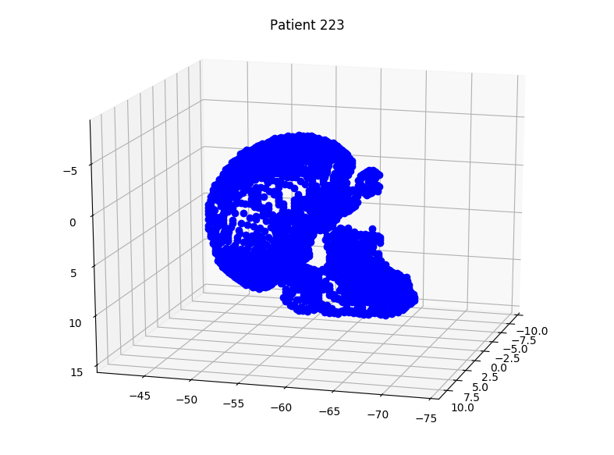
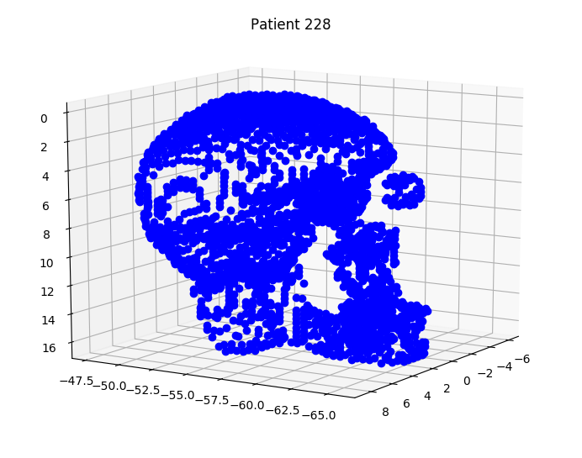
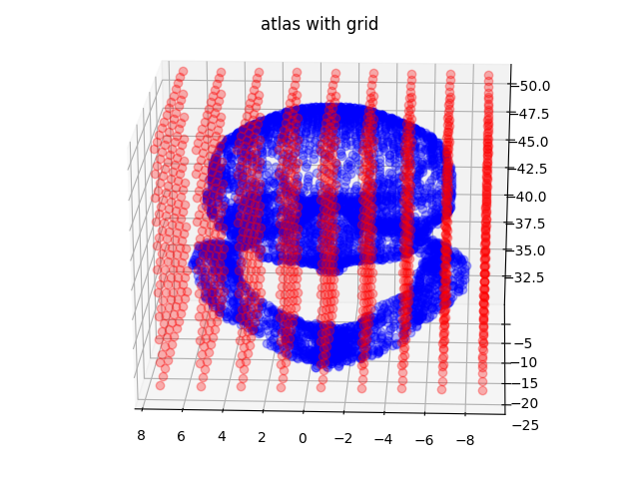
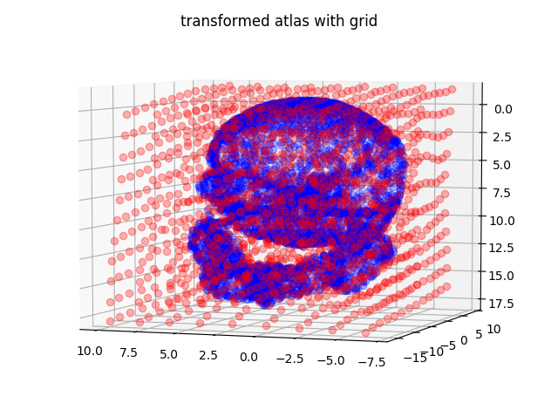
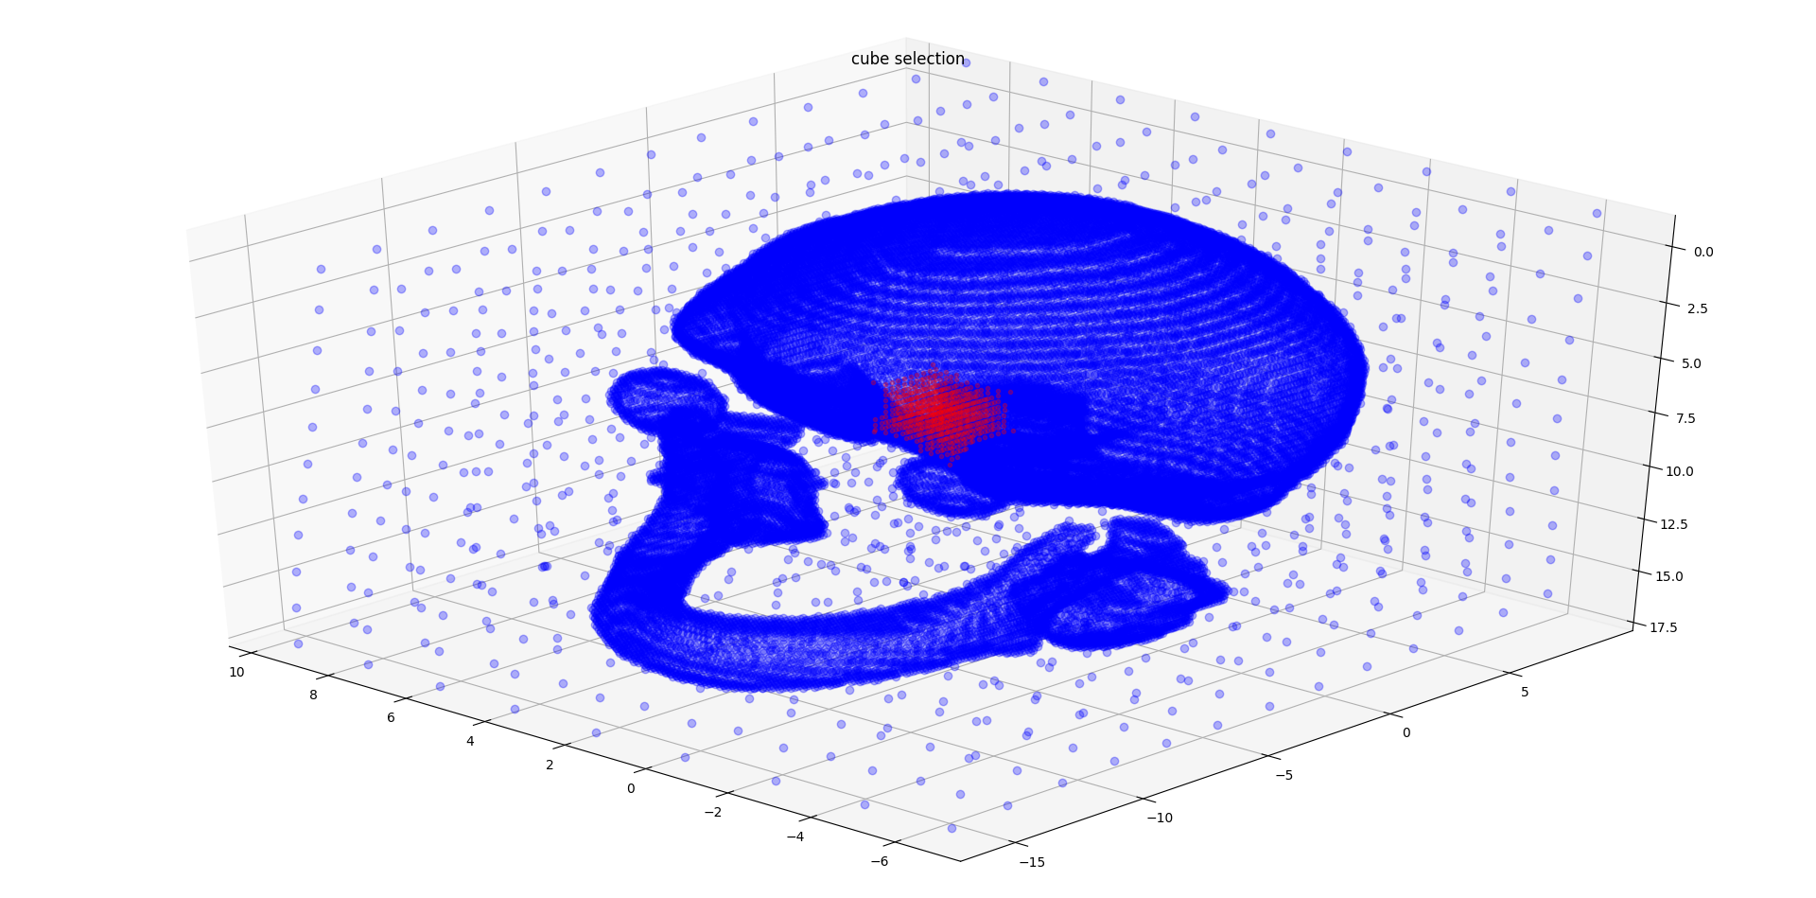
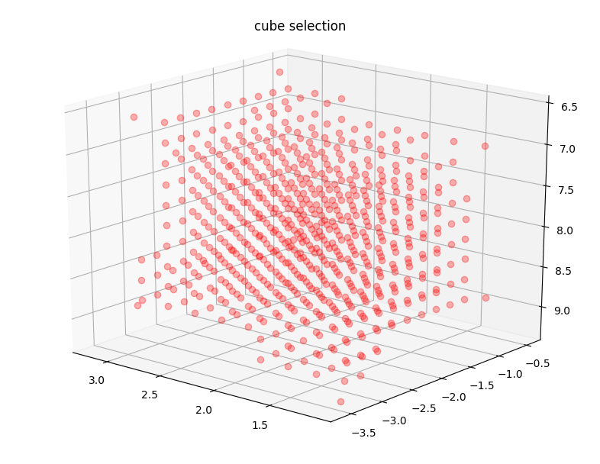
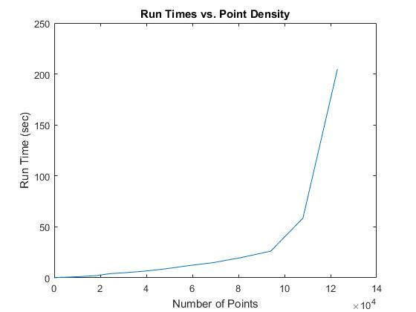
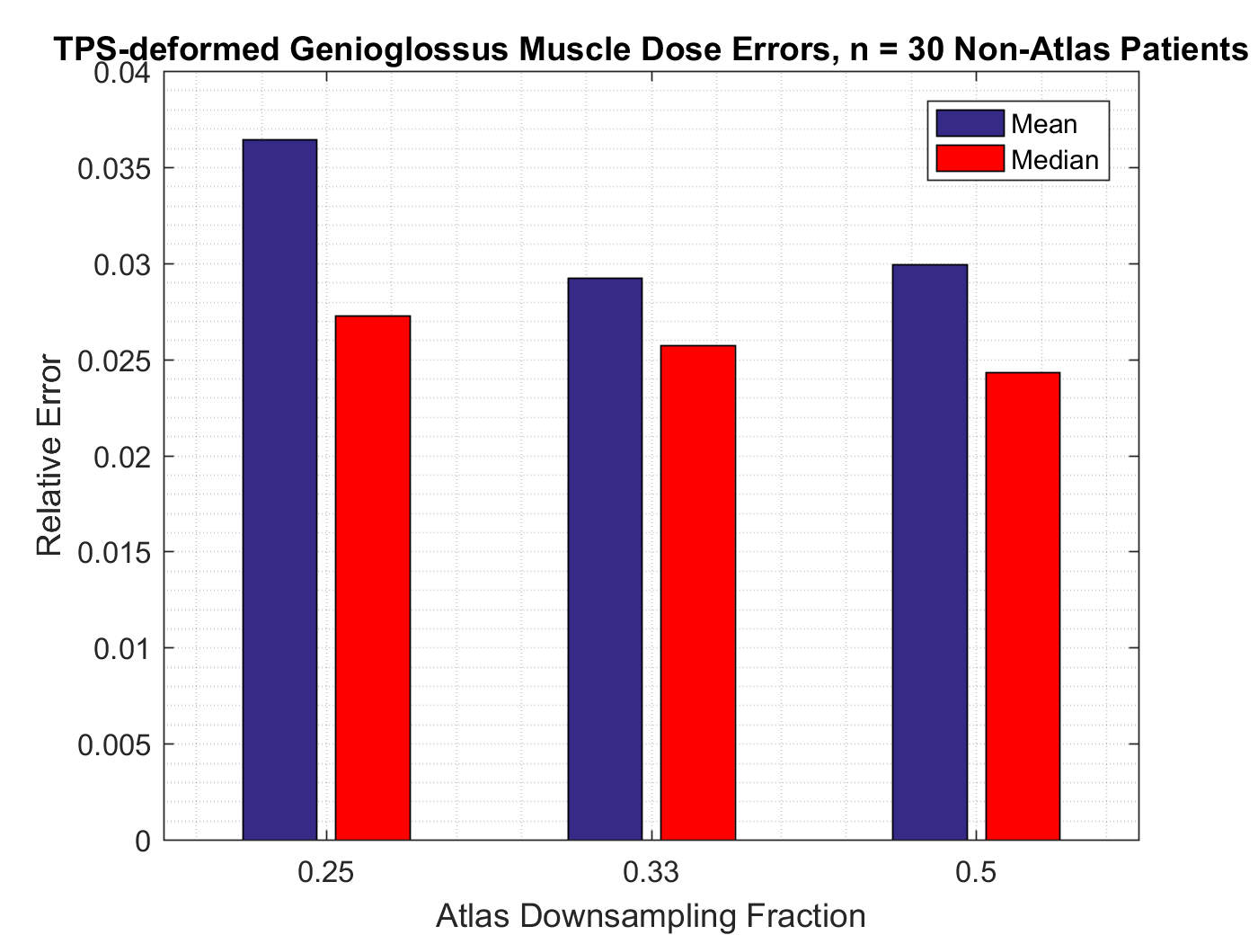
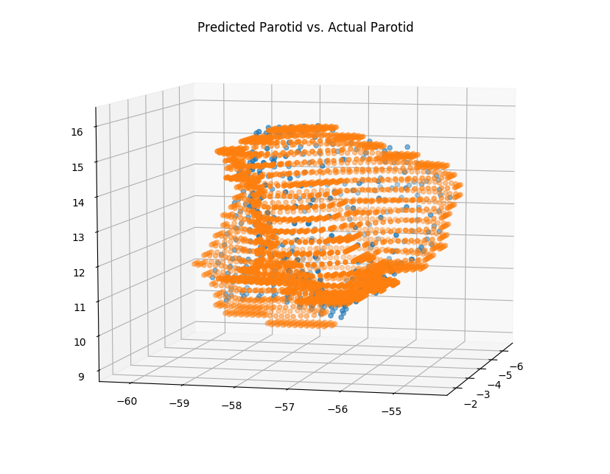
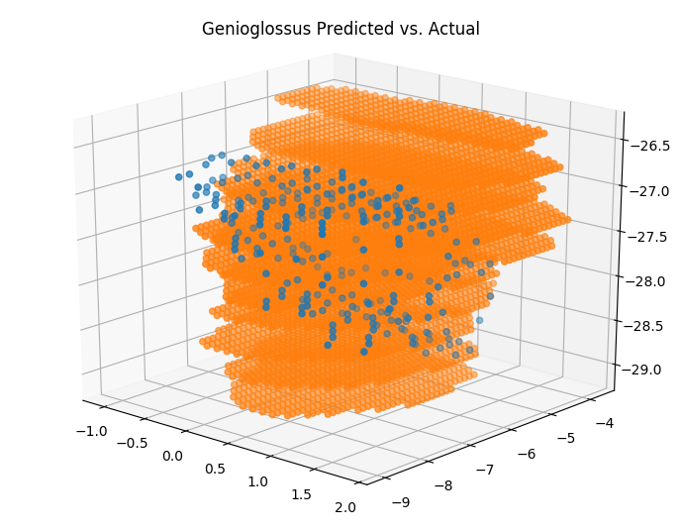
Framework for Automatic Identification of Critical Regions of the Head and Neck for Refined Dose-Toxicity Analysis in Radiotherapy Computer Integrated Surgery II Spring, 2017 Chris Micek, Arun Raghavan, Julie Shade, Mentors: Dr. Todd McNutt and Dr. Russ Taylor
Introduction
We have developed an API for the creation and manipulation of statistical atlases from a radiotherapy planning database.
Using coherent point drift (CPD) registration, Thin Plate Spline (TPS) fitting, and available dose statistics, we are able to define an arbitrary region in the coordinate space of an Atlas, and accumulate dose statistics in that region across any subset of patients.
The potential application of this API is in the study of the correlation between radiation delivered to previously unexamined inter-organ spaces and toxicity and/or quality of life outcomes in patients.
A
B
C
D
E.
The Problem
In radiotherapy, the effects of radiation to inter-organ spaces on patient quality of life have not been thoroughly investigated, and potentially some of these regions have a higher impact on outcome than currently known.
Radiotherapy can have undesirable side effects, such as difficulty swallowing, etc.
In order to study these effects, and determine the relative significance of inter-organ spaces, a large amount of data is necessary. Therefore creating software to take advantage of previously compiled data can increase the efficiency of studies into these factors.
Figure 1: The process of accumulating dose statistics. A. Patient representations are queried from the database and put through our AtlasCreation algorithm, which performs registration to a common coordinate space to create an atlas. B. The atlas is then registered to an individual patient. C. The results of registration can then be used to fit a Thin Plate Spline transformation. D. In this example we use TPS to transform a uniform grid to an individual patient. E. We can then pick a transformed section of the grid and query for dose statistics from the database. This queried data corresponds to the location specified by the original section of the grid in the atlas.
The Solution
We created an API that makes use a prebuilt database querying software and registration algorithm from the McNutt Lab.
Our solution uses the provided CPD registration to iteratively construct a statistical average point cloud representation of the patients in the database, given a user specification of the organs of interest.
Our API includes a suite of tools to define arbitrary geometric regions to accumulate dose metrics in across a subset of patients.
The API uses TPS fitting to create a mapping function from the atlas coordinate system to any individual patient space.
Validation was done by testing the predictive power of the API to reconstruct organs left out of a given patient point cloud.
Outcomes and Results
We created an atlas comprised of 30 patients containing the left eye, right eye, mandible, left parotid, right parotid, brain, and multiple other organs using CPD.
We used relative error between mean dose in contoured patient regions and regions deformed from the atlas as our validation metric.
Figure 2 shows a bar graph of error in validation with relations to the sampling frequency used during Registration and TPS transformation and a corresponding graph of the algorithmic runtime vs. the point density used.
In all cases, the median error in dose accumulation is less than the mean, implying that outliers are present in terms of error.
We found that down-sampling by a fraction of 0.33 results in the best tradeoff between runtime and accuracy.
Figure 2: Runtime and Validation. Top left: A graph of the algorithm runtime in seconds vs. the number of points used in Registration and TPS fitting. Top right: Mean and median relative error of dose accumulated from an atlas deformation of the genioglossus muscle in 30 patients and the actual dose in those regions versus the atlas down sampling fraction. Bottom Left: A scatter plot of a predicted right parotid gland (in blue) with the actual parotid gland overlaid (in orange). Bottom Right: A scatter plot of a predicted genioglossus muscle (in blue) with the actual parotid gland overlaid (in orange).
Future Work
The continuation of this work will involve the training of machine learning algorithms using this data to create a model relating outcome and dose to inter-organ spaces.
Further steps to increase accuracy are also necessary.
Support by and Acknowledgements
Thank you to Dr. Taylor, Dr. McNutt, and Pranav Lakshminarayanan
Credits
Chris Micek: Validation and Dose Querying
Arun Raghavan: Sector Registration, Thin Plate Spline
Julie Shade: Atlas Creation, Grid Creation and Delineation
Engineering Research Center for Computer Integrated Surgical Systems and Technology

