Slide 1
Detection and Guidance of K-Wire Placement in Pelvic Trauma Surgery
Motivation:
Fractures of the pelvis require fixation
K-wires are used to guide cannulated screws
3D reckoning from 2D fluoroscopy is challenging
Trial and error (>2 min radiation exposure)
K-wires bend during insertion
What Students Will Do: Develop and train a CNN for detecting K-wires in radiographs
Simulate DRR from CT
Project deformed K-wires onto DRR
Design a CNN to identify / segment K-wires
Train and validate the CNN on simulated data
Use detections as initialization for 3D guidance (e.g., 3D-2D registration)
Repeat fluoroscopy
Implant deformation

Slide 2
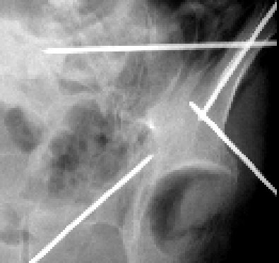
Detection and Guidance of K-Wire Placement in Pelvic Trauma Surgery
Deliverables:
Minimum: K-wire detection in 2D radiographs
Expected: Systematic evaluation in phantom and/or cadaver studies
Maximum: 3D guidance from multiple detections (e.g., AP & LAT)
Size group: 2–3
Skills:
Programming skills (e.g., Python)
Basic knowledge in machine learning (e.g., TensorFlow/PyTorch)
Mentors:
Dr. Ali Uneri (ali.uneri@jhu.edu)
Dr. Jeffrey H. Siewerdsen (jeff.siewerdsen@jhu.edu)
2D Detection
Superior ramus
Plan
3D Guidance

Slide 3
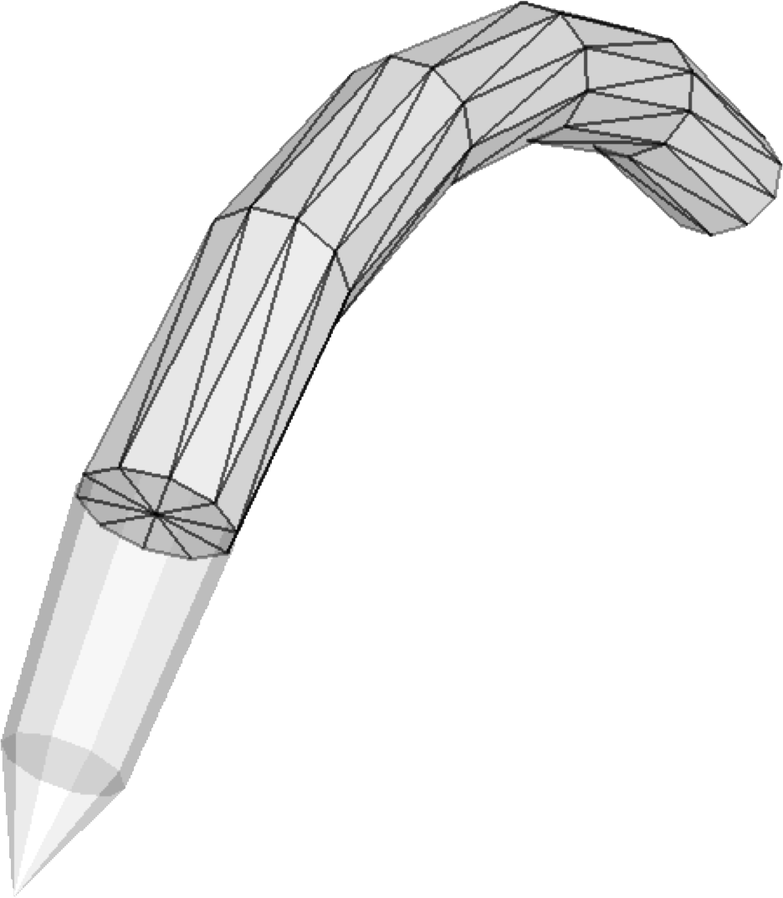
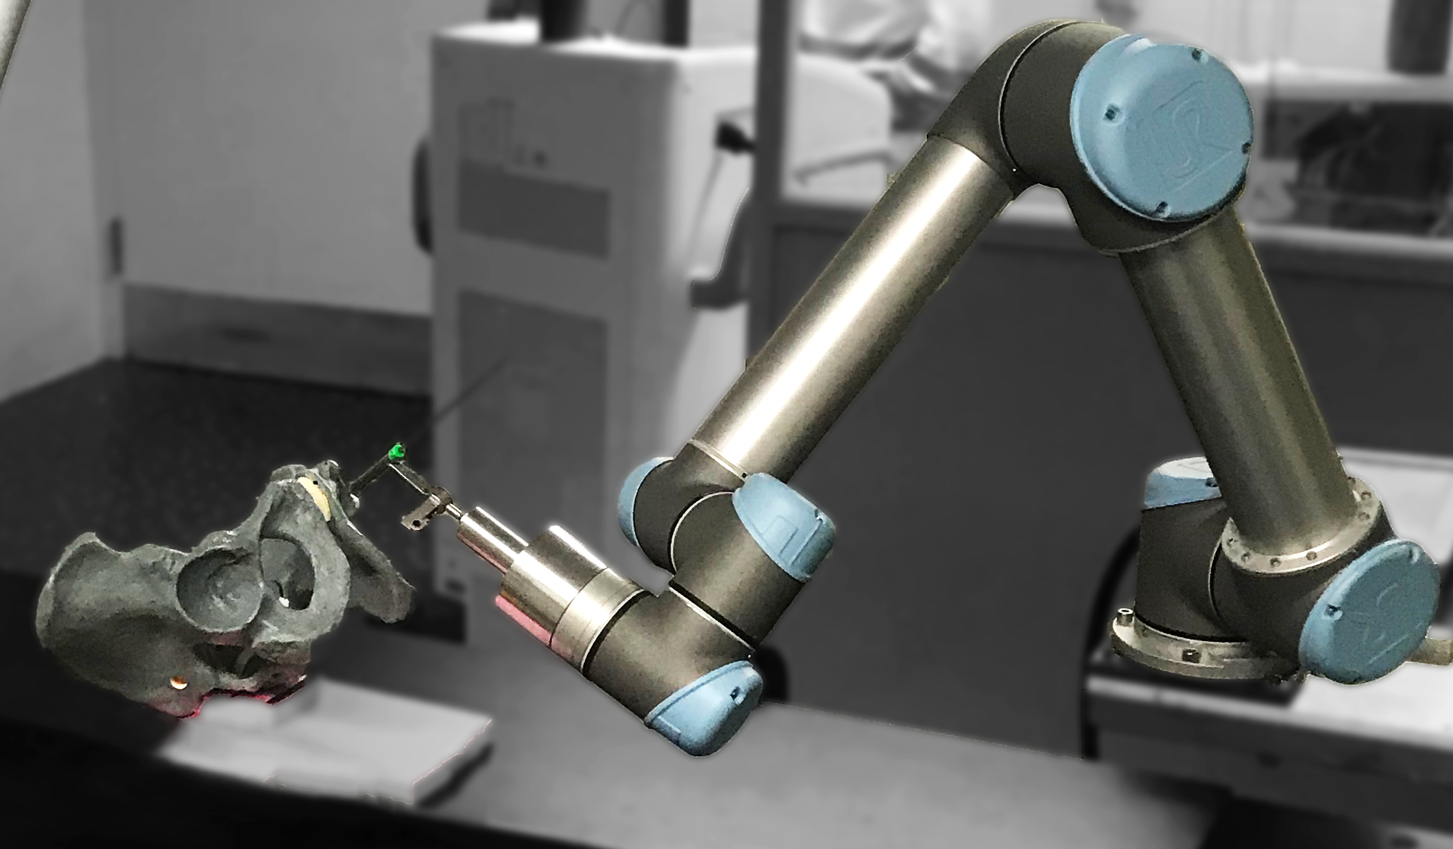
Detection and Guidance of K-Wire Placement in Pelvic Trauma Surgery
Deformable K-Wire Model
3D-2D Deformable Registration
$$a_{2}$$
$$a_{3}$$
$$a_{1}$$
X-Ray Guidance of Robotic Trajectory
$$C(u)$$
$$a_{0}$$
Contact: Dr. Ali Uneri (ali.uneri@jhu.edu)

