Slide 1
Project 8: UI for Radiation Therapy Cohort Selection
Members: Domonique Carbajal, Keefer Chern
Mentors: Todd McNutt,Pranav Lakshminarayanan
TM
CIS II 601.456 Spring 2019

Slide 2
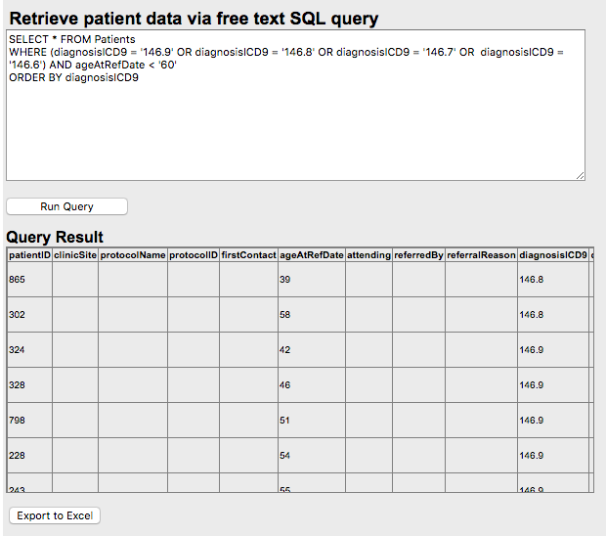
Summary
Problem
Currently there is no quick and intuitive way to select patient cohorts from this database other than through a command prompt.
There is also no visuals of the outcomes of patients selected by these variables.
No way to save and load variable parameters
Goal
Develop a User Interface that will allow researchers and clinicians the ability to select a patient cohort based upon any number of the variables in available patient information and view historic patient outcomes
Notes:
Domonique, Speak to motivation for clinicians

Slide 3
Work to Date
Front End:
Created the framework/website to which UI will be developed upon. Can query for static variables (age and diagnosis) through the UI.
Back End:
Became familiar with schema of database
Wrote scripts performing cohort selection with static variable, multiple variables, and longitudinal variables.
Notes:
Keefer?

Slide 4
Frontend Implementation Choices
Language: java and html
Eclipse - IDE
JSF - Java Server Faces
Spring - Connection between java classes
Maven - Makes using Spring easier
Hibernate - Connection to the backend
Tomcat - Website
Notes:
JSF - Connection of html files
Maven - includes a necessary dependencies when building

Slide 5
Old Deliverables
Minimum: UI and algorithm allowing for static variable(age, race, gender, diagnosis) selection of cohort with code and documentation.
Expected: Longitudinal variable (duration/onset of symptoms) selection of cohort with code and documentation. Query saving and loading implementation.
Maximum: Derived variable selection(Dose Volume Histogram comparison) of cohorts with code and documentation.
Notes:
Dom

Slide 6
Updated Deliverables
Minimum: Develop SQL, Algorithm allowing for static variable(age, race, gender, diagnosis) selection of cohort with code and documentation. Framework setup for the implementation of the UI as website.
Expected: Algorithm for Longitudinal variable (duration/onset of symptoms) selection of cohort with code and documentation. Creating a UI for static variable Cohort Selection along with code and documentation.
Maximum: Algorithm for Derived variable selection of cohorts with code and documentation. Query saving and loading and UI for longitudinal variable Cohort Selection implementation along with code and documentation.
Notes:
Edit Expected and Maximum still

Slide 7
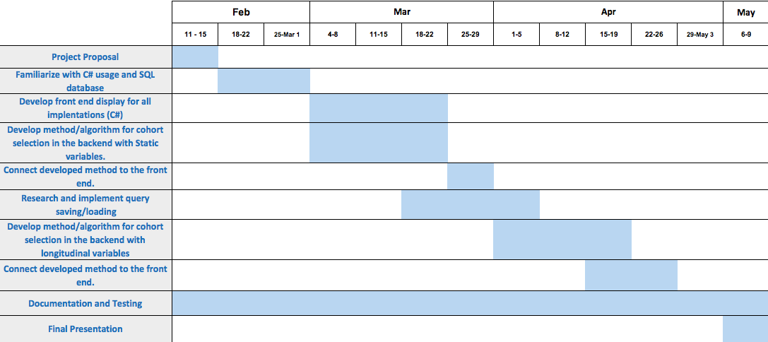
Timeline
Notes:
Dom

Slide 8
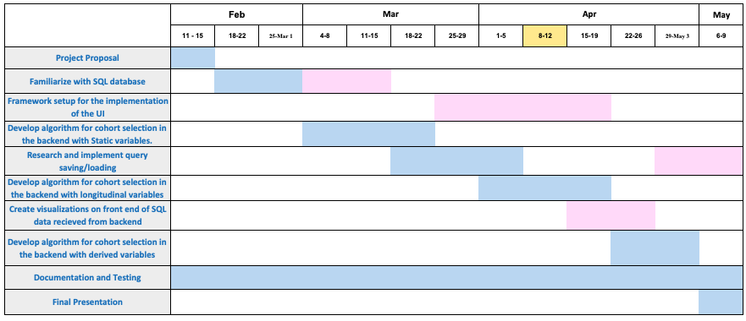
Updated Timeline
Access to database took longer than expected
Altered Deliverables, need to establish framework and connect to developed SQL

Slide 9
Updated Milestones
Milestone | Updated Milestone | Date | Status | Measurable
Presentation And Proposal |  | 2/14-2/28 | Done | Complete presentation and email proposal
Familiarize self with code and database |  |  | Done | Be capable of editing website and understanding existing code
UI set up to allow for cohort selection with Static variables. | SQL code formatted for cohort selection with Static variables. | 3/25 | Done | Perform a cohort selection, have report of code and documentation
UI set up to allow for cohort selection with Longitudinal variables | SQL code formatted for cohort selection with Longitudinal variables | 4/19 | In process | Perform a cohort selection, have report of code and documentation
 | UI with selection of static variable | 4/14 | In process | Be able to perform cohort selection in UI and patient table.
 | UI with selection of longitudinal variables | 4/26 | To Do | Be able to perform cohort selection in UI and receive visualizations.
Query Load and Save Parameters |  | 5/2 | To Do | Successfully save query and load independently on site
Final Presentation |  | 5/9 | To Do | Present report of completed work.
Notes:
Dom

Slide 10
Current Dependencies
Dependency | Plan to Resolve | Estimated Resolution Date | Need to be resolved by? | Resolved?
Access to Database and Website | Talk to Dr. McNutt | 2/12/19 | 2/12/19 | Yes
Access to Previous Code | Talk to Dr. McNutt/Pranav | 2/14/19 | 2/14/19 | Yes
Access to Clinicians or Researchers to Test Usability | Talk to Dr. McNutt or have Dr.McNutt as the Tester | 2/15/19 4/22/2019 | 2/15/19 4/26/2019 | No
✅
✅
Notes:
Keefer? Talk about we basically need to be done-ish first but assured No problem

Slide 11
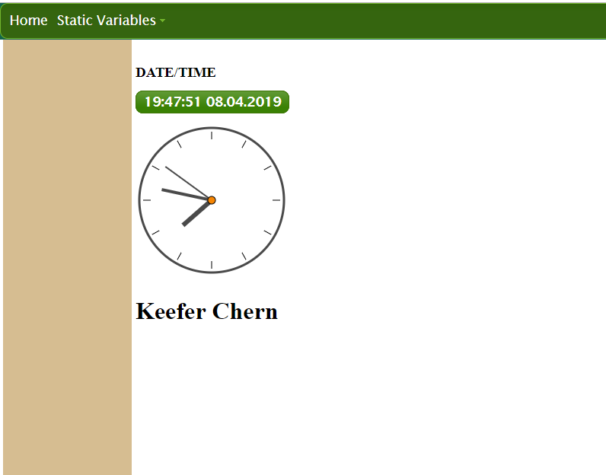
Current Main Webpage

Slide 12
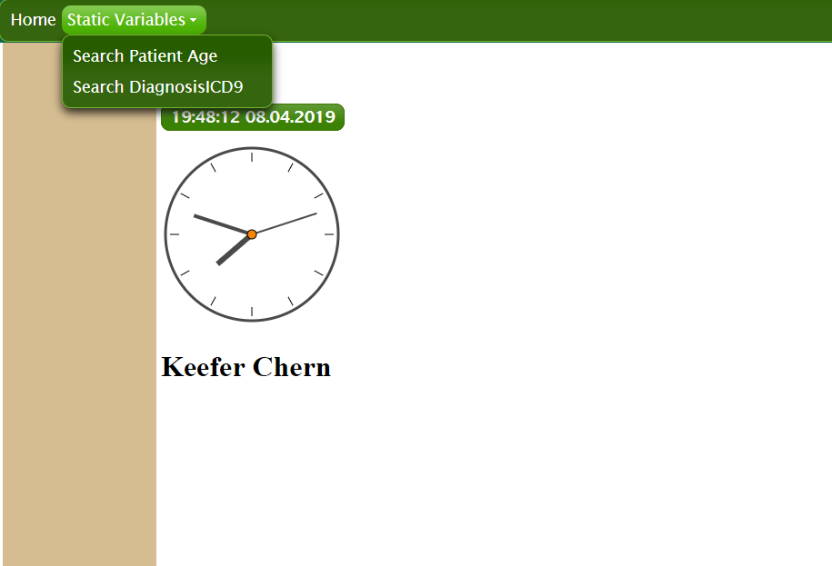
Menu Scroll Down

Slide 13
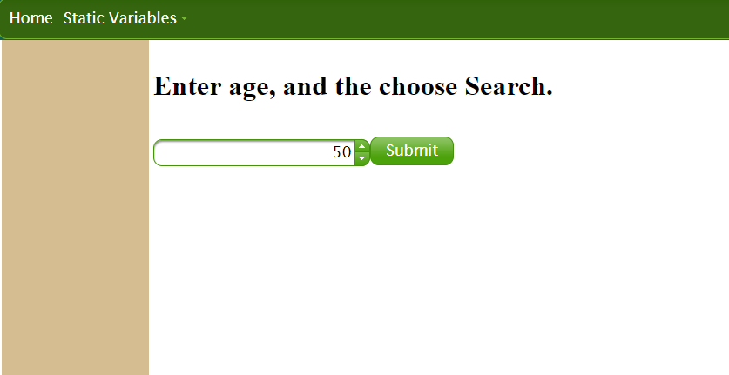
Selecting Patient Age

Slide 14
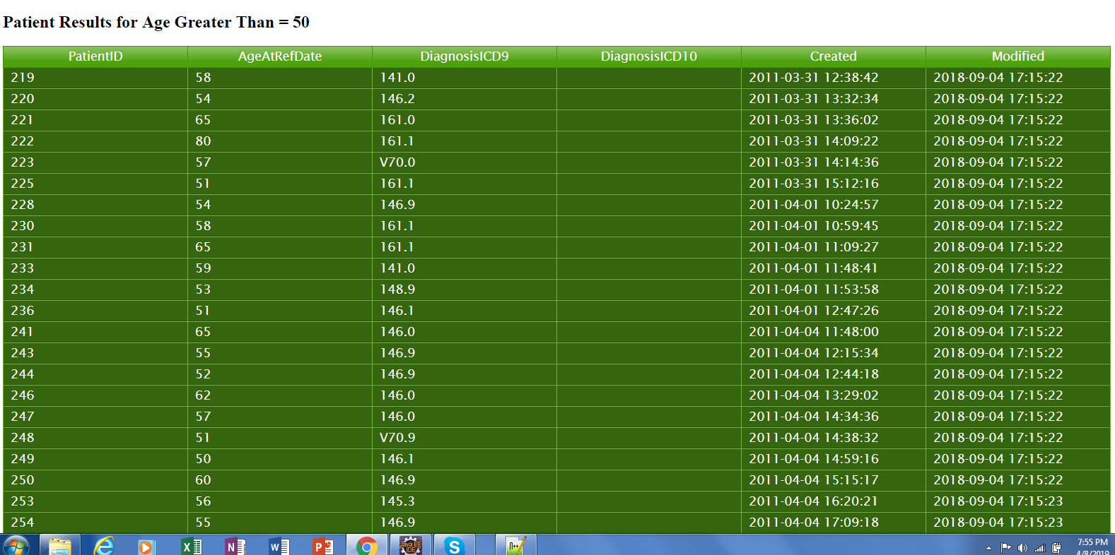
Searching for Patient Age > 50

Slide 15
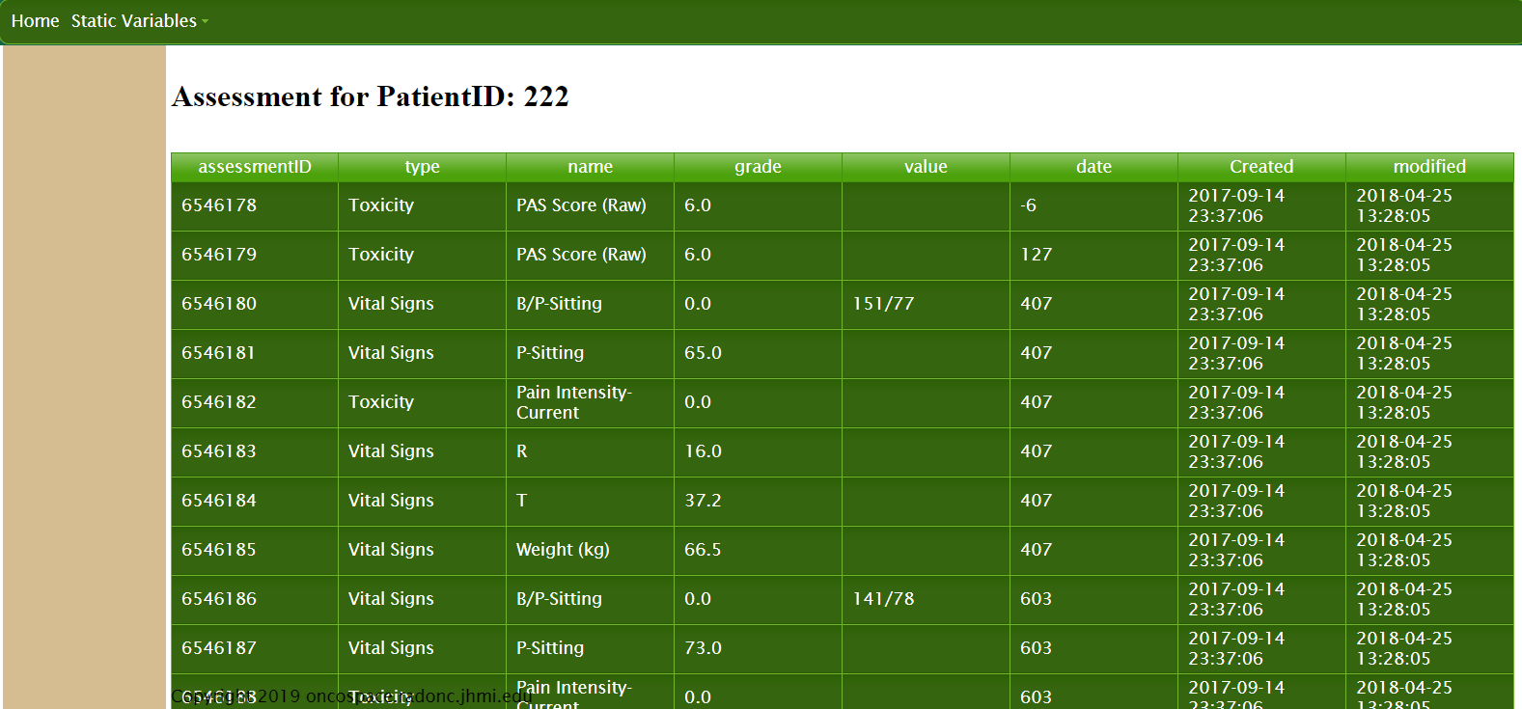
Further get more information

Slide 16
Choosing Diagnosis
Notes:
Malignant Neoplasm of the supraglottis

Slide 17
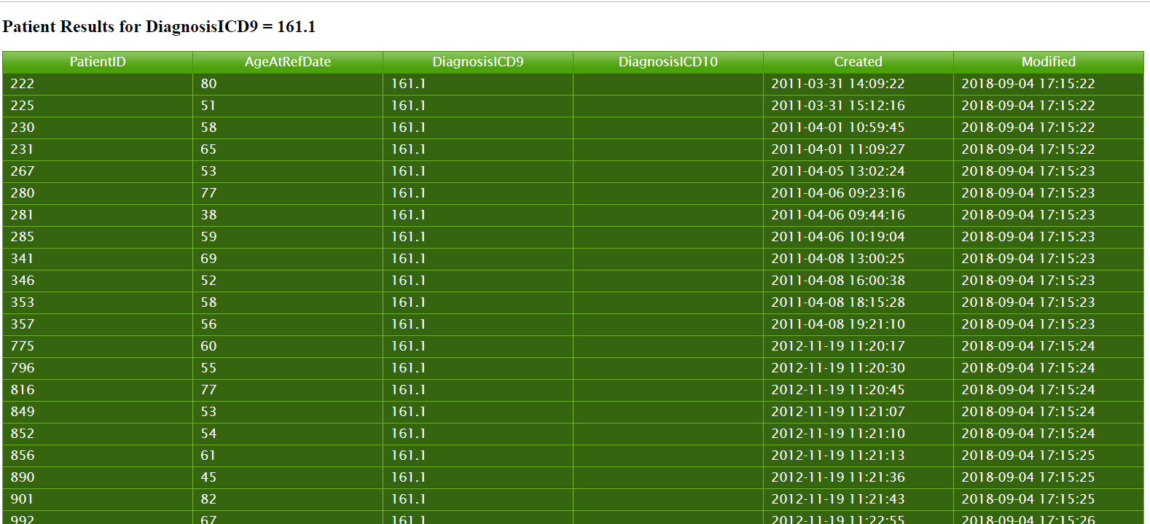
Results from Search

Slide 18
Frontend Summary:
Setback/Slow down
Solution To Setback
Difficulty in setting up the framework with so many parts
Connecting backend to intermediary code
Connecting intermediary code to frontend
Generating the frontend webpage
Optimizing build method
Spent Time
Debugging
Creating unit tests

Slide 19
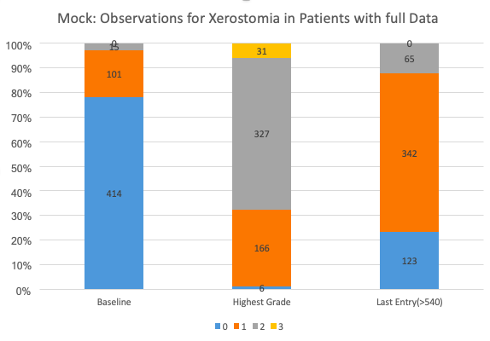
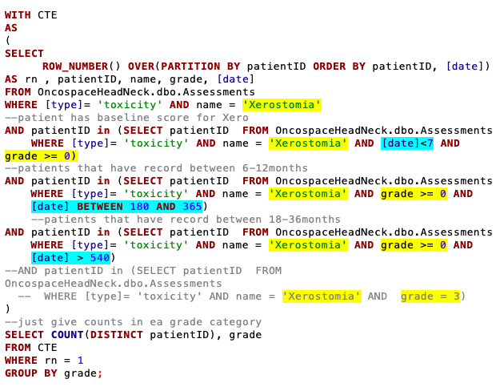
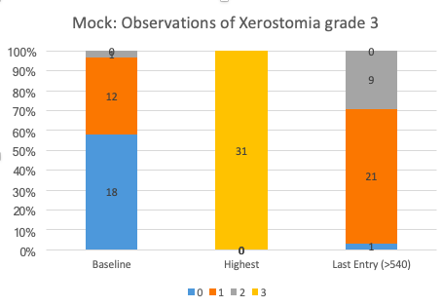
Notes:
Dom

Slide 20
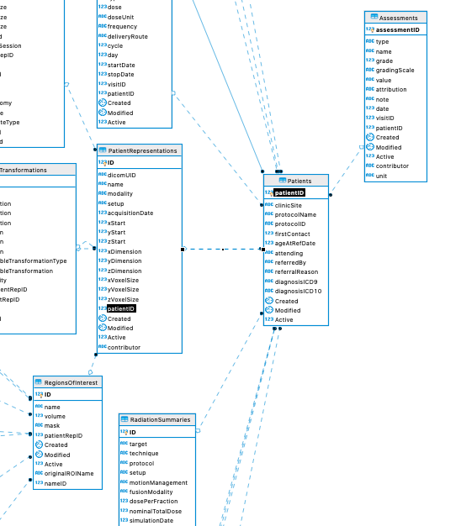
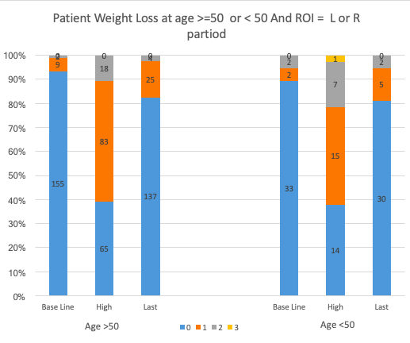
To get a Region of Interest, Age, and Toxicity selection requires 4 tables

Slide 21
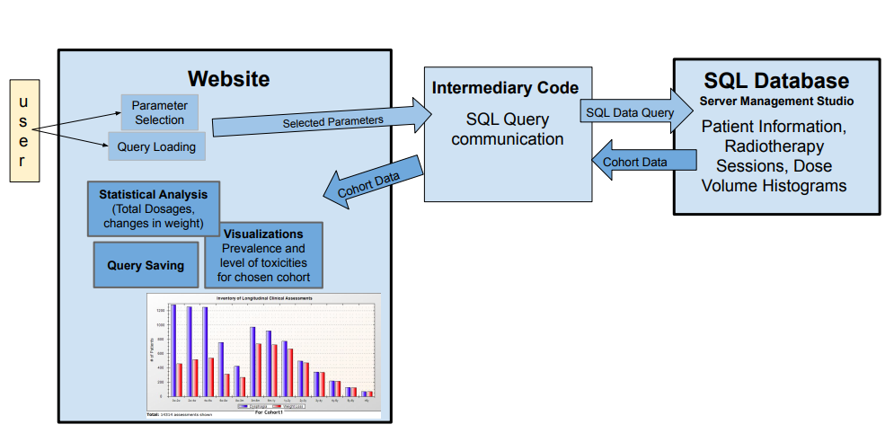
Block Diagram

Slide 22
Questions?

