Slide 1
Paper Review: A Comprehensive Study on Deep Image Classification with Small Datasets Chandrarathne, Gayani and Thanikasalam, Kokul and Pinidiyaarachchi, Amalk Advances in Electronics Engineering, pp. 93-106. Springer, Singapore, 2020
Reviewed by Nick Greene
Project 5 : Vision Guided Mosquito Dissection for the Production of Malaria Vaccine
Mentors: Balazs Vagvolgyi, Alan Lai, Parth Vora

Slide 2
Overview
Paper performs experiments to determine optimal CNN based methods for training on small datasets
Outline
Relevance to project
Background
Methods
Results
Critiques
Applications to project

Slide 3
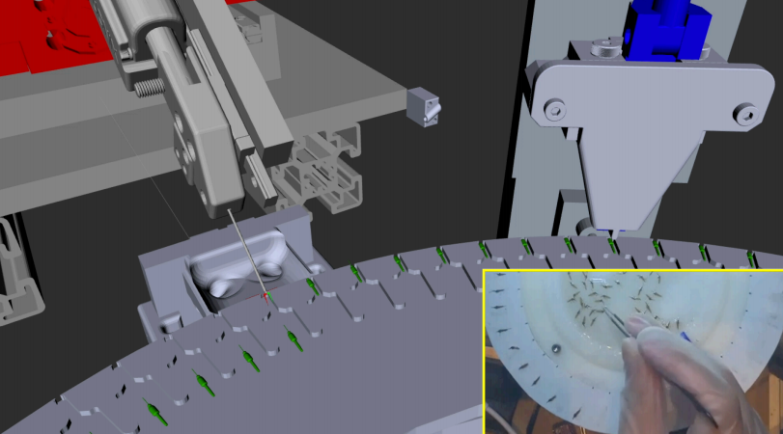
Relevance
Project 5: Vision Guided Mosquito Dissection for the Production of Malaria Vaccine
Project Goal: Implement image classification vision algorithms with both machine learning and conventional image processing:
Classification tasks
Check if turntable cleaning was successful after
each attempted cleaning
Check if gripper clearing was successful
Dataset size is ~300 images
CAD Model of Robot System
Image Source: JHU

Slide 4
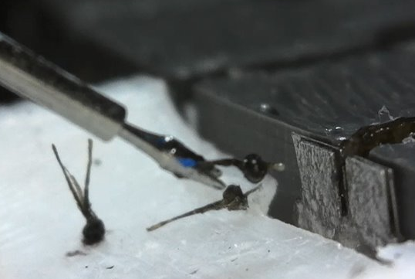
Relevance
Physical Setup:
Cleaning Station Top View
Gripper
Successfully Cleaned
Unsuccessfully Cleaned
Image Source: JHU
Image Source: JHU

Slide 5
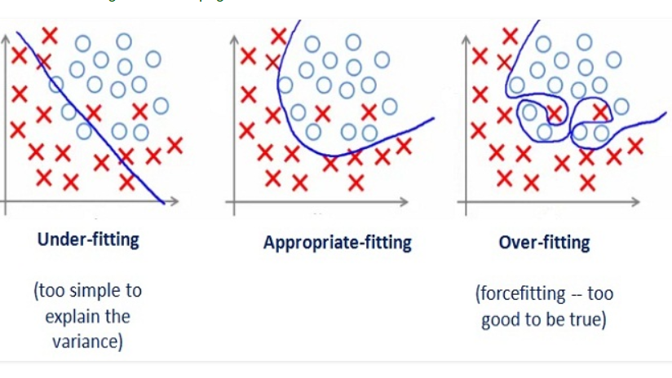
Background
Deep Convolutional Neural Networks are successful at image classification
Require lots of data
For a small dataset
Too complex of a model will over fit causing poor generalization
Reducing model complexity to prevent overfitting can cause prevent adequate learning of the task
Image source: https://medium.com/greyatom/what-is-underfitting-and-overfitting-in-machine-learning-and-how-to-deal-with-it-6803a989c76

Slide 6
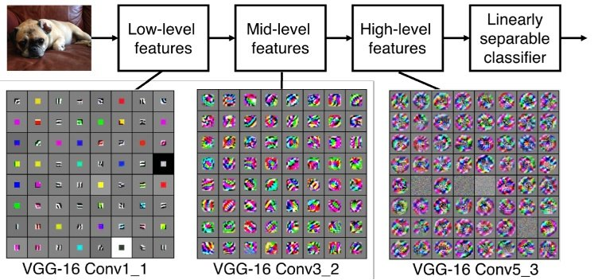
Background
Deeper networks are better at image classification
Reducing trainable parameters to prevent overfitting on a small dataset means a less deep network
Transfer learning preserves lower level features
Use these as static filters and only train a small number of parameters higher in the network
VGG-16 Learned Feature Visualization

Slide 7
Experiments
Find optimal number of convolutional layers for training on a small dataset from stratch
Find optimal number of convolutional layers to re-learn from scratch during transfer learning on a small dataset
Source: neurohive.io

Slide 8
Datasets
Caltech101 and CIFAR10 are the small datasets used for training
For Transfer learning, VGG-16 was pretrained on ImageNet before training on Caltech101 and CIFAR10

Slide 9
Methods – Training from Scratch
Three fully connected layers at the end of dimensions 512, 256, and num_classes
Fully connected layers use ReLU activation and dropout
Train VGG-16 from scratch with 0 to 9 convolutional layers
Max pooling layers are placed in between convolutional layers.
Highest performing CNN architecture for CIFAR10

Slide 10
Methods - Transfer Learning
Reinitialize and train on 0-12 of the last convolutional layers of VGG-16. Three fully connected layers at the end are always trained on.
Remaining convolutional layers are frozen (kept fixed) throughout the training.
Same three fully connected layers used after the convolution layers
For the best number of layers, perform the training again, except unfreeze the frozen weights (lower learning rate for these layers)

Slide 11
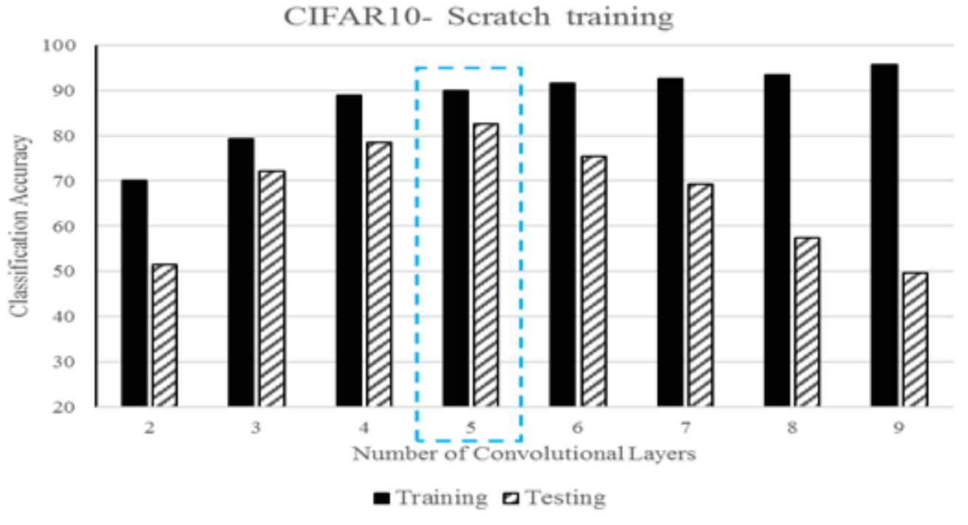
Results

Slide 12
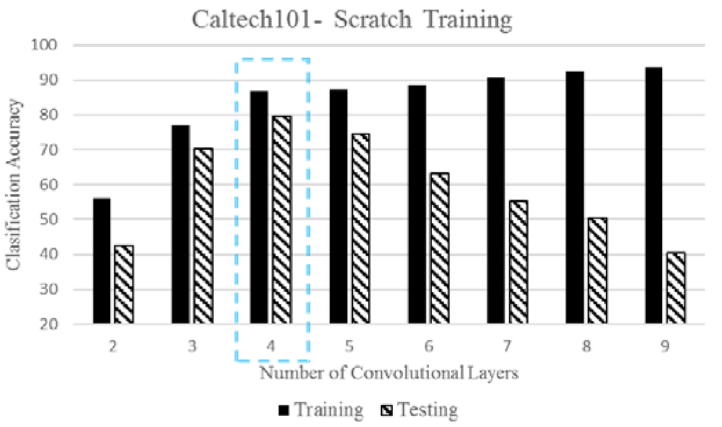
Results

Slide 13
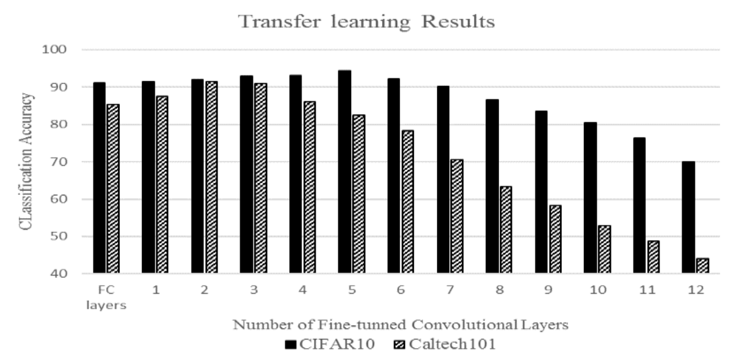
Results

Slide 14
Results

Slide 15
Critiques
Did not compare the number of parameters being learned in each to the dataset size
No use of data augmentation in experiments despite mentioning that it is a valuable asset for small datasets
Only used a single base architecture
No description of data preprocessing
Did not discuss future work

Slide 16
Suggested Future work
Use even smaller datasets
Experiment with different input resolutions
Downsizing an image can significantly reduce the number of parameters in a network while retaining the architecture.
Downsizing the input could allow for a deeper network without significantly changing the number of parameters.
Less fully connected layers
Fully connected layers use a large number of parameters.
Fully convolutional networks have no fully connected layers

Slide 17
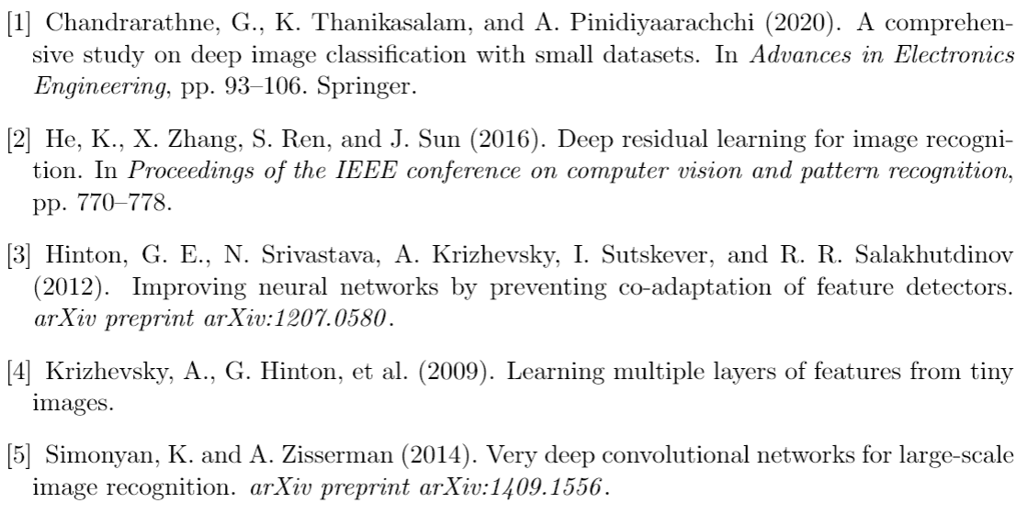
References

