Slide 1
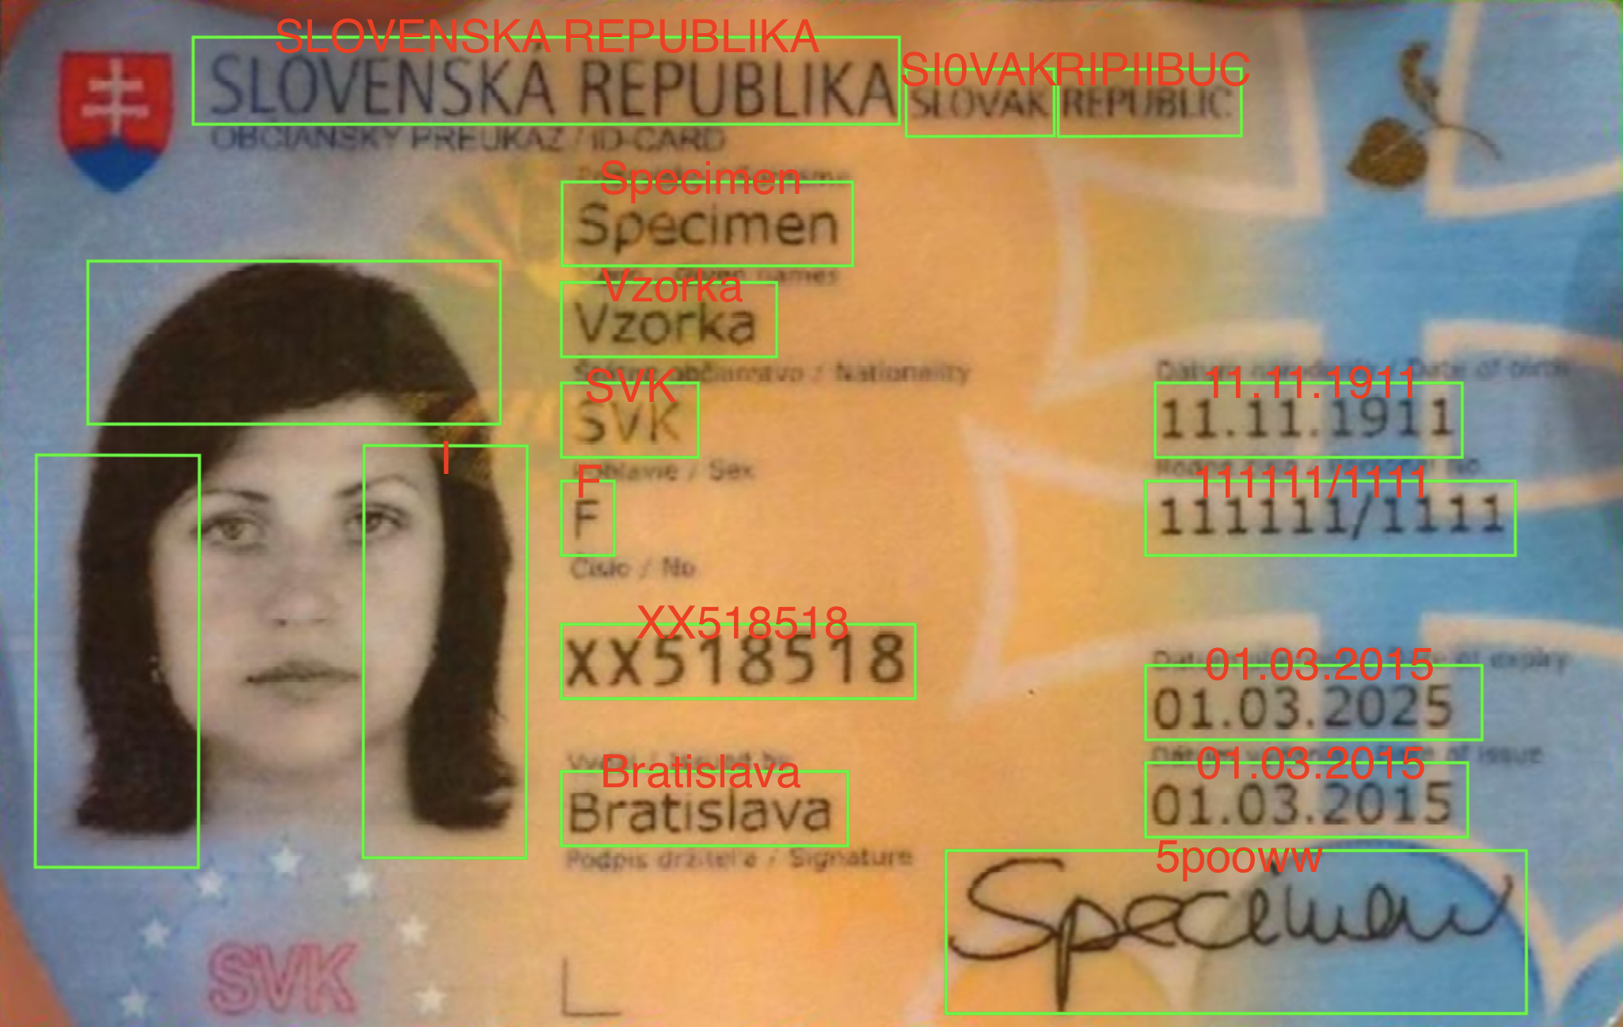
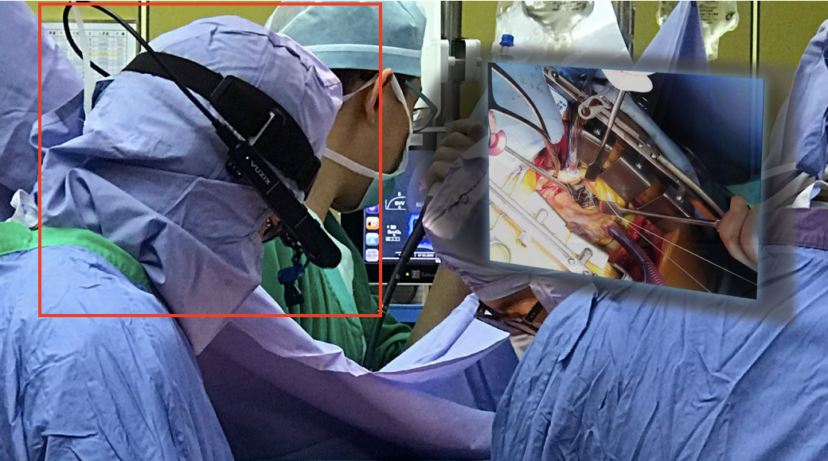
Group 11 (ROOM 4): Vital Monitor and ID Detection through Machine Vision for Improving EMS Communication Efficiency Robert Huang
Mentors: Dr. Nick Dalesio, Dr. Laeben Lester, Dr. Mathias Unberath
Goals and Significance:
Objective 1: Extract Information from IDs to streamline documentation to increase treatment time.
Objective 2: Extract Vitals from Monitors to provide confidence to remote physicians to increase treatment speed.
Results:
Integrated object detection, character recognition, and frame averaging algorithm to achieve >95% accuracies.
Emergent use of Smart Glasses
Vuzix Corporation. Vuzix Corporation, 2020, VUZIX SMART GLASSES AT THE CHI MEI MEDICAL CENTER, TAIWAN, ss-usa.s3.amazonaws.com/c/308483104/media/21105f5a523ce21ce43889049199725/Vuzix-Chi-Mei-Medical-Case-Study-2020.pdf.
Driver License Fields of Interest Detection
CIS 2, Spring 2020
Notes:
Hello this is group 11, and our project is "Vital Monitor and ID Detection through Machine Vision for improving EMS communication." Smart glasses have recently been introduced in emergency medicine. Seeing room for AI, we have taken this video feed and have programmed object detection and optical character recognition algorithms to streamline documentation and physician overseeing to ultimately increase treatment times and speed. Documentation streamlining has been done by extracting information from IDs, and physician overseeing has been streamlined through vitals extraction, and these algorithms have shown higher than 95% accuracies.

Slide 2
Extract Vitals from Monitors
CIS 2, Spring 2020

