Slide 1
Surgical Instrument for Robotic Open Microsurgery
NSF Engineering Research Center for Computer Integrated Surgical Systems and Technology
Team: Radhika Rajaram and Olivia Puleo
Mentors: Yunus Sevimli, Dr. Taylor, Dr. Razavi

Slide 2
Project Overview
Design a microforceps instrument that can be used with the Galen steady-hand robot
Instrument needs to be held above the robot tool attachment
Allows for rotation of tool

Slide 3
Technical Approach
Take apart existing forceps and cannibalize useful parts.
Design different gripper/actuators for the forceps.
Design tool-holder accessory for rotational DOF
Prototype feasible designs
Test with Galen and evaluate
Iterate over design and fabrication methods

Slide 4
Deliverables Update

Slide 5
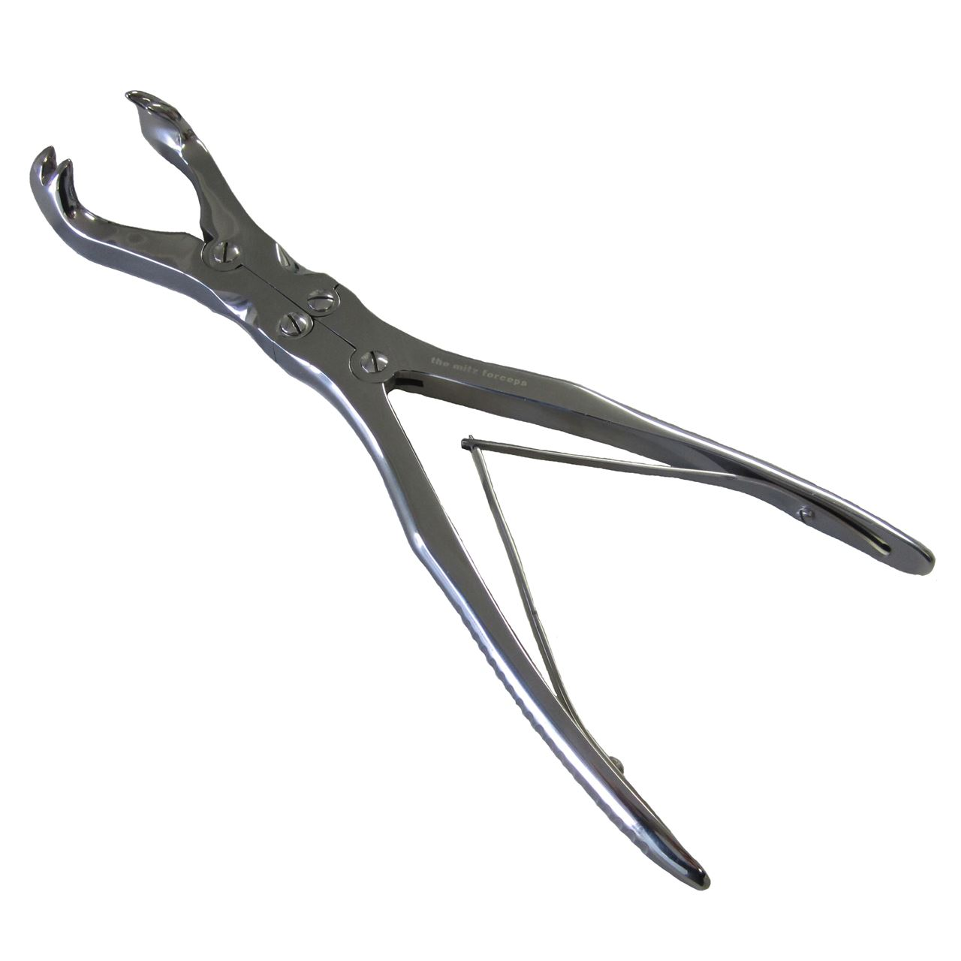
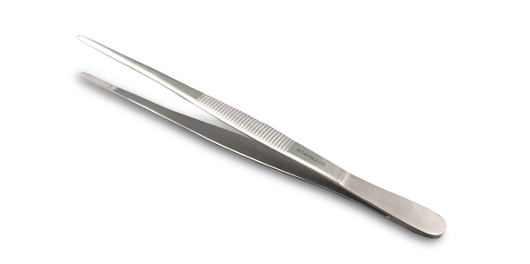
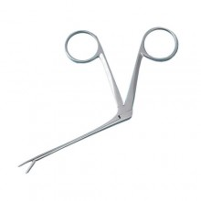
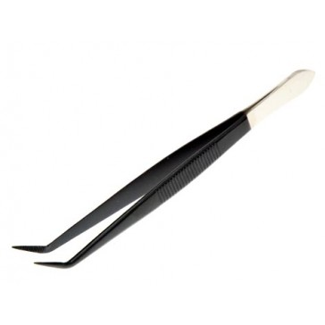
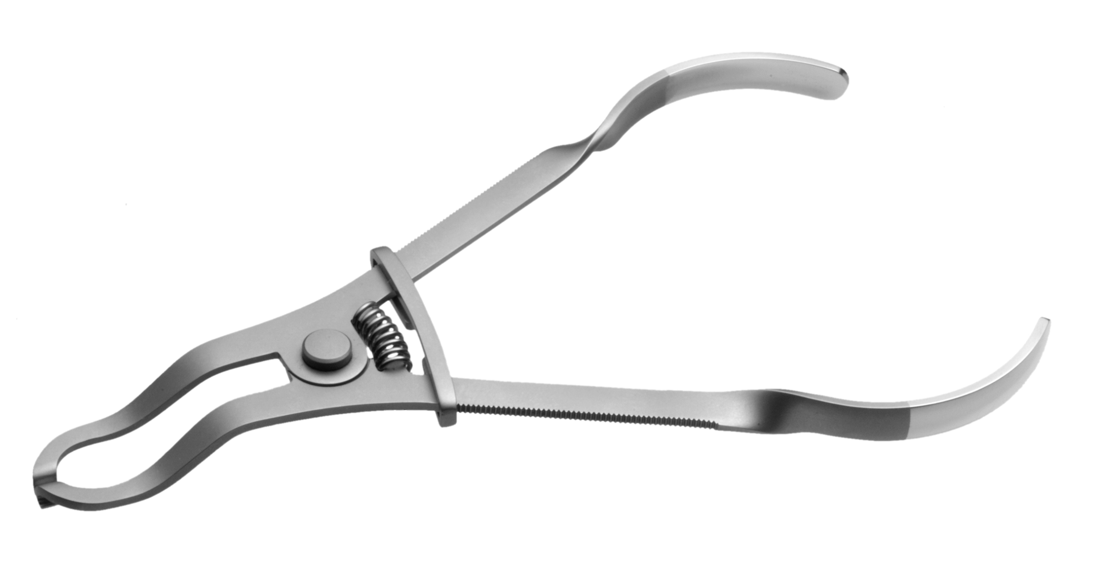
Existing Forceps designs
There are many varieties of forceps with different mechanisms of actuation, grips and jaws adapted to every surgical application such as grasping, holding, clamping, cutting, dissecting, dilating, suctioning etc.

Slide 6
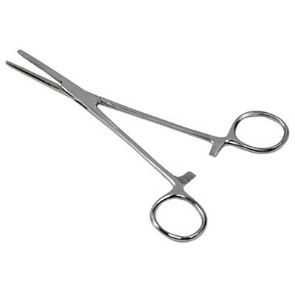
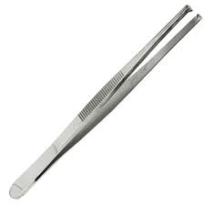
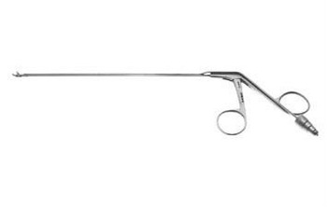
Classification of forceps
Based on mechanism of actuation we have three main categories:
1) Scissoring type
easy construction
2) Tweezer type
single body
3) Sliding rod type
slim profile

Slide 7
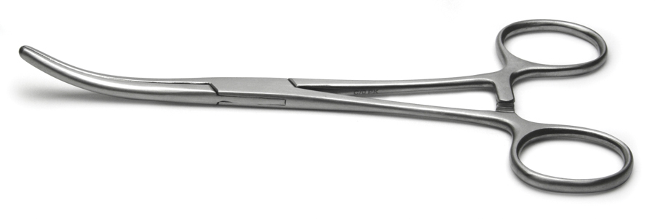
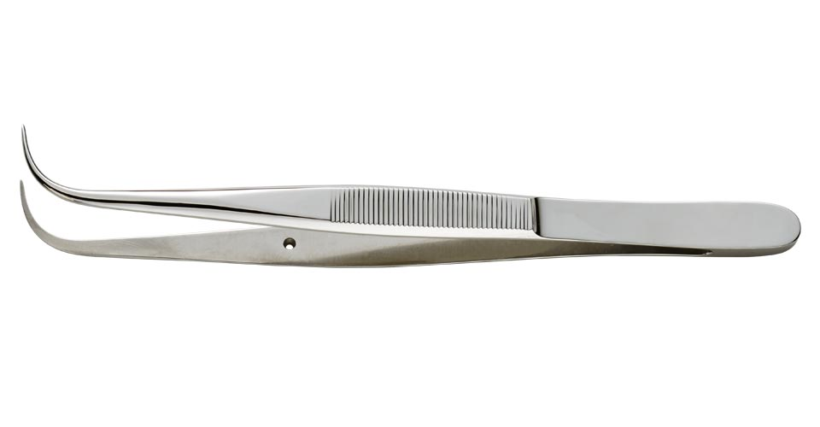
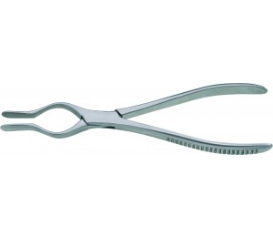
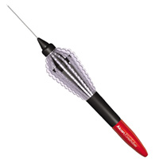
Classification of forceps
Based on grip design we have four categories:
1) Loop grip
Hard to drop, but difficult to rotate
2) Tweezer grip
Elastic return, but droppable
3) Pliers grip
Can apply a lot of force, but clunky
4) Misc.
Notes:
mix and match fun time

Slide 8
Design Selection
Sliding rod actuation + Tweezer grip
Sliding rod actuation advantages:
Cylindrical nature- inherent rotatability
Long and thin nature- easy access of surgical site
Easily cannibalized
Tweezer grip advantages:
Can be made cylindrical to allows the tool to be rolled
Elastic nature allows for normally-open / normally-closed designs without addition of a spring

Slide 9
First Round Grip Design

Slide 10
Round Grip Demonstration
sd

Slide 11
Second Round Grip Design
Notes:
Talk about why we stopped using this design

Slide 12
First Tweezer Grip Design

Slide 13
Second Tweezer Grip Design

Slide 14
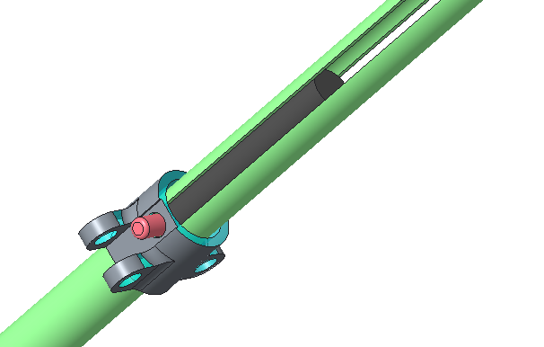
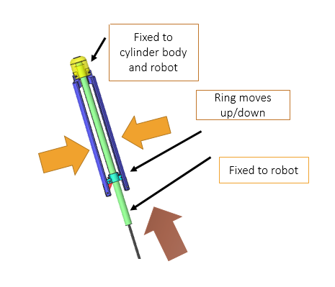
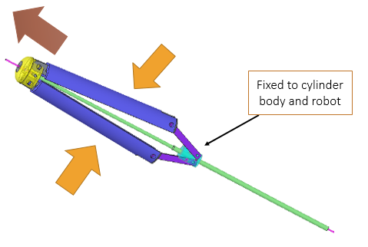
Proposed changes
Latest design
Proposed design

Slide 15
Recommendations from Patkin, M. (1977)
Length from grip to top of handle should be ~10cm
Handle diameter should be 5 – 10mm
The force required for opening or closing the instrument should be 40 – 100 g.
A 6:1 mechanical advantage or greater is ideal. 3:1 minimum

Slide 16
Dependency Status

Slide 17
Original Timeline

Slide 18
Updated Timeline
Future work:
Rapid prototype latest design
Obtain suitable pins and springs
Change dimensions and tolerances for stainless steel
Fabricate metal prototype

Slide 19
Questions?

Slide 20
References
1 . Patkin, M. (1977), Ergonomics Applied to the Practice of Microsurgery. Australian and New Zealand Journal of Surgery, 47: 320–329.
2. [Web log post]. (n.d.). Retrieved from http://www.u.arizona.edu/~pen/ame352/Notes%20PDF/3%20Analytical%20kinematics.pdf

