Slide 1
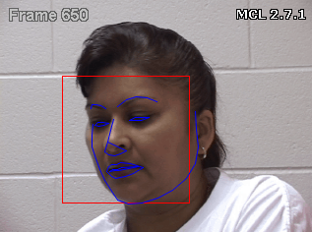
Pain Recognition Using Video-Based Facial Features
Pain assessment is normally based on self-reporting due to the subjective nature of feeling or experiencing pain. However, subjective measures are difficult to quantify and scale up. In this project, we will develop regression and classification algorithms to demonstrate the feasibility to derive pain intensity using features extracted from face videos.
What Students Will Do:
Process Shoulder-Pain dataset
Tune ordinal support vector regression (OSVR, CVPR’16)
Replicate experiments
Improve OSVR with a hypothesis
Test the hypothesis
Accept or reject the hypothesis
Size group: 1-2
Skills: MATLAB, Python (optional), machine learning (optional)
Mentors:
Harry Quon hquon2@jhmi.edu
Austin Reiter areiter@cs.jhu.edu
Xiang Xiang xxiang@cs.jhu.edu

Slide 2
Pain Recognition Using Video-Based Facial Features
Deliverables: short description or bullets
Process Shoulder-Pain dataset
Provided: raw data (possibly with a few starter scripts)
Expected: processed data in required formats
Tune ordinal support vector regression (OSVR, CVPR’16)
Provided: algorithm sketch and demo program
Expected: executable with source and readme
Replicate experiments
Provided: (fully, weakly-, un-)supervised setting
Expected: evaluation and analysis (see next page)
Improve OSVR with a hypothesis
Provided: possibly a basic idea
Expected: a concrete short proposal in written form
Test the hypothesis
Expected: evaluation and analysis in written form
Accept or reject the hypothesis.
Expected: a presentation with reasoning

Slide 3
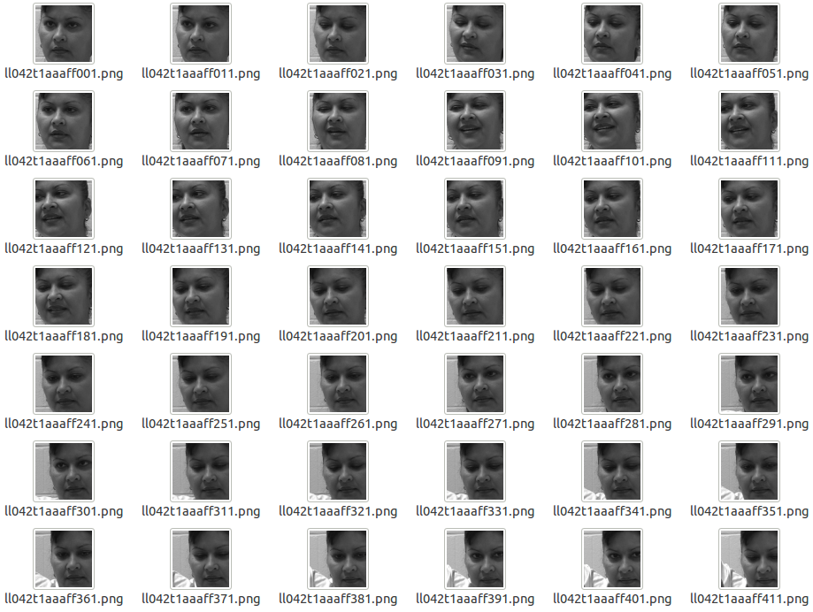
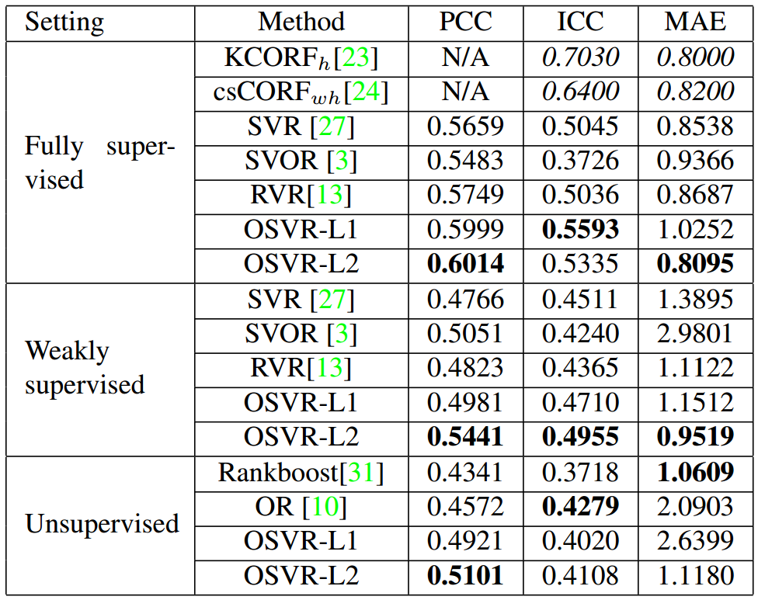
Pain Recognition Using Video-Based Facial Features

