Slide 1
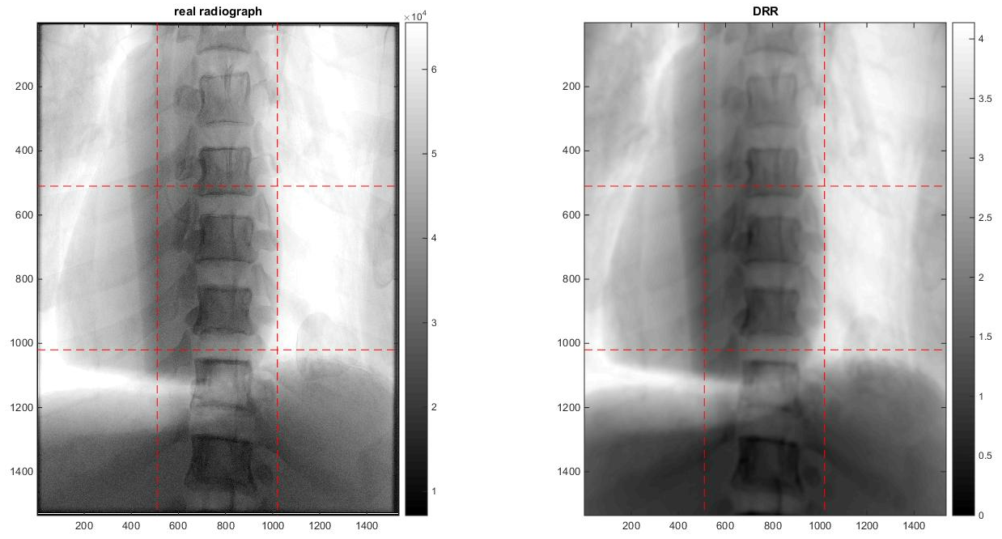
Fluoroscopy Simulation of a Mobile C-arm Computer Integrated Surgery II, Spring, 2016 Ju Young Ahn, and Seung Wook Lee, (mentorship by Matthew Jacobson, Joseph Goerres, Tharindu De Silva, Ali Uneri, and Professor Jeff Siewerdsen)
Goals:
Develop a user interface to provide real-time simulation of C-arm’s fluoroscopic images
Significance:
Motivation of the project is to allow surgeon to more efficiently find optimal view with less time consumption and radiation exposure
Results:
Achieved a system that provides a simulated fluoroscopy similar to the actual view in purely orbital and angular directions.

Slide 2
Demo Video

