Slide 1
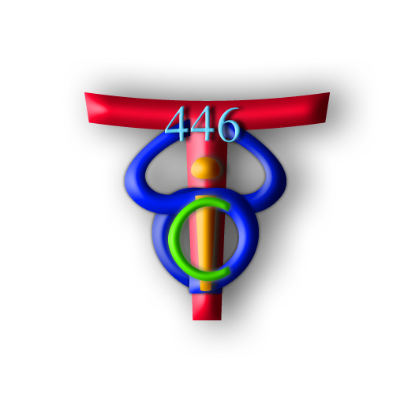
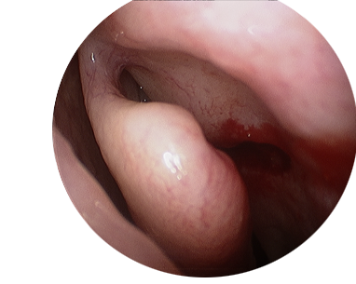
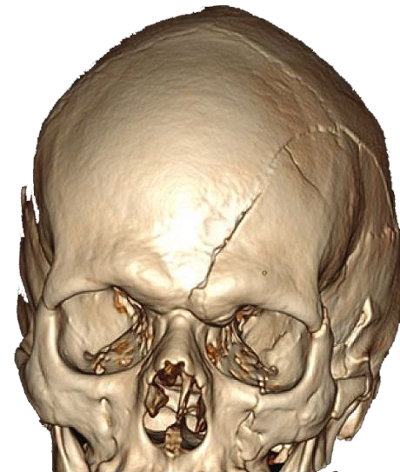
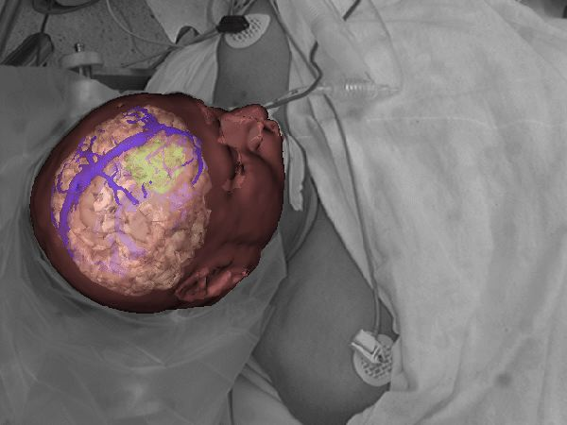
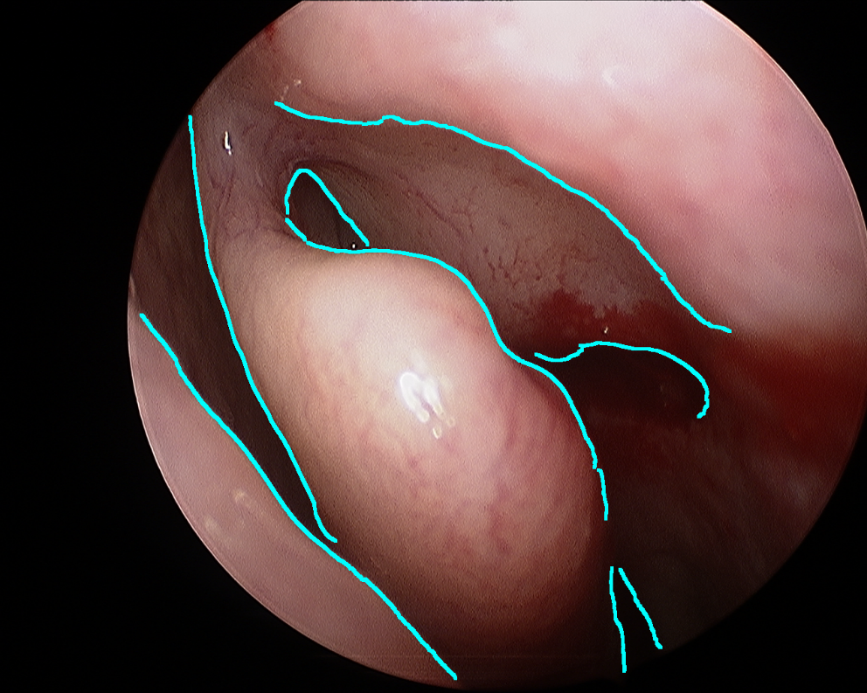
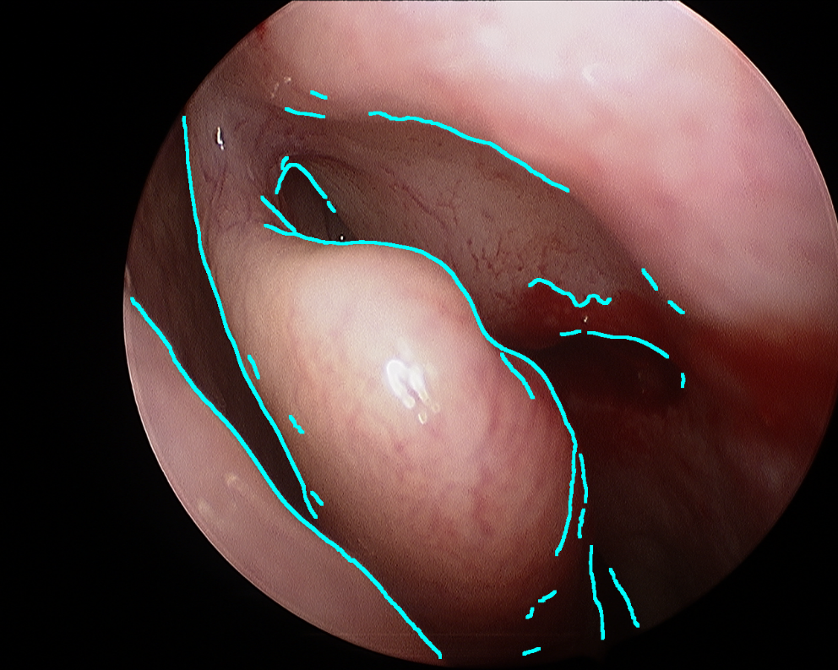
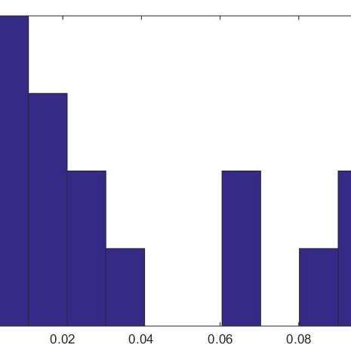
Image Processing for Video: CT Registration in Sinus Surgery Computer Integrated Surgery II Spring, 2015 John Lee, Kyle Xiong, and Calvin Zhao Mentors: Austin Reiter, Balazs Vagvolgyi, Seth Billings
Introduction
We designed and implemented an algorithm to extract occluding contours in sinus surgery endoscopic videos. Our project supports an existing registration algorithm that registers video data contours to CT image contours. With our work we aim to enhance surgical instrument electromagnetic tracking utilizing occluding contours and CT data.
Identify Contours
Integrate with CT registration
Enhanced Tracking
Occluding contour prediction flow diagram.
Outcomes and Results
We compared detected edges to hand-labeled truths and defined error as each edge pixel’s distance from its corresponding ground truth.
The Problem
Occluding edge extraction has been a complex computer vision challenge.
Existing edge detection algorithms do not distinguish between contour and texture edges.
Light artifacts can cause false edges
 | Frame 21 | Frame 32 | Frame 48 | Frame 69
Average error per pixel | 8.399 | 11.652 | 12.332 | 14.424
Median error per pixel | 0 | 0 | 0 | 0
Top Left: Hand-labeled ground truth. Top Right: Edge detection result. The majority of detected points correspond to true edges. Bottom: Table of average error per edge pixel for four frames.
We require that the overwhelming majority of detected points are edge points.
Per frame edge detection ran in MATLAB in under 1 min on a 2.5Ghz Intel Core i7-4170HQ
Existing edge detection methods. Hand labeled contour edges are in teal and texture edges are in purple
The Solution
We used machine learning to classify detected edges
The Support Vector Machine (SVM) was trained using 10 hand labeled ground truth images
Future Work
Remove edge artifacts
Port MATLAB code to C to achieve near real-time performance
Fully test integration with CT registration algorithm
Create an augmented reality interface that informs surgeons of important landmarks, like nerves and other sensitive tissue
Lessons Learned
Difficult finding the right parameters for initial edge detection
Optical flow, which was an original metric we wanted to use, proved to be infeasible.
SVM training flow diagram.
We used 3 features for training:
Credits
John created the framework for SVM training and developed the scaled gradient feature.
Kyle developed the intensity histogram metric, and increased efficiency of feature extraction programs.
Calvin developed and optimized the local edge strength chi squared distance metric
Gradients of a scaled down image
Local histograms of image values
Local edge strength from histogram chi squared distance
Support by and Acknowledgements
NSF CISST/ERC
Thank you to Prof. Russell Taylor, Dr. Austin Reiter, Balazs Vagvolgyi, Seth Billings
We then applied morphological filters to clarify edge lines
We calculated the normal vectors for each edge pixels to be used in the registration algorithm
Engineering Research Center for Computer Integrated Surgical Systems and Technology

