Slide 1
Checkpoint Presentation: Computer-Guided X-Ray C-arm Positioning
03/24/16
Group 5: Ju Young Ahn, Seung Wook Lee
Mentor: Dr. Jeff Siewerdsen
Dr. Matthew Jacobson, Dr. Tharindu da Silva, Dr. Joseph Goerres

Slide 2
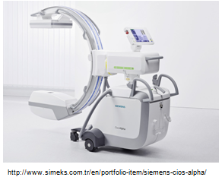
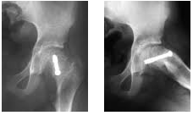
Project Background: Motivation
C-arm: An X-ray imaging device with flexible positioning of X-ray source.
Widely used for diagnostic imaging or surgical procedures in many areas including orthopedic surgeries.
Multiple degrees of freedom (DOF) of the arm with angular and orbital movements allow guidance and localization for surgeons to set an optimal viewpoint
Challenge: “Fluoro-hunting”
Surgeons should take multiple to set an optimal fluoroscopic view.
Time-consuming, more radiation exposure to both patients and physicians, physically cumbersome, safety issues.
Notes:
Ju Young Ahn
This is a brief overview of our project.
C-arm is an X-ray imaging device with flexible positioning of X-ray source
it is commonly used in orthopedic surgeries for guidance and It has multiple degree of freedom (DOF) with angular and orbial movements that allow surgeons to set an optimal viewpoints
An example of an optimal viewpoint is illustrated on the bottom right.
These are x-ray scans of the screw embedded inside the pelvis. However, the fluoroscopic image on the right shows the depth of the screw better than the left one.
So, in order to find this optimal viewpoint surgeons who utilize C-Arm during their surgical procedure encounter a challenge called a “fluoro-hunting”
Fluoro hunting is a process that surgeons take an average of 5 to 10 shots to find an optimal fluoroscopic view that they like.
This process has several problems in that in order to take multimple x-ray scans, substantial amount of time is needed.
more radiation is exposed to both patients and physicians.
it is physically cumbersome for physicians to move the C-arm manually
which might cause safety issues with patients.

Slide 3
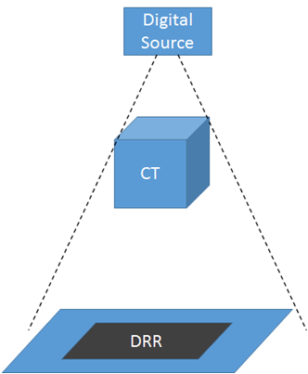
Project Background: Solution
Goals: Develop user-friendly interfaces to find an optimal C-arm position with a digitally reconstructed radiograph (DRR) generated from preoperative 3D CT data.
Advantages:
- Less time consuming
- Less radiation exposure for both physicians and patients - Less user variability, more consistency
2 Approaches: Computer interface / Physical interface
Notes:
So, as a solution we propose that the goal of this project is to develop surgeon friendly user interfaces that find an optimal C-arm position with a digitally reconstructed radiograph generated from preoperative CT, which simulates X-ray image without radiation.
DRR, digitally reconstructed radiograph, simulates 2D X-ray scan of the patient from 3D CT- data.
The figure on the right shows our general idea of the project. We will have a digital source on simulation which is representative of the C-arm source position.
Then, we will simulate X-ray beams from that source onto the CT data and its projection, which is DRR, will be generated
Using this method, there are many advantages. It will be less time consuming, since DRR can be generated in real time, less radiation exposure for both physicians and patients because we are only using 3D preoperative CT, and there would be less user variability, any operator will be able to find an optimal source position and will be able to obtain same optimal fluoroscopic image
We propose two approaches. One is a computer interface and the other is physical interface

Slide 4
Project Background: 2 Approaches (CI/PI)
Computer Interface (CI)
Advantages of CI
Less physically cumbersome
Motorized movement of C-Arm to the desired position
Physical Interface (PI)
Advantages of PI
Seamless integration to surgury workflow
C-arm Source and
Center of Rotation Positions
Take Fluoro Image
C-arm Source and
Center of Rotation Positions
Take Fluoro Image
C-arm Calibration/Registration
(C-arm 3D → Optical 3D)
C-arm Calibration/Registration
(C-arm 3D → Optical 3D)
Pt. Fiducial
Drive
C-arm using SITA
Pt. Fiducial
Pt-CT Registration
(Optical 3D → CT 3D)
3D CT Data
Pt-CT Registration
(Optical 3D → CT 3D)
3D CT Data
Fluoro-Sim Module
Evaluation
Generate DRR
Fluoro-Sim Module
Evaluation
Generate DRR
Move C-arm source
position in simulation
Manually Drive C-arm without radiation exposure
Notes:
This is a flow diagram to show the process of computer interface and physical interface
For both interfaces, the registartion process is similar. We performed C-arm calibration/ registration with an optical tracker. Then, using the same optical tracker, we also registered Patient to CT data So that everything is now in the same 3D CT coordinate.
Then, using a fluoro-sim module, DRR will be generated based on a C-arm source position. And then we will evaluate the generated DRR image and this is where computer interface and physical interface become different.
For computer interface, we simply modify the angular and orbital C-arm source position sliders on simulation and an updated DRR will be shown. This process will be repeated until an optimal viewpoint is set. Then, the computer interface will drive the C-arm to that set preferred view position using SITA interface, a built-in interface of the C-arm and take a fluoroscopic image.
For physical interface, after evaluation, the operator will manually drive the C-arm just as if the operator is doing fluoro hunting just without X-ray scans.
Once an optimal viewpoint is set, since the C-arm is already in that position, we can simply take a fluoroscopic image
Advantages of computer interface is that the C-arm is motorized to move to the optimal position and thus less physically cumbersome
Advantage of physical interface is that the seamless integration to surgery workflow

Slide 5
Original Deliverables
MIN
Registration of C-arm, patient, and patient CT data with an optical tracker/markers
Verification: measure Target Registration Error (TRE)
Modify existing DRR generation module to define source position i/t/o orbital/angular position
EXP
Physical Interface: acquire pyhsical C-arm position and display DRR
Computer Interface: define virtual C-arm position and display DRR
Validation measure Projection Distance Error (PDE) between generated DRR and actual fluoroscopic image
MAX
Physical/Computer Interfaces: Encoder-based C-arm positioning, Pt-CT reg. w/ 3D-2D image registration
Computer Interface: Drive the C-arm to preferred position with SITA interface
Verification: Measure accuracy of C-Arm positioning, TRE.
Notes:
These are our original deliverables. There have been some changes in our deliverables but we have mainly worked on our minimal deliverables which are registration of C-arm, patient and patient CT data with verification. And also modification of DRR generation module to incorporate orbital and angular positioning of the source position. We will discuss our current progress and afterwards we will wrap up our updated deliverables and progress.

Slide 6
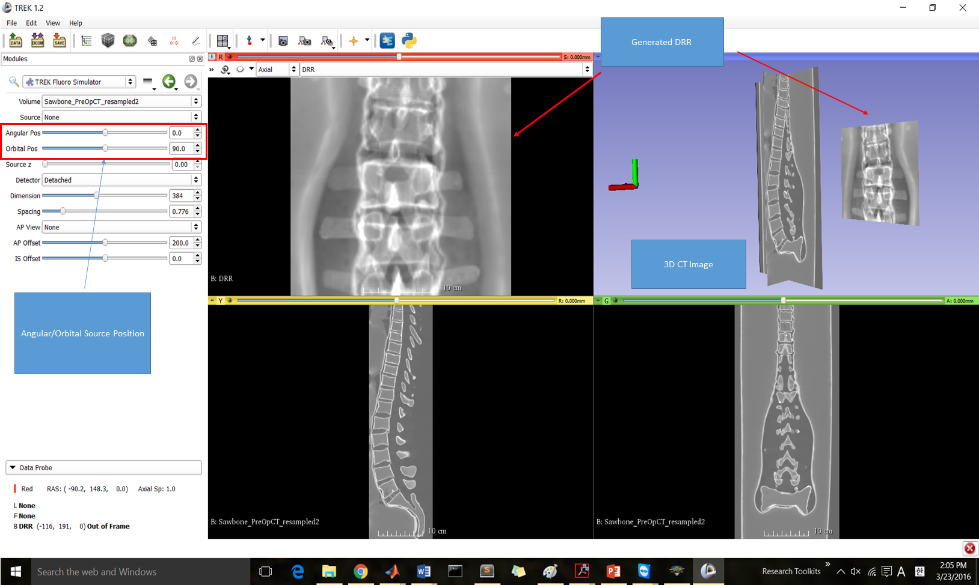
DRR genereration based on C-arm source position
Notes:
Explannation on projection matrix and how they are generated?
Using basic pinhole model of camera, projection matrix to reconstruct DRR is defined. The matrix depends depends on positions of object, which is CT data in our case, and relative position of the source relative to the detector. For the purpose of development, object is at origin. We defined source and detector transformations so that it could simulate movement of C-arm in both position (using euler matrices) and based on the transformations we defined projection matrix.
This is the DRR generation module that we modified to define source positions in angular/orbital positions. Source position in at that coordinate-like figure, 3D CT data, and DRR on the detector plane.
Currently, 3D CT data are located at origin (0,0) and C-arm rotates basically using the origin as a center of rotation. Combined with registration process, relative positions of sources, SDD and position of CT, we should be able to accurately depict ~
Combined with registration process which allows us to define ce
Include video?
Contrast issues / Display C-arm in 3D coordinate issue ← Cosmetic, but important for user friendliness.

Slide 7
Notes:
Here is a video of the demo. We can define orbital/angular position of the source and DRR is generated based on the projection matrix defined by the source position.
One thing that DR Siewerdsen considered was to put a figure representing C-arm in the 3D space so physician could have better idea of the orientation. We also talked about adjusting contrast of the DRR also for convenience. These are though not our top priorities; we are focusing on making everything work together. Would maybe tackle these if we have time.

Slide 8
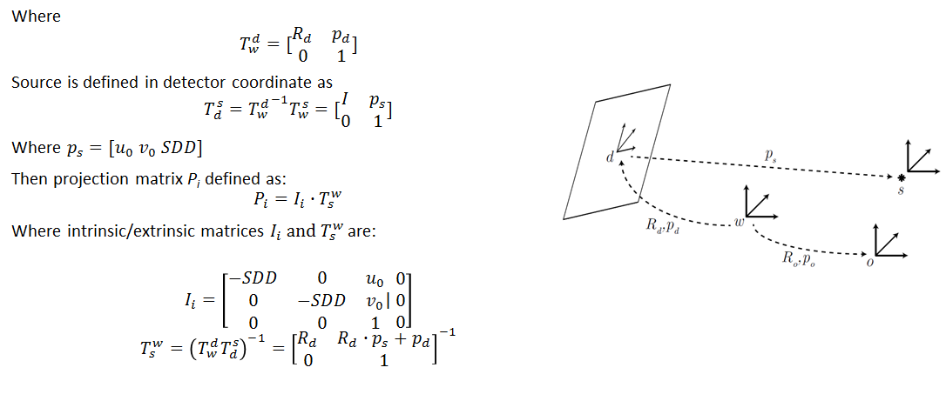
DRR genereration based on C-arm source position
A. Uneri, Y. Otake, A. Wang, J. Siewerdsen. “Projection Geometry.” The I-STAR Lab. Johns Hopkins University. April 2014
Notes:
Projection matrix P that computes 2D projection of the object from camera is defined as following.
…
Using basic pinhole model of camera
This suggest that we can compute projection matrix when detector transformation and source position in detector coordinate is known. C-arm is a system with fixed source-to-detector distance and source should be located at 180 rotation from the detector. We defined Td and Ts that follows this phiscial characteristics in a way that they are dependent on orbital and angular position, and with the definition of the transformation we could successfully generate corresponding projection matrix and DRR.
Implemented physical char. of C-arm

Slide 9
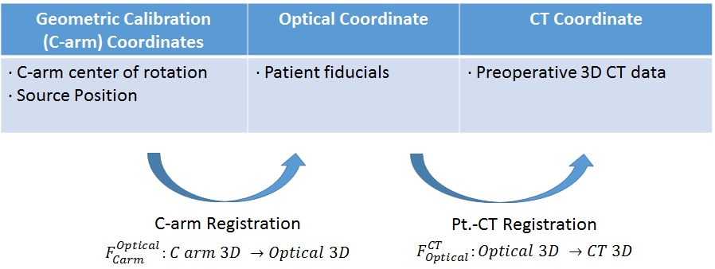
Registration
Notes:
This is an overall idea of C_arm, phantom and CT data registration. We have 3 coordinate systems of C-arm, optical tracker, and 3D CT data.
In our C-arm coordinates, we have defined C-arm center of rotation and source postion.
Through C-arm registration, which we will dicuss in detail, c-arm cordinate will be transformed into an optical tracker coordiante.
In our optical coordinate system, we have patient fiducials and in our CT coordinate we have preoperative 3D CT data.
Using fiducial Patient to CT registration we will define transformation from an optical tracker coordinate system to 3D CT coordinate system

Slide 10
Registration
Notes:
This is an overall idea of C_arm, phantom and CT data registration. We have 3 coordinate systems of C-arm, optical tracker, and 3D CT data.
In our C-arm coordinates, we have defined C-arm center of rotation and source postion.
Through C-arm registration, which we will dicuss in detail, c-arm cordinate will be transformed into an optical tracker coordiante.
In our optical coordinate system, we have patient fiducials and in our CT coordinate we have preoperative 3D CT data.
Using fiducial Patient to CT registration we will define transformation from an optical tracker coordinate system to 3D CT coordinate system

Slide 11
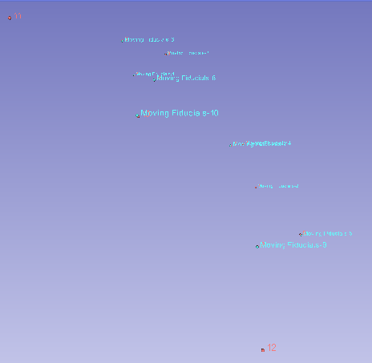
Patient-CT Registration
Tracked phantom’s 10 fiducial points, already known in 3D CT data, using an optical tracker.
Utilized TREK’s built-in fiducial registration, existing software from Dr. Siewerdsen’s Lab
Horn’s method with Quarternion Technique to peform fiducial registration
Obtained Phantom to CT transformation matrix defined by fiducial registration using an optical tracker.
Notes:
So we used TREK’s built-in fiducial registration to register Phantom with CT data.
Provide diagram and explain technical approaches. X necessarily need pics. Horn’s method or what method are we using?
Mention: Methods we used
-------------------------------------------------------
For CT_Phantom registration, we tracked 10 fiducial poins on the phantom which are already known in the CT data using an optical tracker.
Then we utilized TREK’s built in fiducial registration process, which is given from Dr. Siewerdsen’s lab
This fiducial registration incorporated horn’s emthod wth quarternion technique which we used in CIS 1
As a result we were able to obtain phantom to CT transformation matrix.

Slide 12
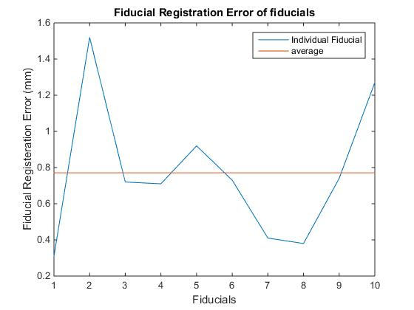
Patient-CT Registration: Verification
The registration process validated using Fiducal Registration Error (FRE)
Transformation obated from fiducial registration process registers CT and Phantom fiducials with mean FRE = 0.77 mm.
Other validation methods such as Target Registration Error (TRE) should also be explored
Notes:
Then, we verified our CT-phantom registration process through fiducial registration error (FRE)
We obtained a mean FRE of 0.77mm and since this is less than 1 mm, we considered our CT_phantom registration process to be validated
We will also perform other validation method such as target registartion error by next Monday

Slide 13
Registration
Notes:
This is an overall idea of C_arm, phantom and CT data registration. We have 3 coordinate systems of C-arm, optical tracker, and 3D CT data.
In our C-arm coordinates, we have defined C-arm center of rotation and source postion.
Through C-arm registration, which we will dicuss in detail, c-arm cordinate will be transformed into an optical tracker coordiante.
In our optical coordinate system, we have patient fiducials and in our CT coordinate we have preoperative 3D CT data.
Using fiducial Patient to CT registration we will define transformation from an optical tracker coordinate system to 3D CT coordinate system

Slide 14
C-arm Registration
Original Plan: use optical marker attached on the C-arm
Issues:
- Limited field of view of optical tracker - Accurate location of X-ray source
Encoder: provides orbital/angular position, no FOV issues. Could locate sources by calibration
Change of plan:
Use encoder-based approach (originally a maximum deliverable)
Take multiple shots of multi-modal markers in different angles, acquire 3D position of the markers in optical/C-arm coordinate
Calibration step required in prior to registration
Notes:
Our original plan to do this was to optically track C-arm position with marker attached on C-arm gantry
But we faced a few limitation; namely
Limited field of view of optical tracker. We are given Polaris Vicra, which had small field of view. We X track full movement of C-arm with the its field of view. We could use polaris spectra with wider FOV but field of view would be still an issue.
Needed accurate location of X-ray source, but it was difficult to measure the source position accurately in optical coordinates.
In contrast, if we use encoder which provides us orbital/angular positions of the C-arm, there is no field of view issue and are able to locate source positions by calibration.
So we changed our approach for this registration to use the encoder, which was originally supposed to be one of our maximums.
Details of this process will be explained in next slide. This method requires us to use multi-modal markers - meaning they could be tracked both optically and radiographically. And calibration step before registration.

Slide 15
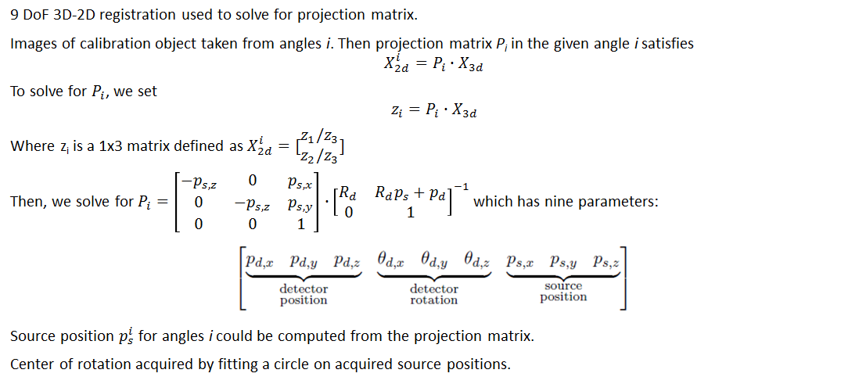
C-arm Registration: Calibration
A. Uneri, Y. Otake, A. Wang, J. Siewerdsen. “Projection Geometry.” The I-STAR Lab. Johns Hopkins University. April 2014
Notes:
This is a really brief expl. of calibration. There was already existing algorithm for this in the i-star lab.
To breifly go over, the calibration process takes 2D projection images of a calibration object from multiple angles. Markers on the calibration object have their own 3D position in object coordinate.
Then as we know X2d and X3d we solve for the projection matrix which has nine degrees of freedom; source/detector positions and rotation angles.
Hence, when P is known, we could extract source postions respect to angles. With measured source positions in different angles, we fit a circle and define its center to define center of rotation.

Slide 16
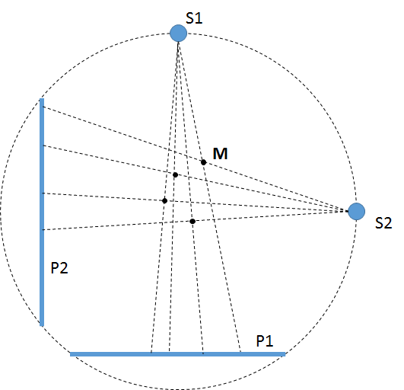
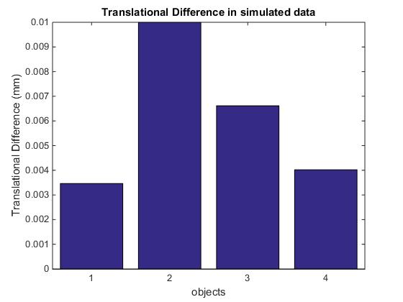
C-arm Registration
Notes:
Returning to C-arm registration, we know projection matrices for multiple angles and center of rotation in calibration object coordinate, or C-arm coordinate.
For actual registration, we take shots of the multi-modal markers in number of the known angles. We compute 2D position of the markers in each projection by finding centroids. With these 2D positions and projection matrices at each angle, we triangulate to define 3D position of the markers. Then using 3D positions of the markers in optical domain, we do define transformation from C-arm coord. to Optical coordinate.
We coded for this and ran it with simulation data. With the simulation data we got translational eifferences sub .1 milimeter which is quite accurate. What we will do next is though

Slide 17
Updated Delilverables

Slide 18
Dependencies
Equipment Accessibility - resolved
Access to C-arm, optical tracker, optical markers, and 3D phantoms
Software/Existing tools - resolved
Necessary softwares for modules, 3D CT data of phantoms.
Version Control/Documentation - resolved
Safety Training - In progress (Completed by end of this week)
Schedule with mentors - resolved
Access to the lab - resolved

Slide 19
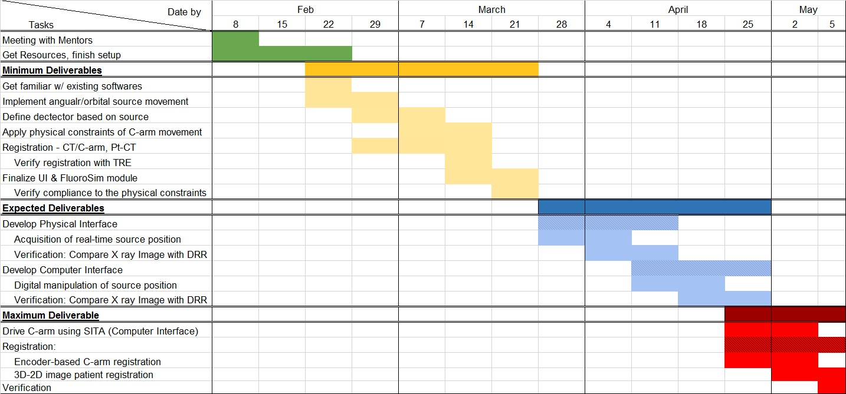
Project Timeline (before)

Slide 20
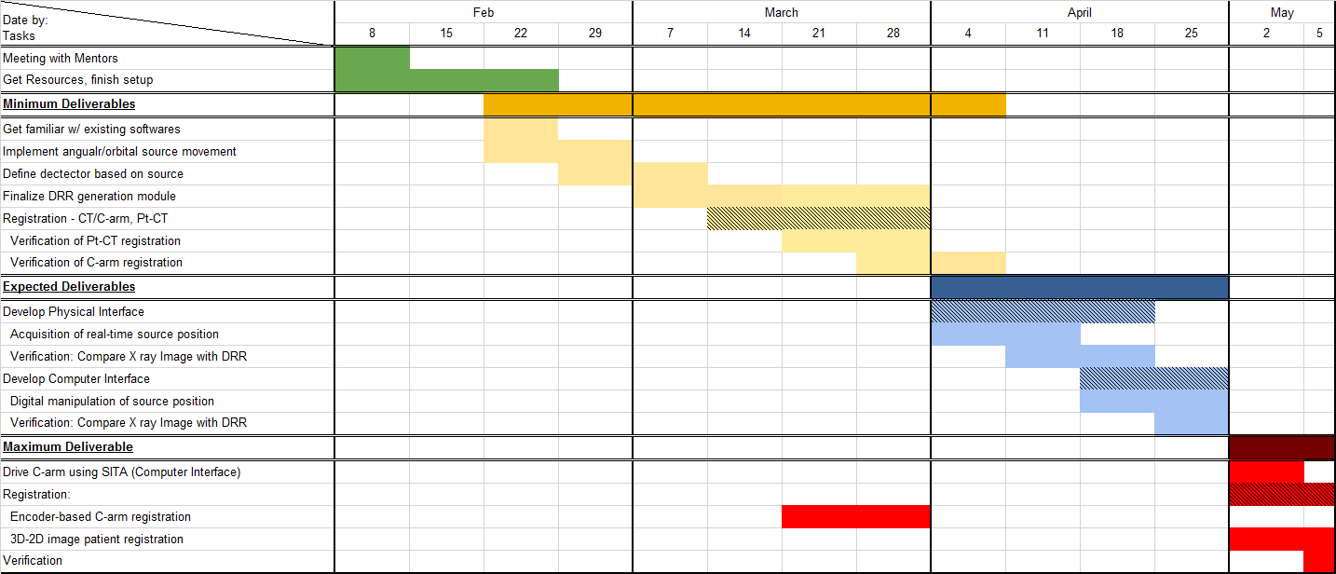
Project Timeline (Updated)
Notes:
We have to push back one week for our minimum deliverable but we already incorporated encoder based C-arm positioning which was one of our maximum deliverables.
So, we expect to finish our expected deliverable by the end of aprial and will work on our maximum deliverable on May.

Slide 21
Upcoming Milestones
Physical Interface
Build a bridge so physical movement of C-arm/Source can be tracked and inputted to the module in real-time
(by 04/04/16 → 04/11/16)
Acquire X-ray image of preferred view, error check with generated DRR (Validation) (by 04/11/16 → 04/18/16)
Computer Interface
Read C-arm/Source position with an optimal fluoroscopic preview (by 04/18/16 → 04/25/16)
Verification process by comparing a DRR preview to an acquired X-ray image (by 04/25/16)
Advanced Features (MAX)
Using SITA interface, allow computer interface to drive C-arm to a desired position. (by 05/02/16)
Encoder-based C-arm position measurement (by 05/02/16 → 03/28/16)
Pt.-CT registration via 3D-2D registration with 2 X-ray shots (by 05/05/16)
Verification process by comparing a DRR preview to an acquired X-ray image (by 05/05/16)
Notes:
These are upcoming milesteones.
For PI, we wil incorporate real time tracking of C-arm source position according to the physical movement of C-arm by 04/11/16
We will validate PI by 04/18/16.
Concurrently we will work on CI, and we will be able to manipulate the source position in the CT coordinate and generate an optimal fluoroscopic preview by 04/25/16 and we will verify this process as we go through.
So, by 04/25/16, we will finish our expected deliverables.
For MAX deliverables, we will motorize C-arm movement to a desired position using SITA by 05/02/16
Encoder based C_arm position registration is expected to be done by next monday
Patient CT registration with 2D-3D registration will be done by 05/05/16 and verification will be done simultaneously.

Slide 22
Questions?

