Slide 1
Mosquito Decapitation and Squeeze Prediction
EN.620.801 MSE Robotics Research
Alan Lai
Mentors: Balazs Vagvolgyi, Dr. Russ Taylor
Confidential

Slide 2
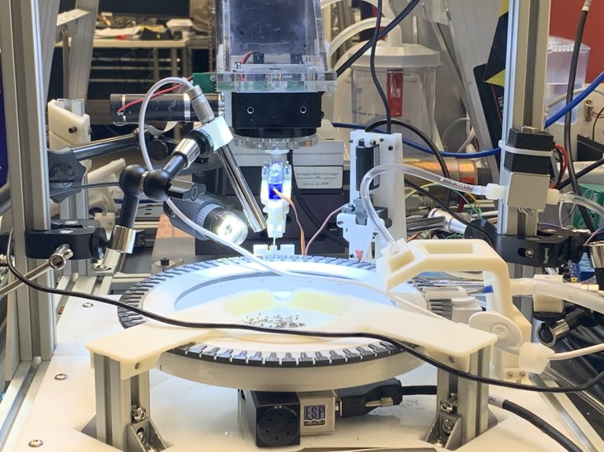
Project Background
Goal: To create a ROS-integrated computer vision system for prediction of mosquito decapitation and salivary gland extraction success to guide an automated mosquito dissection robotic system for live malaria vaccine production
Background:
Malaria causes over 400,000 deaths a year
Sanaria has developed a live malaria vaccine shown to be 100% effective in clinical trials
Extraction of salivary glands vital for vaccine production
Currently done manually; but automatic mosquito microdissection system (MMS) proposed
Confidential

Slide 3
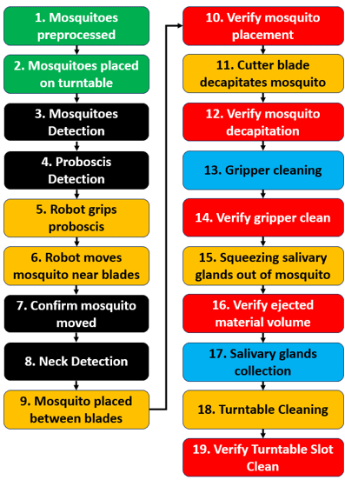
Project Background
5
9
15
2
18
[Li]
Confidential

Slide 4
Project Goal + Motivation
Predict decapitation + squeezing success & failure
Analyze and classify failure cases
Improve System
Predict success
5
9
15
Predict failure
2
18
[Li]
Confidential

Slide 5
Project Deliverables
Working algorithm on decapitation prediction
Working algorithm on squeeze success prediction
ROS integration test client/server for prediction algorithms
Documentation on all algorithms and usage
Confidential

Slide 6
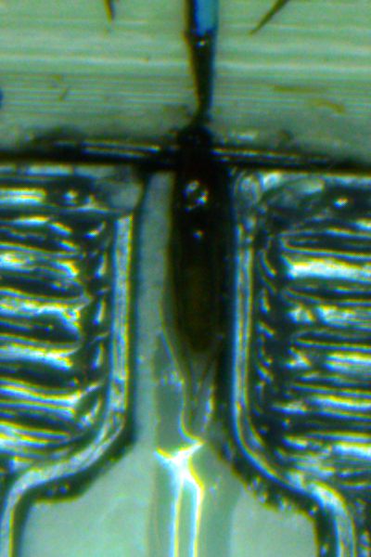
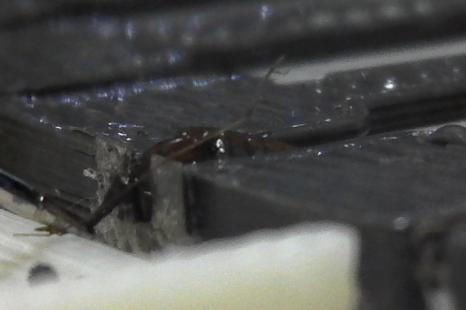
Data
85 images of mosquito after placement on blades
Overhead view
Side view
 | Decap. Success | Decap. Fail
Squeeze Success | 36 | 0
Squeeze Fail | 29 | 20
Overhead view
Side view
Confidential

Slide 7
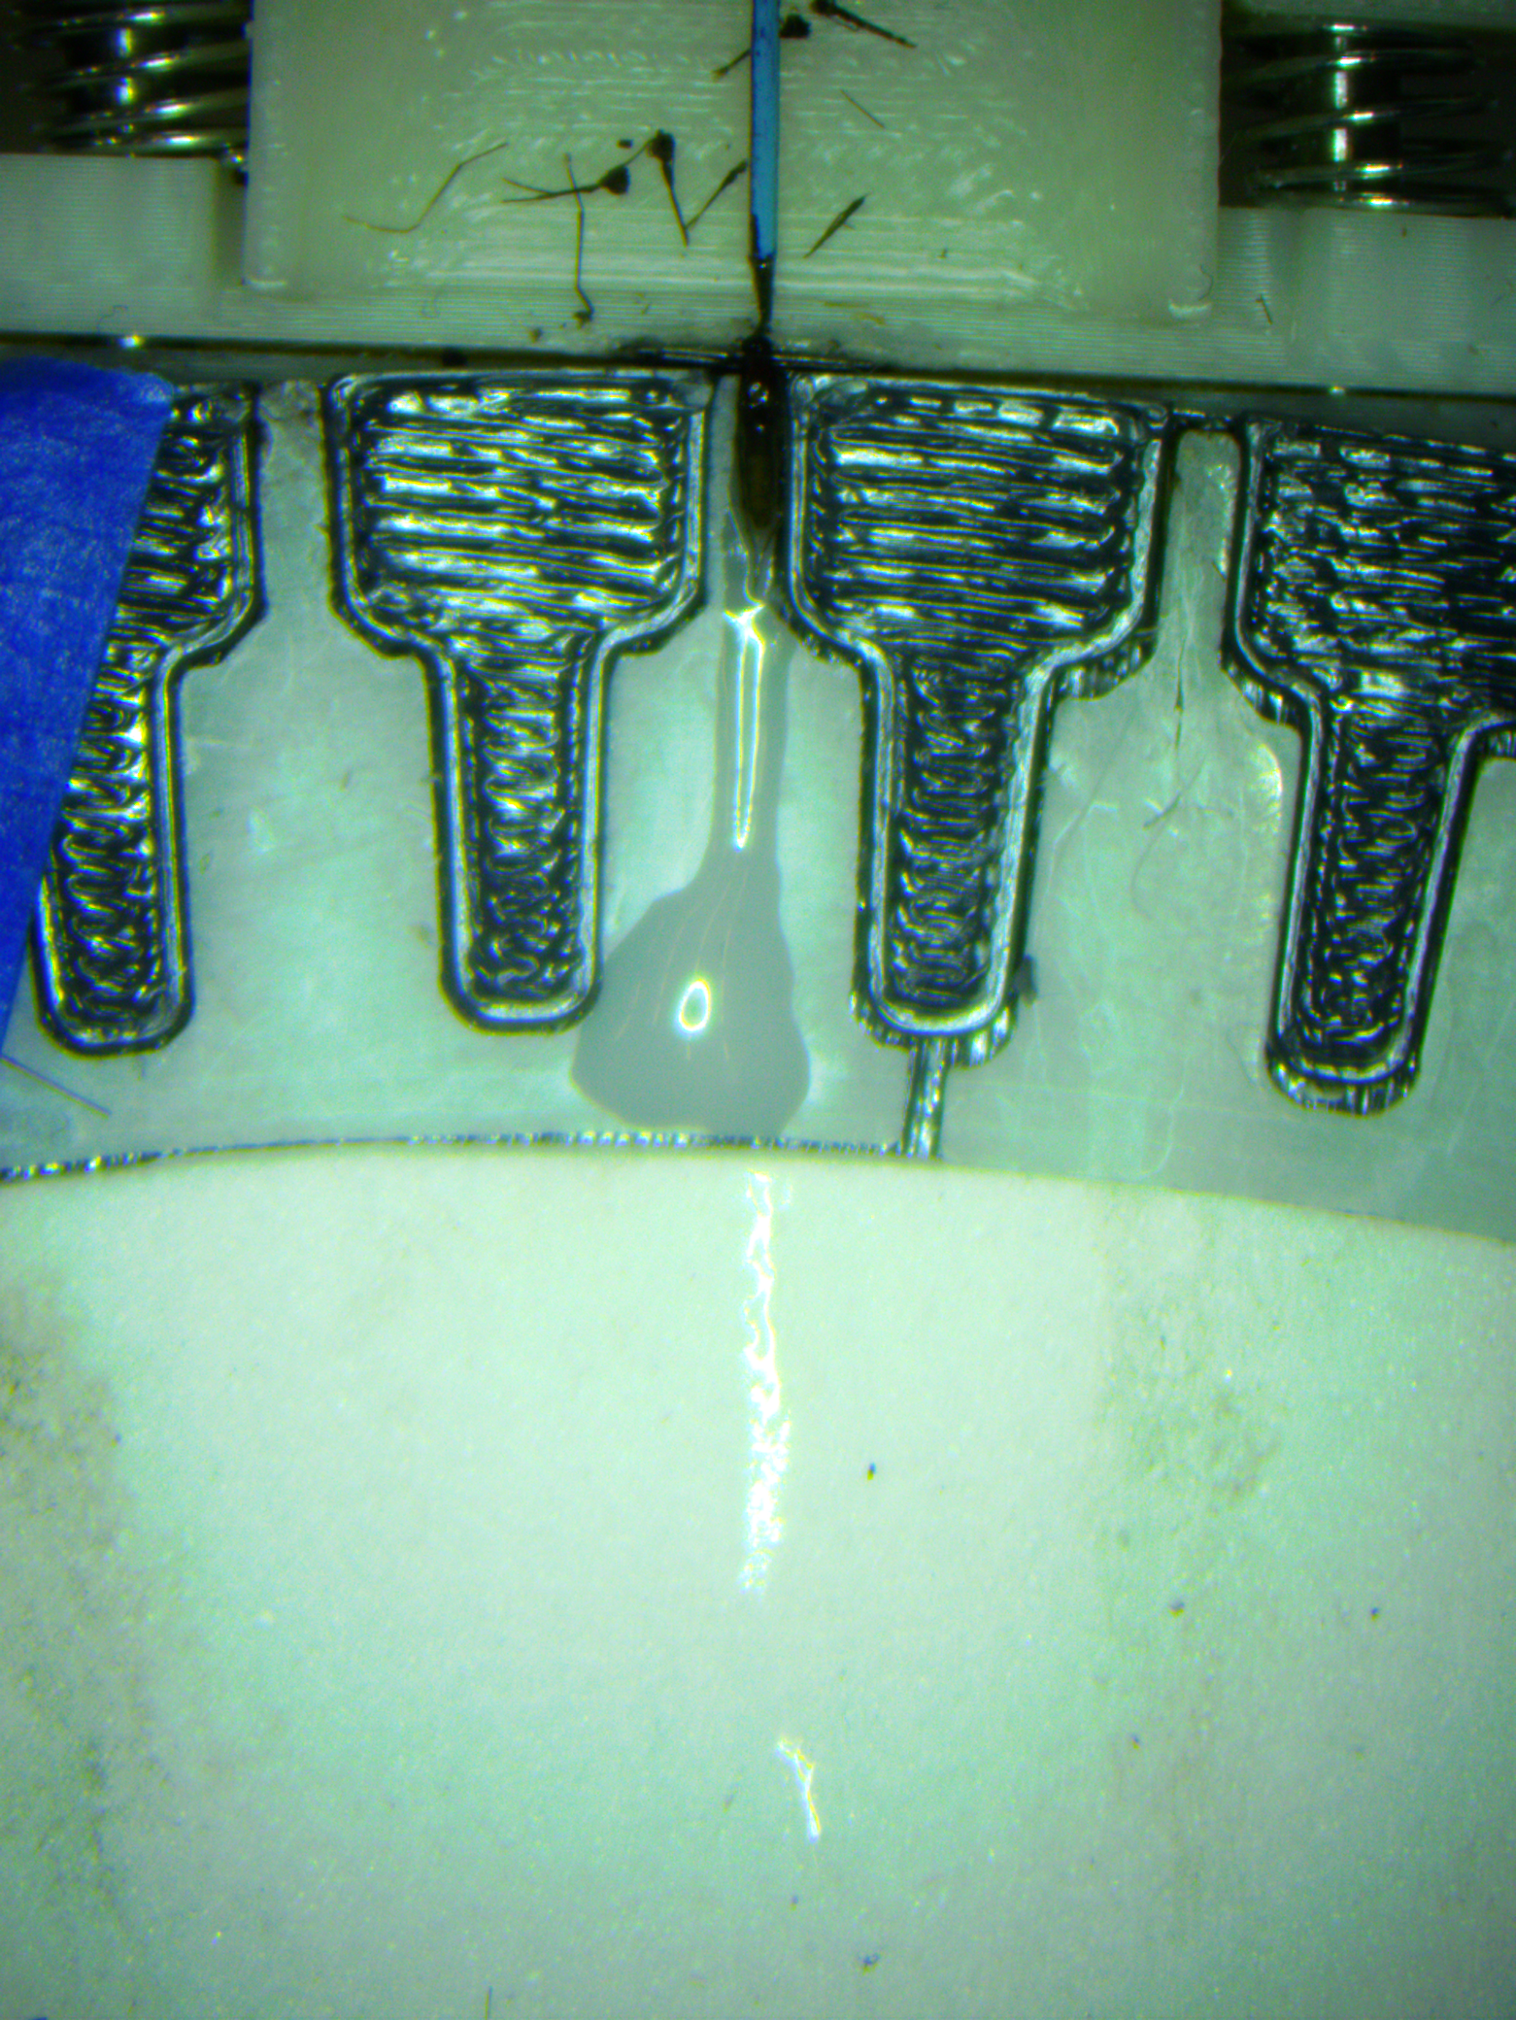
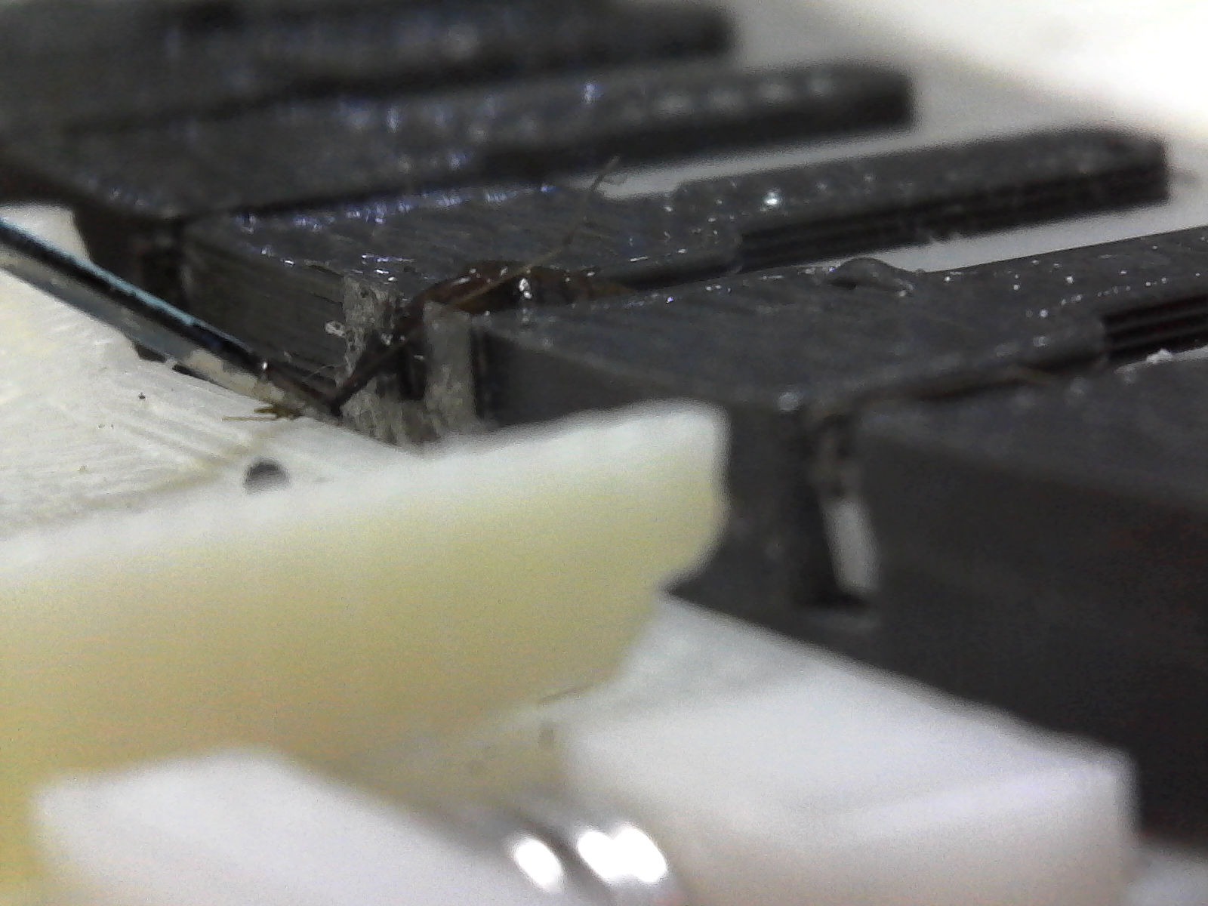
Data
Overhead view
Side view
Confidential

Slide 8
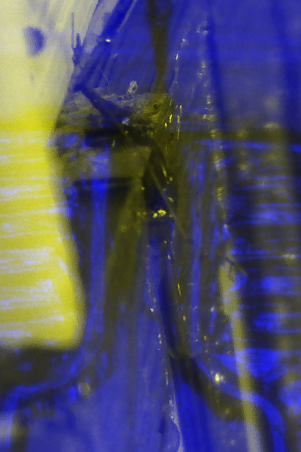
Data
Overhead view
Side view
Combined view
Confidential

Slide 9
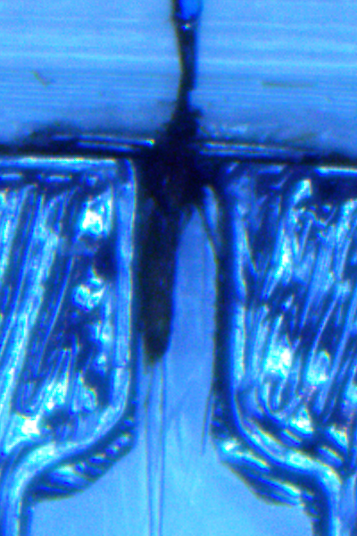
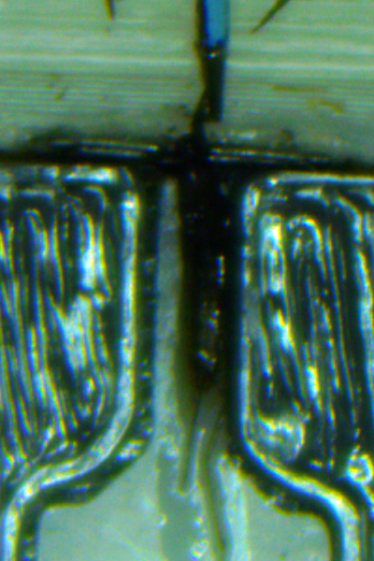
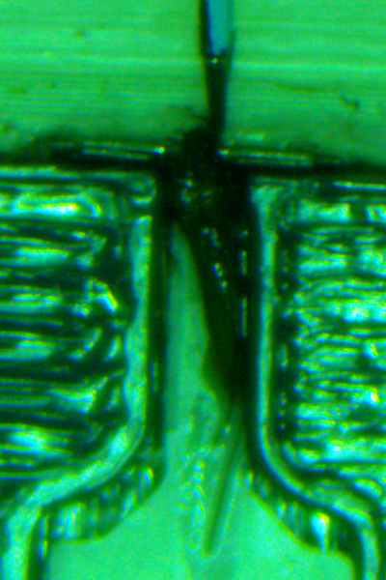
Methods
Deep Learning via PyTorch
Transfer Learning with ResNet18
Normalized intensities
Cross entropy loss
Images split 75/25 train/val
Confidential

Slide 10
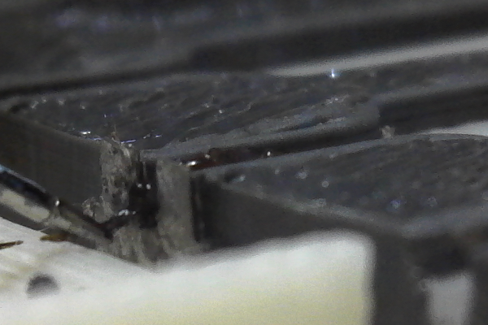
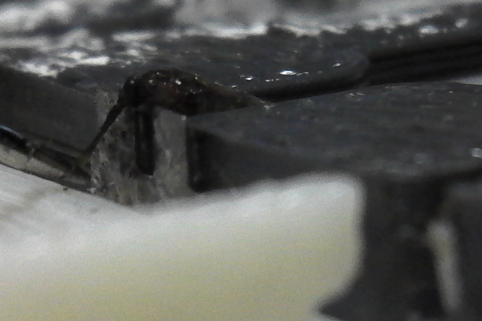
Preliminary Results - Decapitation Prediction
Prediction of decapitation success/failure
91% accuracy (overhead)
91% accuracy (side view)
91% accuracy (combined)
Success Case
 |  | Ground Truth
 |  | Success | Fail
Prediction | Success | 17 | 1
 | Fail | 1 | 3
Failure Case
Confidential

Slide 11
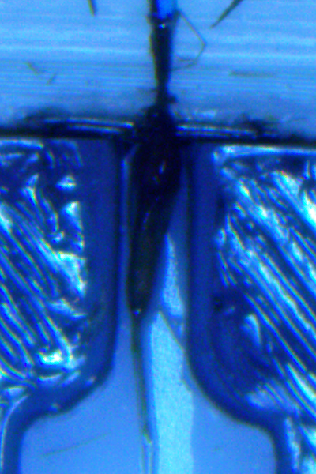
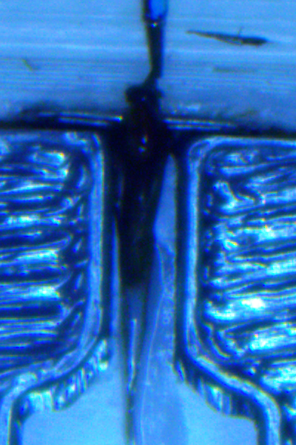
Preliminary Results - Squeezing
Prediction of squeezing success/failure
76% accuracy (overhead)
70% accuracy (side view)
76% accuracy (combined)
 |  | Ground Truth
 |  | Success | Fail
Prediction | Success | 8 | 2
 | Fail | 2 | 5
Success Case
Failure Case
Confidential

Slide 12
Next Steps
Data augmentations
Random intensity shifts
Random crop, rotate
Need more data
Setup framework for future training
Confidential

Slide 13
References
[1] Wu, H., Mu, J., Da, T., Xu, M., Taylor, R. H., Iordachita, I., & Chirikjian, G. S. (2019). Multi-mosquito object detection and 2d pose estimation for automation of PfSPZ malaria vaccine production. In 2019 IEEE 15th International Conference on Automation Science and Engineering, CASE 2019 (pp. 411-417). [8842953] (IEEE International Conference on Automation Science and Engineering; Vol. 2019-August). IEEE Computer Society. https://doi.org/10.1109/COASE.2019.8842953
[2] Li, W., Zhang, Z., He, Z., Vora, P., Lai, A., Vagvolgyi, B., Leonard, S., Goodridge, A., Iordachita, I., Chakravarty, S., Sim, K. L., Hoffman, S. L., Taylor, R.H. (2021). Progress in Development of an Automated Mosquito Salivary Gland Extractor: A Step Forward to Malaria Vaccine Mass Production.
Confidential

