Slide 1
Paper Seminar Presentation: Sinus Surgery Study using the REMS
Group 12
Barbara Kim, Brian Gu, Kurt lee
Mentors: Kevin olds, Dr. Russell Taylor

Slide 2
REMS - Robotic ENT Microsurgery System
Robotic system designed with the goal of addressing surgical challenges - specifically those encountered in OHNS (of which sinus surgery is a subset)
Assists in manipulation - eliminates unwanted movement from surgeon (ie hand tremor)
Assists in navigation - combines positional tracking information with registered pre-operative images to avoid sensitive anatomy ("barrier zones")

Slide 3
Subproject 1: REMS Sinus Validation Study
Primary goal is to determine if robotic surgical assistance with REMS improves surgical skill compared to conventional surgery.
Protocol:
20 students randomly separated into two groups
10 will "learn sinus surgery" with the REMS
10 with current learning protocol
compare accuracy of two groups
An expert group will perform the task to gather data on how REMS affects professionals.

Slide 4
Paper selection
Objective Evaluation of Expert and Novice Performance during Robotic Surgical Training Tasks
Judkins, Timothy N., Dmitry Oleynikov, and Nick Stergiou. "Objective evaluation of expert and novice performance during robotic surgical training tasks." Surgical endoscopy 23.3 (2009): 590-597.

Slide 5
Paper relevance
Quantitative metrics for surgical skill assessment
Time to task completion, total distance traveled, speed, curvature, phase
Experiment protocol
Novice training setup
Complex surgical tasks

Slide 6
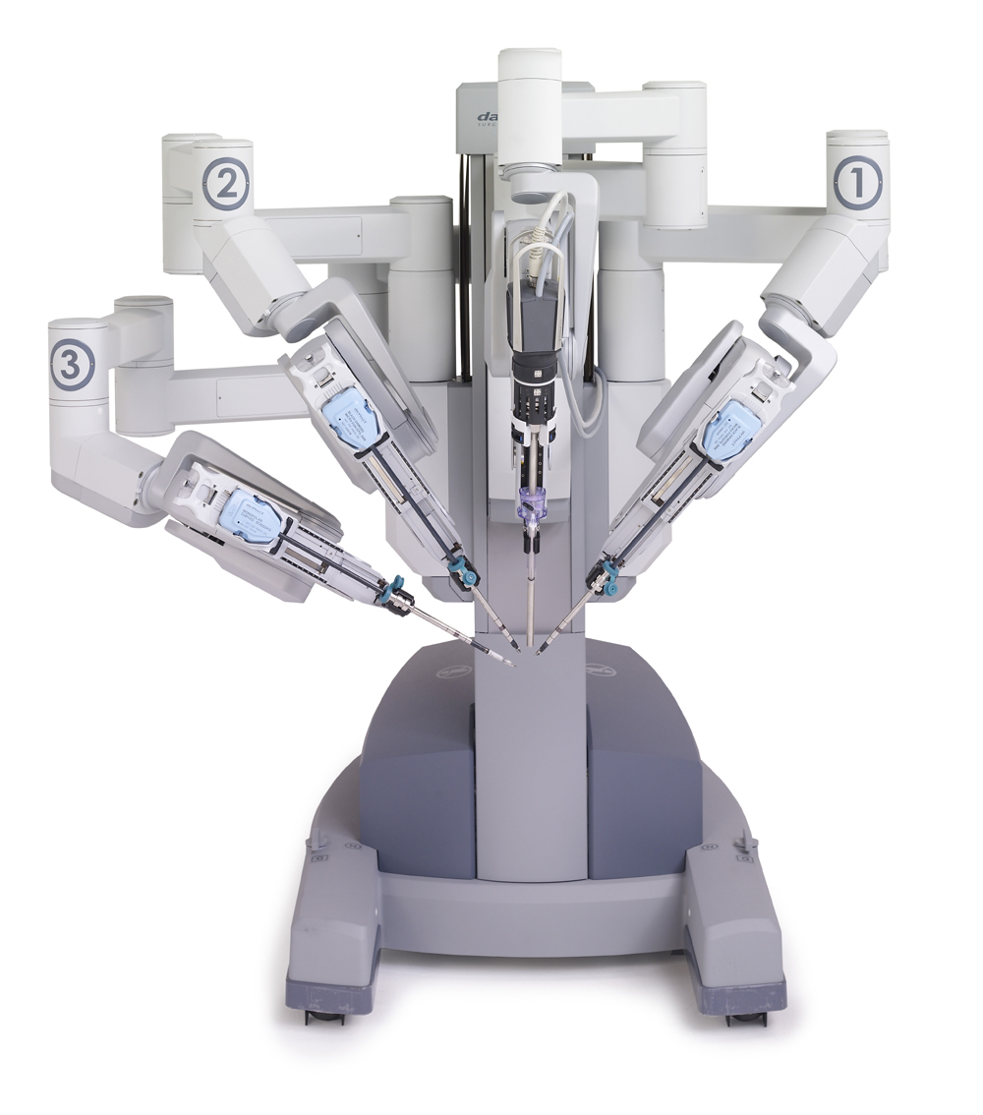
Paper overview
Goals
Experimental Setup
Objective Measures
Results

Slide 7
Goals
Previous evaluations of surgical performance were:
Incomplete, or
Subjective
Thoroughly evaluate objective measures by:
Comparing experts and novices
Before and after training
Under three surgical tasks of varying difficulty

Slide 8
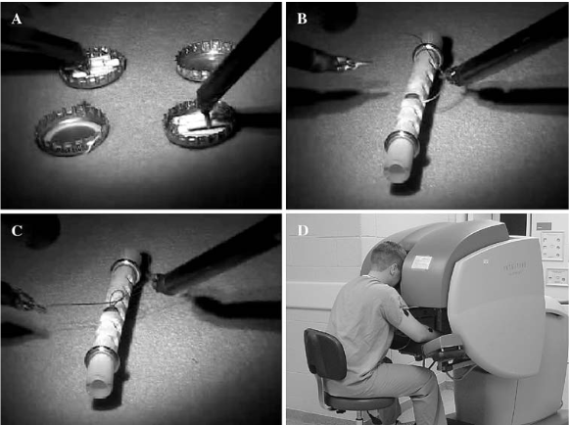
Experimental setup
Three different surgical tasks
Bimanual carrying
Needle passing
Suture tying
Compare novices (before and after training) and experts

Slide 9
Training paradigm
Novices – 16 trials
3 pretraining (N-PRE)
10 training
3 posttraining (N-POST)

Slide 10
Objective Measures
Time to task completion (TTC)
Total distance traveled (D)
Grip Force (F)
Speed (S)
Curvature (κ)
$κ \text{=} \frac{\left|\dot{r} ∗ \ddot{r}\right|}{{\dot{r}}^{3}}$
Relative Phase (Φ)

Slide 11
Results

Slide 12
results
Significant differences between novice and expert and training effects
All objective measures were significantly different, except Φmean
Performance of novices after training vs. experts

Slide 13
Critique
Didn’t measure performance of experts before and after training
Doesn’t fully explain how these measures provide a comprehensive comparison
Instead of just using TTC and D
Unclear criteria to determine difficulty of surgical task

Slide 14
Questions?

