Slide 1
Intraoperative Registration of Pathology for Adjuvant Postoperative Radiotherapy
Kareem Fakhoury, Matthew Hauser, Steven Lin
Project #4
Kareem Fakhoury Matthew Hauser Steven Lin
CIS Confidential

Slide 2
Mentors
Dr. Harry Quon, M.D.
Department of Radiation Oncology
Dr. Junghoon Lee, Ph.D
Department of Radiation Oncology
Dr. Jeremy Richmon, M.D.
Department of Head and Neck Surgery Robotic Program
Kareem Fakhoury Matthew Hauser Steven Lin
CIS Confidential

Slide 3
Overview
1. Project Plan
2. Data Collection
3. Image pre-processing
4. Polaris Registration
5. Image Processing
6. What’s Next
Kareem Fakhoury Matthew Hauser Steven Lin
CIS Confidential

Slide 4
Overview
Pre-Operative CT Scan
Remove a Piece of Pig Tongue
Insert Markers on Tongue and record positions with Polaris
Open CT Scan
Close Surgical Wound
Closed CT Scan
Kareem Fakhoury Matthew Hauser Steven Lin
CIS Confidential

Slide 5
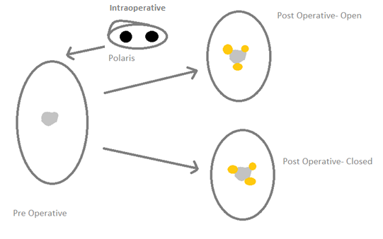
Overview
Kareem Fakhoury Matthew Hauser Steven Lin
CIS Confidential

Slide 6
Deliverables
Minimum
Data collection
Registration of Preop Scans to Post-op scans with location of polaris points
Expected
Implementation of workflow to register image data
Comparison of Deformable Registration Algorithms
Maximum
Evaluate Tissue Deformation
Determine optimal marker placements for tissue deformation evaluation
Help Dr. Quon with grant submission
Kareem Fakhoury Matthew Hauser Steven Lin
CIS Confidential

Slide 7
Deliverables
Minimum
Data collection
Registration of Preop Scans to Post-op scans with location of polaris points
Expected
Implementation of workflow to register image data
Comparison of Deformable Registration Algorithms
Maximum
Determine feasibility of registration of tongue outside of mouth
Evaluate Tissue Deformation
Determine optimal marker placements for tissue deformation evaluation
Help Dr. Quon with grant submission
Kareem Fakhoury Matthew Hauser Steven Lin
CIS Confidential

Slide 8
Data Collection
Kareem Fakhoury Matthew Hauser Steven Lin
CIS Confidential

Slide 9
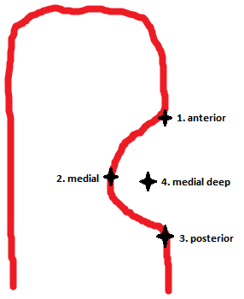
Data Collection
5 fiducials were placed on the pig head before resection
4 markers were placed in the tongue after resection
Kareem Fakhoury Matthew Hauser Steven Lin
CIS Confidential

Slide 10
Clips
Kareem Fakhoury Matthew Hauser Steven Lin
CIS Confidential

Slide 11
Kareem Fakhoury Matthew Hauser Steven Lin
CIS Confidential

Slide 12
Deliverables
Minimum
Data collection
Registration of Preop Scans to Post-op scans with location of polaris points
Expected
Implementation of workflow to register image data
Comparison of Deformable Registration Algorithms
Maximum
Determine feasibility of registration of tongue outside of mouth
Evaluate Tissue Deformation
Determine optimal marker placements for tissue deformation evaluation
Help Dr. Quon with grant submission
Kareem Fakhoury Matthew Hauser Steven Lin
CIS Confidential

Slide 13
Marker Removal- Where is it?
Kareem Fakhoury Matthew Hauser Steven Lin
CIS Confidential

Slide 14
Marker Removal- There it is!
Kareem Fakhoury Matthew Hauser Steven Lin
CIS Confidential

Slide 15
Polaris to Pre-Operative CT Scan
Previous inaccuracies resolved
Registered Polaris fiducial coordinates ~ 1 mm away from the CT fiducial

Slide 20
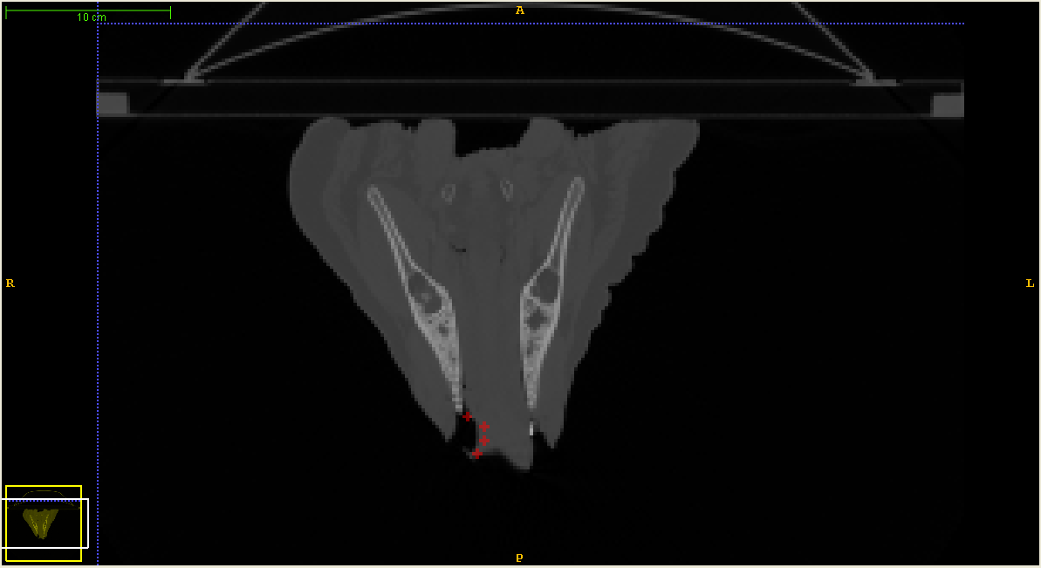

Slide 21
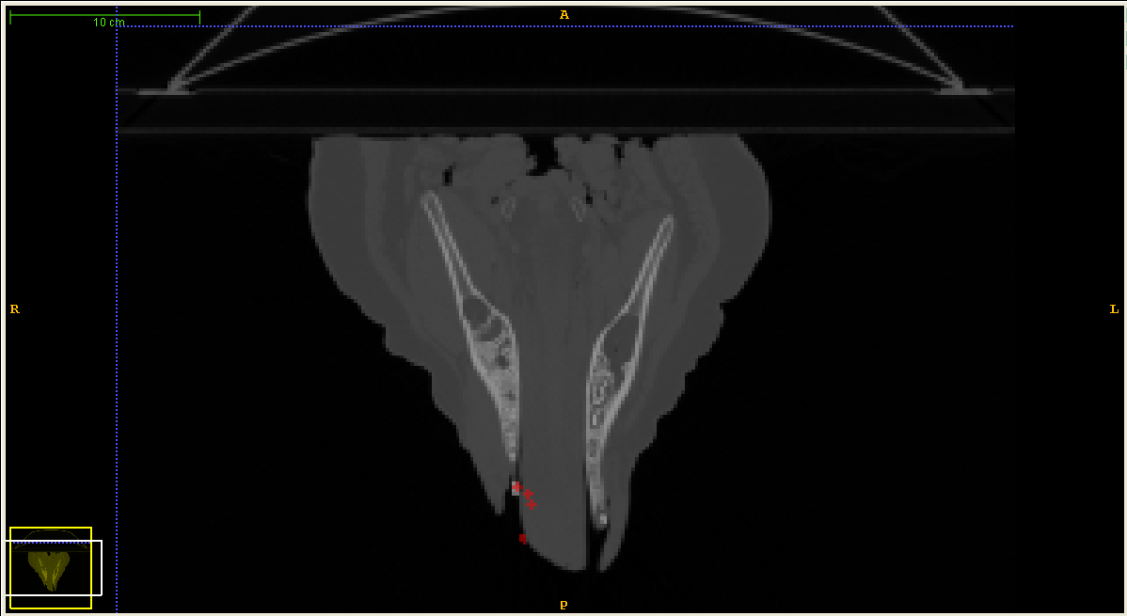

Slide 22
Deliverables
Minimum
Data collection
Registration of Pre-op Scans to Post-op scans with location of polaris points
Expected
Implementation of workflow to register image data
Comparison of Deformable Registration Algorithms
Maximum
Determine feasibility of registration of tongue outside of mouth
Evaluate Tissue Deformation
Determine optimal marker placements for tissue deformation evaluation
Help Dr. Quon with grant submission
Kareem Fakhoury Matthew Hauser Steven Lin
CIS Confidential

Slide 23
Rigid
Kareem Fakhoury Matthew Hauser Steven Lin
CIS Confidential

Slide 24
Binary Mask
Kareem Fakhoury Matthew Hauser Steven Lin
CIS Confidential

Slide 25
Binary Mask
Kareem Fakhoury Matthew Hauser Steven Lin
CIS Confidential

Slide 26
Iterations
Increase in iteration
Deformable Registration of Pre-op increases similarity to post-op
Evaluated on a qualitative basis, need quantitative

Slide 27
1000 Iterations

Slide 28
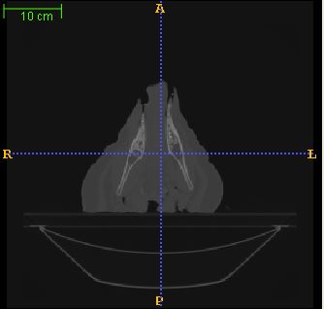
10,000 Iterations

Slide 29
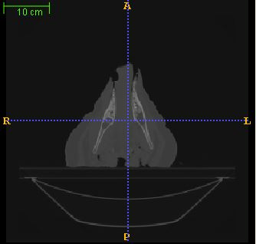
15,000 Iterations

Slide 30
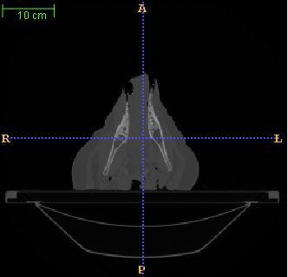
Original Post-Operative

Slide 31
Optimizers
Explored common forms
Conjugate Gradient
Quasi Newton
Standard Gradient
Evaluated at qualitative basis, need quantitative

Slide 32
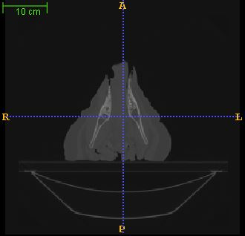
Standard Gradient Descent

Slide 33
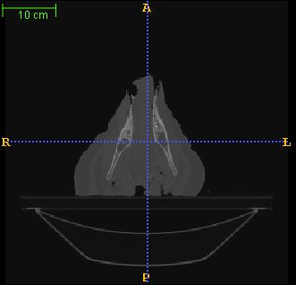
Quasi Newton

Slide 34
Deliverables
Minimum
Data collection
Registration of Preop Scans to Post-op scans with location of polaris points
Expected
Implementation of workflow to register image data
Comparison of Deformable Registration Algorithms
Maximum
Determine feasibility of registration of tongue outside of mouth
Evaluate Tissue Deformation
Determine optimal marker placements for tissue deformation evaluation
Help Dr. Quon with grant submission
Kareem Fakhoury Matthew Hauser Steven Lin
CIS Confidential

Slide 35
Kareem Fakhoury Matthew Hauser Steven Lin
CIS Confidential

Slide 36
Kareem Fakhoury Matthew Hauser Steven Lin
CIS Confidential

Slide 37
Deliverables
Minimum
Data collection
Registration of Preop Scans to Post-op scans with location of polaris points
Expected
Implementation of workflow to register image data
Comparison of Deformable Registration Algorithms
Maximum
Determine feasibility of registration of tongue outside of mouth
Evaluate Tissue Deformation
Determine optimal marker placements for tissue deformation evaluation
Help Dr. Quon with grant submission
Kareem Fakhoury Matthew Hauser Steven Lin
CIS Confidential

Slide 38
Kareem Fakhoury Matthew Hauser Steven Lin
CIS Confidential

Slide 39
Thank You!
Kareem Fakhoury Matthew Hauser Steven Lin
CIS Confidential

