Slide 1
Machine learning to determine regions of influence of treatment related toxicity in lung cancer
The goal is to apply machine learning methods to determine the patterns of dose that influence treatment related toxicities in our patients
What Students Will Do:
Use our existing radio-morphologic features to create spatially dependent features of dose to lungs
Extract outcome measures using pulmonary function tests
Apply machine learning to determine the most influential set of features on pulmonary function
Graphical present the results for clinical interpretation
Deliverables:
Source code used for the evaluation
Presented results
Opportunity for publication
Size group: 1-3
Skills:
3D shapes, Volumetric Image Segmentation
Machine learning methods
Programming experience (SQL, python)
Mentors:
Todd McNutt (tmcnutt1@jhmi.edu)
Pranav Lakshminarayanan (plakshm1@jhu.edu)
Wei Jiang

Slide 2
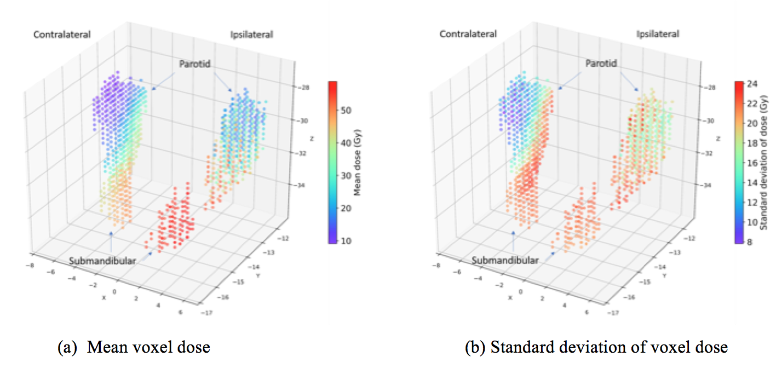
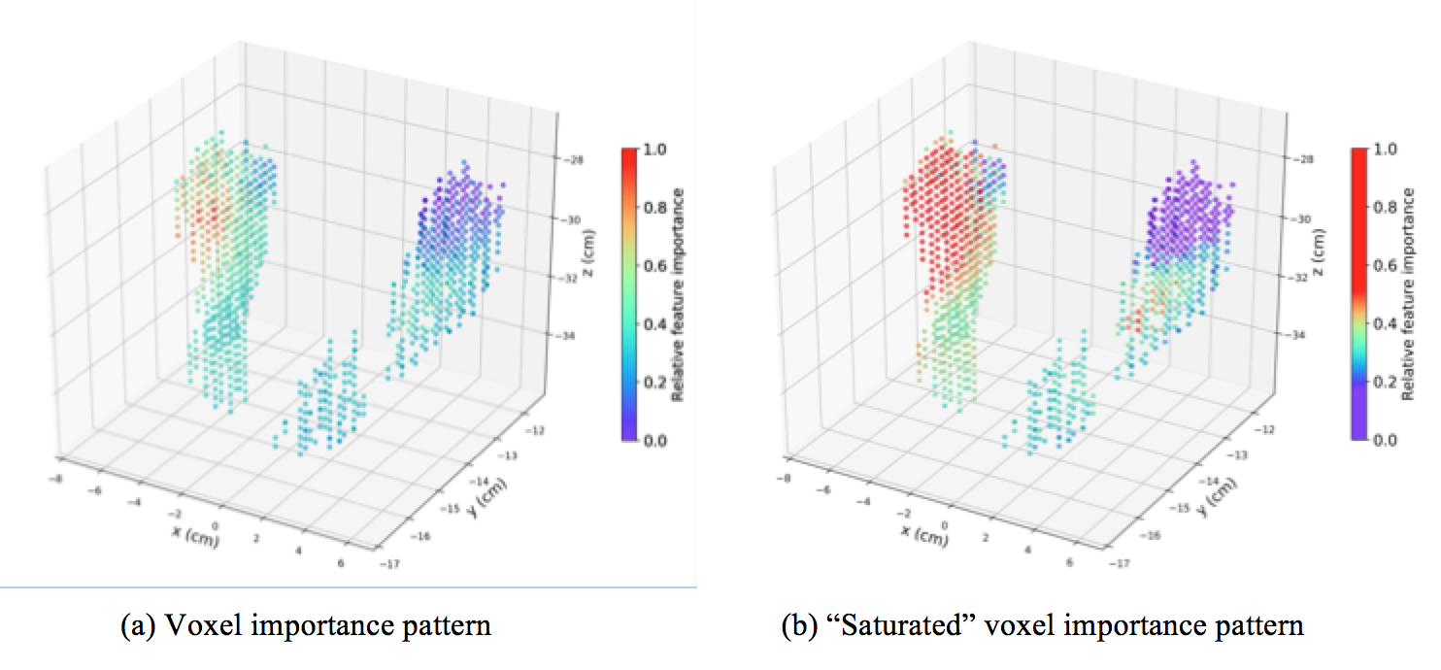
Spatial dose dependence on salivary function

