Slide 1
Towards Robust Vision-based SLAM system with
Learning-based Descriptor
in Endoscopic Surgical Navigation
Student: Yiping Zheng
Mentor: Xingtong Liu
Johns Hopkins University

Slide 2
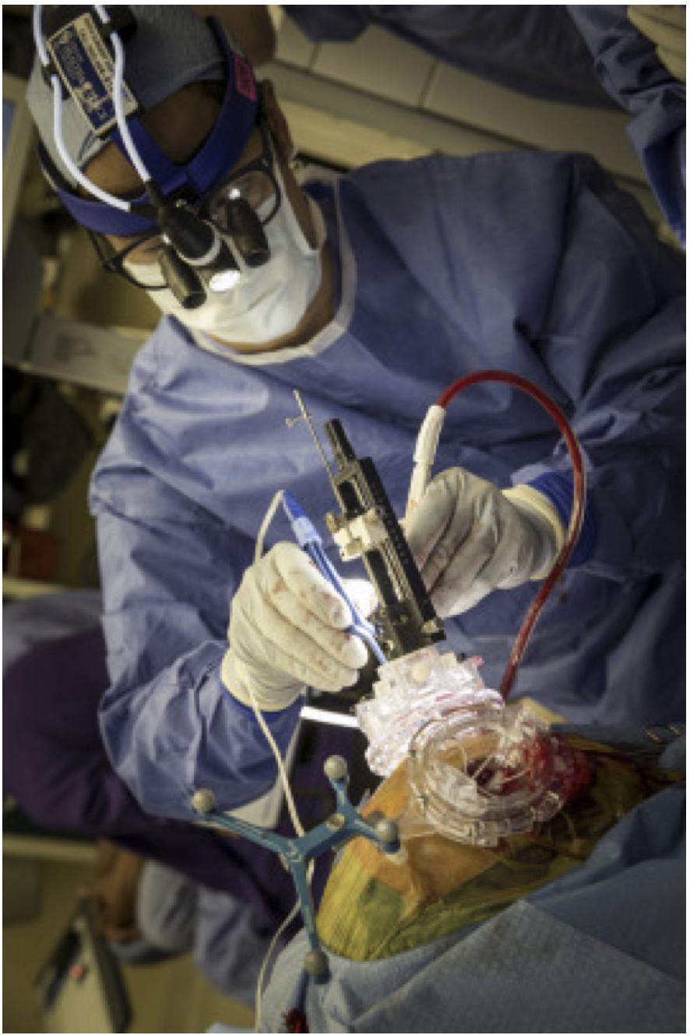
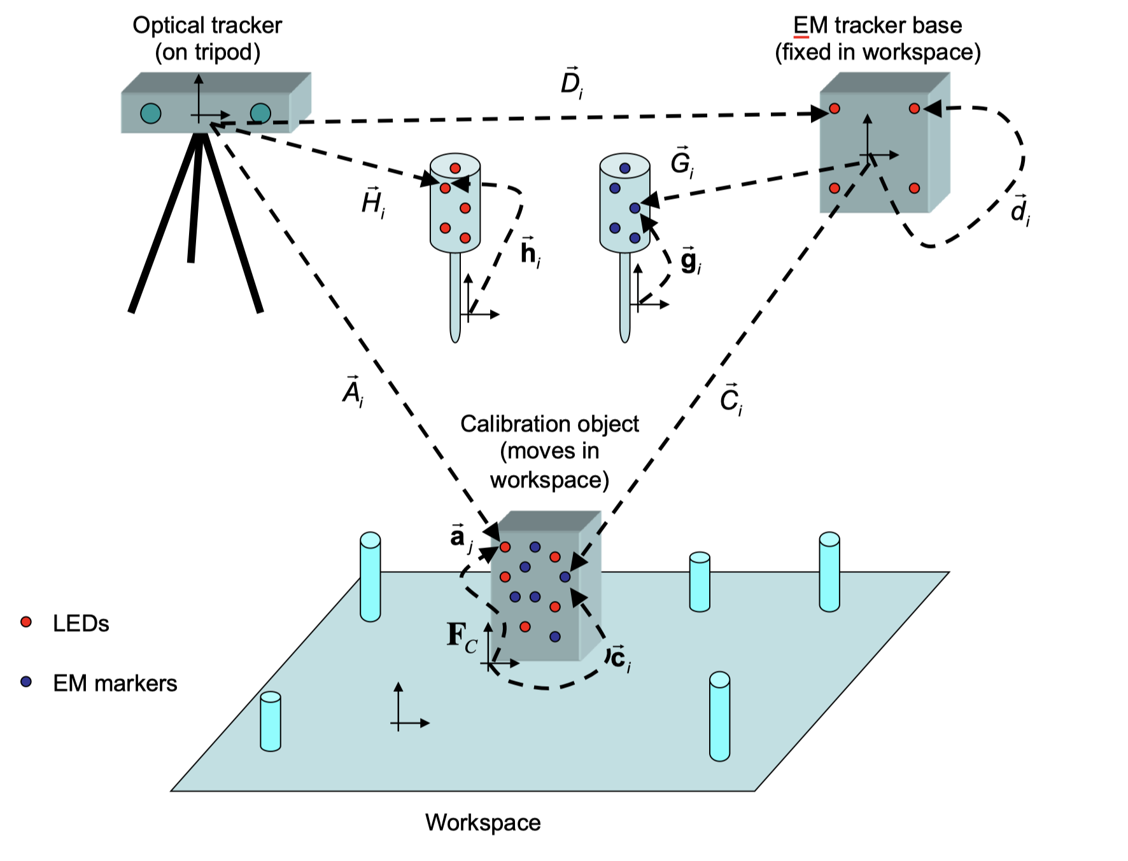
Background
Surgical Navigation

Slide 3
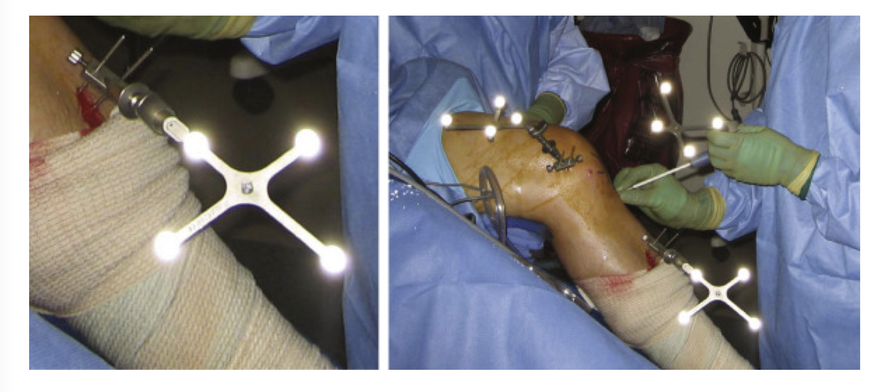
Background
Marker-based Surgical Navigation

Slide 4
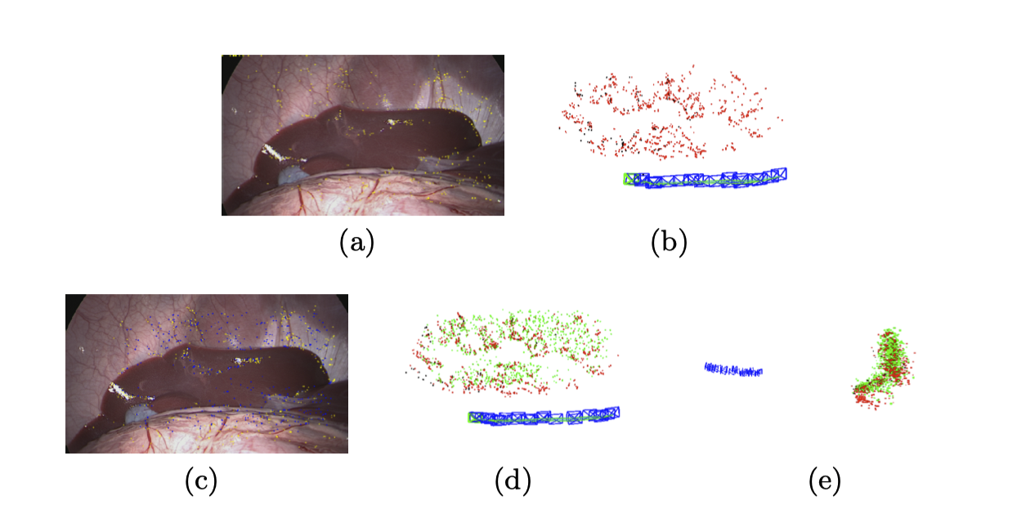
Background
Vision-based Surgical Navigation [1]
(a) Reprojection of the ORB points (yellow). (b) ORBSLAM 3D map. (c) Reprojection of algorithm 1 map points. (d, e) Algorithm 1 map (green) and ORBSLAM map (red), from two diﬀerent points of view

Slide 5
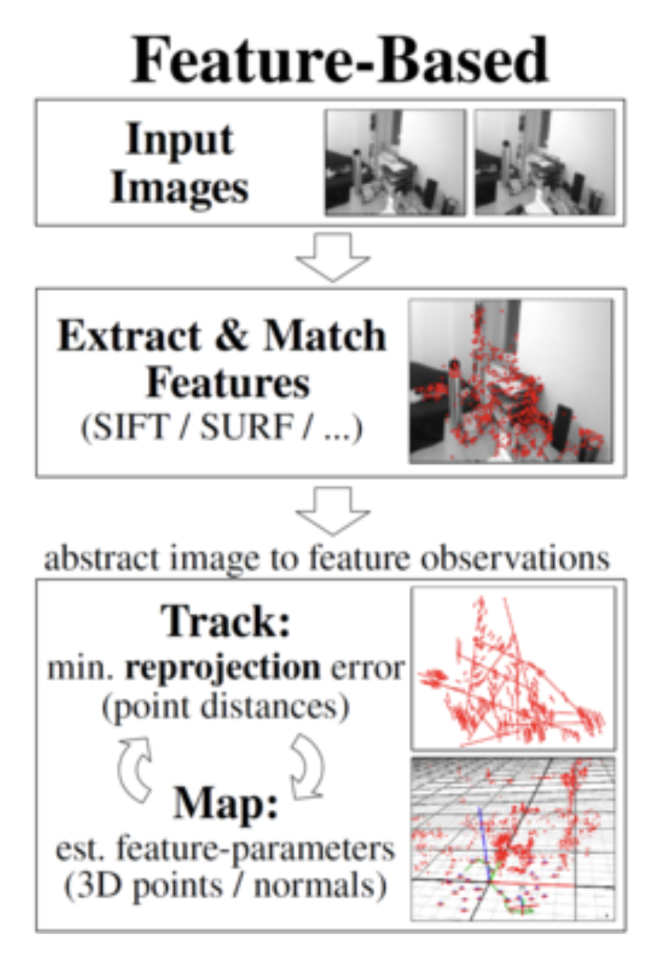
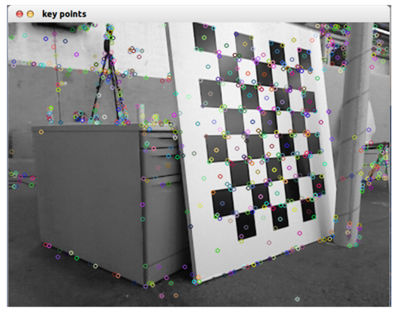
Background
Basic Principle of SLAM system [2]

Slide 6
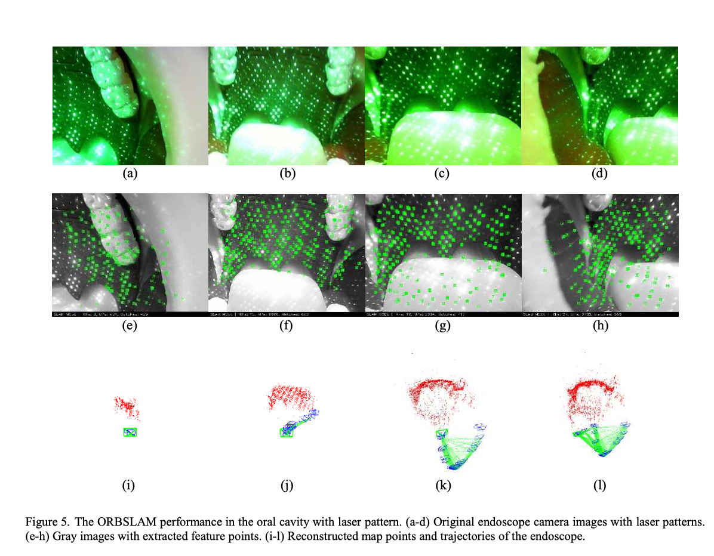
Motivation
Difficulty of Feature Extraction in Endoscope scene [3]
Oral Cavity SLAM
Liu Q. et al, 2019

Slide 7
Project Proposal
Improve the Performance of SLAM-based Surgical Navigation through learning-based descriptor to combine the global anatomical information with the local texture information.

Slide 8
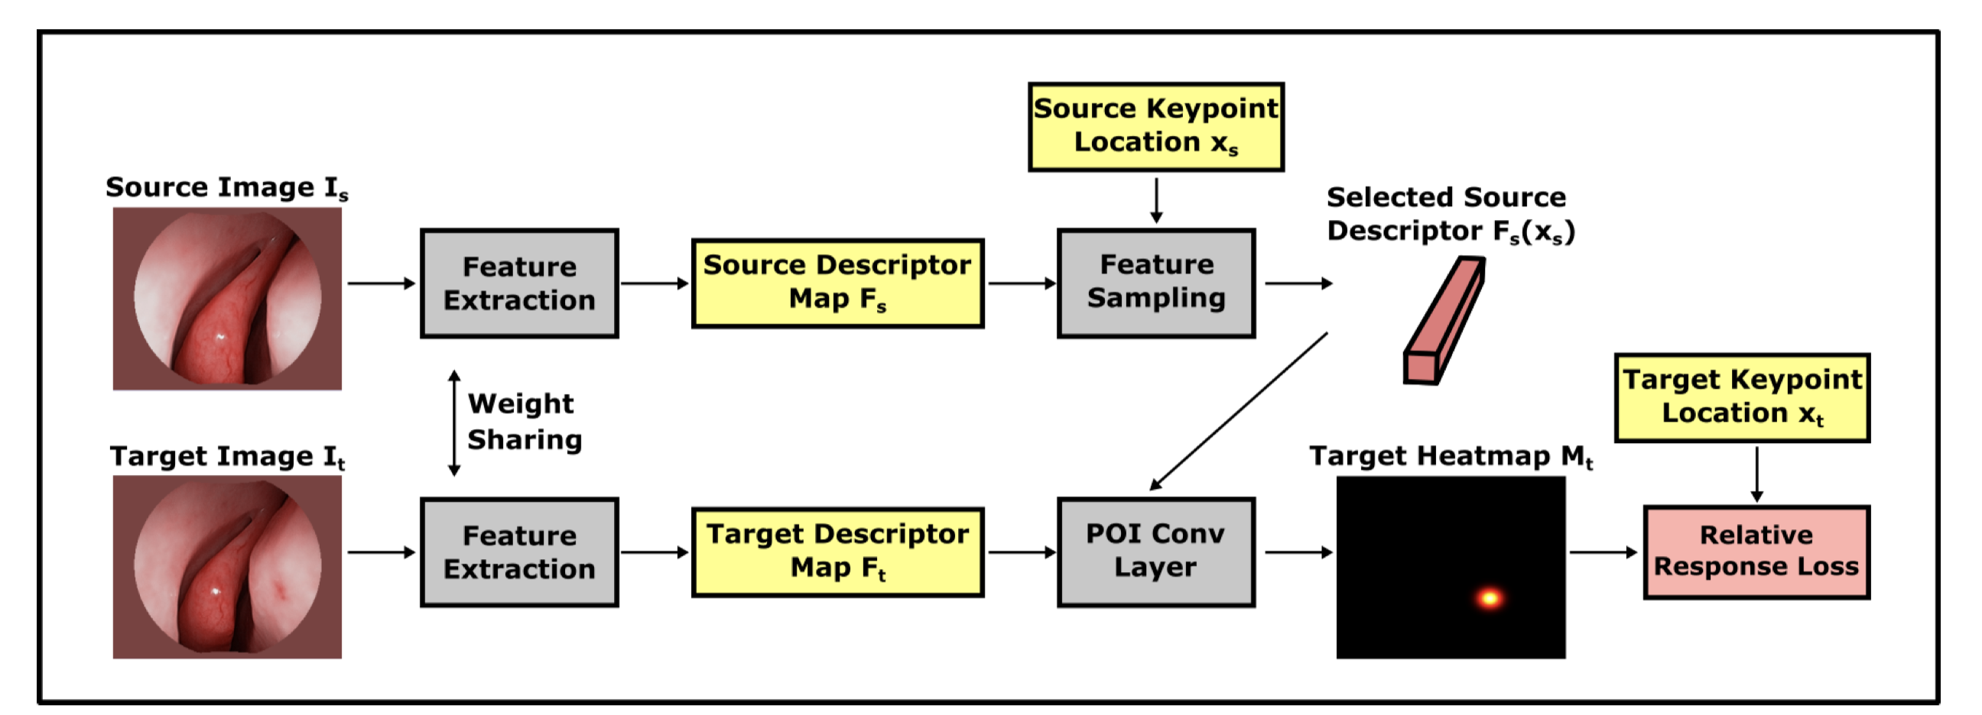
Approach
Dense Descriptor [4]
Overall Neural Network architecture of dense descriptor

Slide 9
Approach
Dense Matching
The computation of dense matching can be parallelized on modern GPU by treating all sampled source descriptors as a kernel with the size of N × L × 1 × 1; N is the number of query source keypoint locations used as the output channel dimension; L is the length of the feature descriptor used as the input channel dimension of a standard 2D convolution operation.

Slide 10
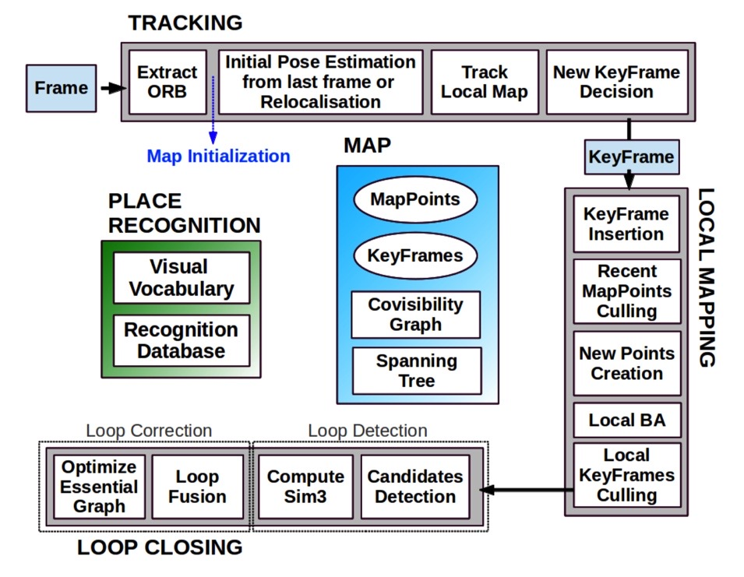
Approach
Modern SLAM System [5]
Overall Architecture of ORB SLAM

Slide 11
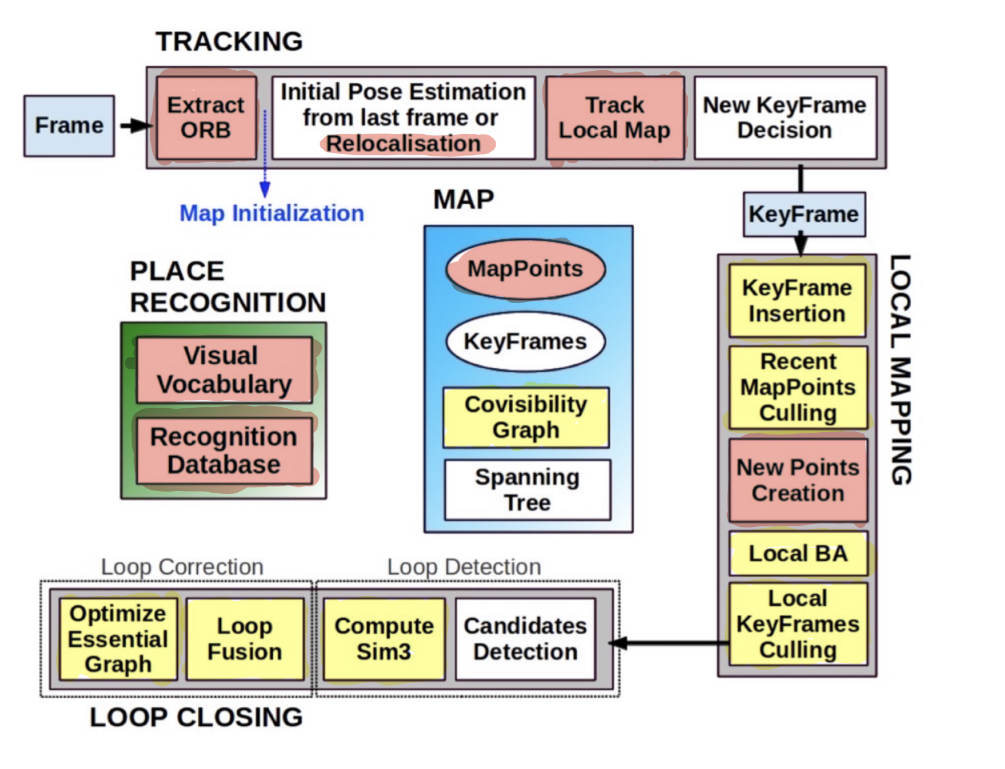
Approach
Implementation and Modification
Red - Modules to be rewritten; Yellow - Modules to be modified

Slide 12
Timeline
Step 1: Getting started Feb. 6 ~ Feb. 10 (5 days)
- Get the test dataset and set up the software environment
- ORB-SLAM, Linux, Pytorch
- Milestone: run the ORB-SLAM and Dense Descriptor properly
Step 2: Implement the algorithm Feb. 11 ~ Mar. 15 (33 days)
- Milestone: run the DenseDescriptor-SLAM pipeline properly
Step 3: Tuning parameters and Evaluate the performance Mar. 15 ~ Apr. 15 (31 days)
- focus on parameters such as, search region tracking, parallax threshold,
projection threshold, hamming distance
- focus on performance speed, reconstruction error, localization error
- Milestone: Surpass the SOTA SLAM system in endoscope scene on at least some properties
Step 4: Tuning parameters and Test on various datasetsApr. 15 ~ Apr. 20 (7 days)
- focus on instrument occlusion and deformation
- Milestone: Achieve fair performance on various scenarios
Step 5: Summarize result and writing report Apr. 21 ~ Apr. 25 (5 days)
- Milestone: Well documented report(or paper) and wiki page
Step 6: Prepare for the poster session Apr. 26 ~ Apr. 30 (5 days)
- Milestone: Final presentation and posters

Slide 13
Deliverable
Minimum: An implementation of a modern SLAM system with learning descriptor integrated. Expected by Mar. 10.
Expected: Fine tuning the parameter of the system to achieve better performance than SOTA SLAM system working in endoscope scene. Expected by Apr. 17
Maximum: Assessment of improvement of system performance over SOTA systems and write a paper over it. Expected by May 1.

Slide 14
Dependencies
 | Solutions | Deadline | Backup Plan | Status
Test Dataset | Contact Xingtong Liu | Feb. 20 | Ask Dr. Taylor for help | Completed
Dense Descriptor | Contact Xingtong Liu | Mar. 10 | Train it my self. ( highly time- consuming) | Not started
SLAM code | Download from https://webdiis.unizar.es/~raulmur/orbslam/ | Feb. 20 | Find another open source SLAM system (eg. SVO) | Completed
Computer | Setup my personal desktop computer | Feb. 10 | Ask Dr. Taylor for help | Completed

Slide 15
Reference
Sinus SfM
1. S. Leonard, A. Sinha, A. Reiter, M. Ishii, G. L. Gallia, R. H. Taylor, et al. Evaluation and stability analysis of video-based navigation system for functional endoscopic sinus surgery on in vivo clinical data. 37(10):2185–2195, Oct. 2018
Stomach SfM
2. A. R. Widya, Y. Monno, K. Imahori, M. Okutomi, S. Suzuki, T. Gotoda, and K. Miki. 3D reconstruction of whole stomach from endoscope video using structure-from-motion. 2019 41st Annual International Conference of the IEEE Engineering in Medicine and Biology Society (EMBC), pages 3900– 3904, 2019
Abdomen SLAM
3. O. G. Grasa, E. Bernal, S. Casado, I. Gil, and J. Montiel. Visual slam for handheld monocular endoscope. IEEE transactions on medical imaging, 33(1):135–146, 2013.
4. N. Mahmoud, I. Cirauqui, A. Hostettler, C. Doignon, L. Soler, J. Marescaux, and J. M. M. Montiel. Orbslam-based endoscope tracking and 3d reconstruction. In CARE@MICCAI, 2016.
Oral Cavity SLAM
5. L. Qiu and H. Ren. Endoscope navigation and 3D reconstruction of oral cavity by visual slam with mitigated data scarcity. In Proceedings of the IEEE Conference on Computer Vi- sion and Pattern Recognition Workshops, pages 2197–2204, 2018.
ORB SLAM
6. Ra´ul Mur-Artal*, J. M. M. Montiel, Member, IEEE, and Juan D. Tard´os, ORB-SLAM: a Versatile and Accurate Monocular SLAM System. Member, IEEE, 2016
Dense Descriptor
7. Xingtong Liu, Yiping Zheng, Russ Taylor, Mathias etc., Extremely Dense Point Correspondences in Multi-view Stereo using a Learned Feature Descriptor. CVPR 2020

Slide 16
Thank you !

