Slide 1
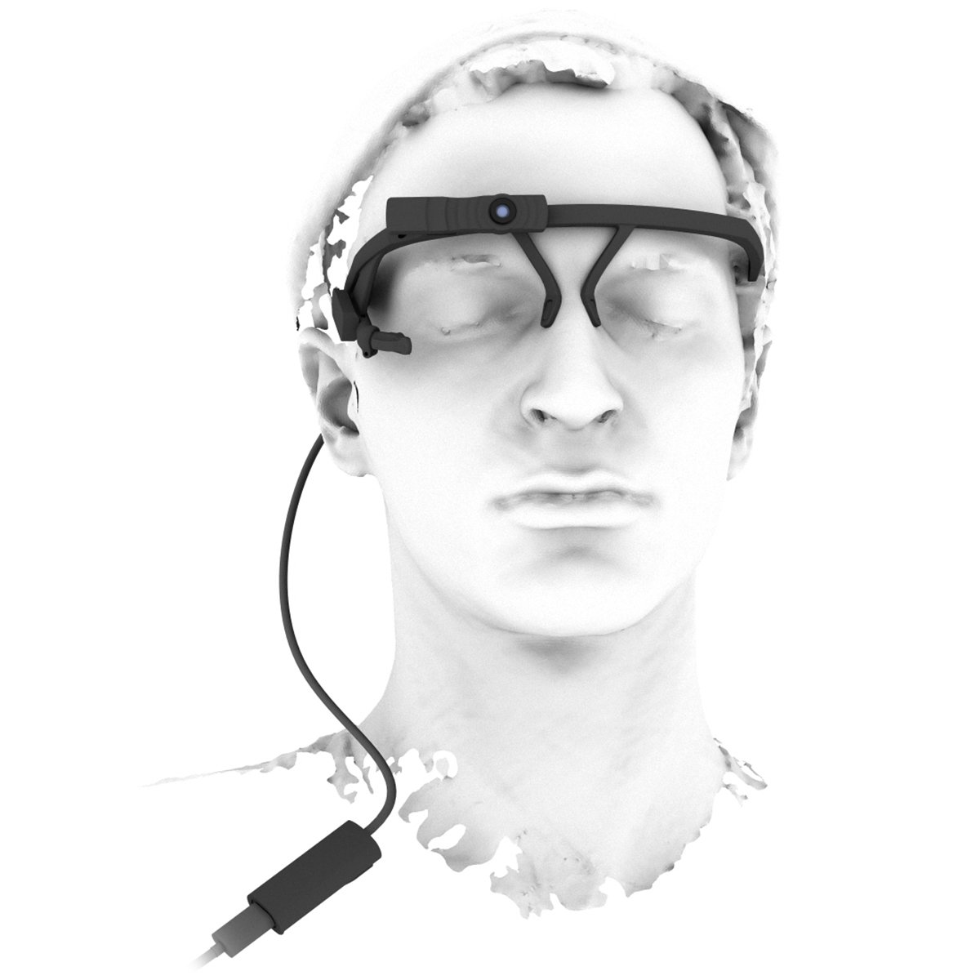
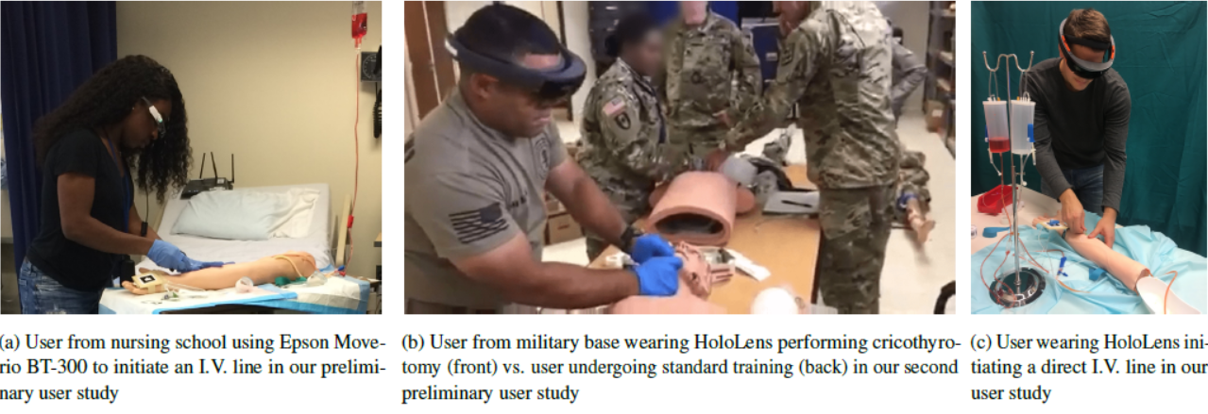
HMD-Based Eye-Gaze Analysis in Performing Medical Procedures
Studies have shown that knowing where to look would improve overall surgical performance of residents more than by receiving verbal feedback from an instructor or just watching the video.
Recording eye motions in surgical environments is challenging. we can use head-mounted, eye-trackers to give more freedom to the surgeons.
We recently evaluated the benefits of using HMDs for training of caregivers in an emergency medical environment.
The ultimate objective of this project is to incorporate eye-tracking technologies into the field of surgical education in order to improve skills of surgeons performing procedures.
© 2018 Intuitive Surgical, Inc.

Slide 2
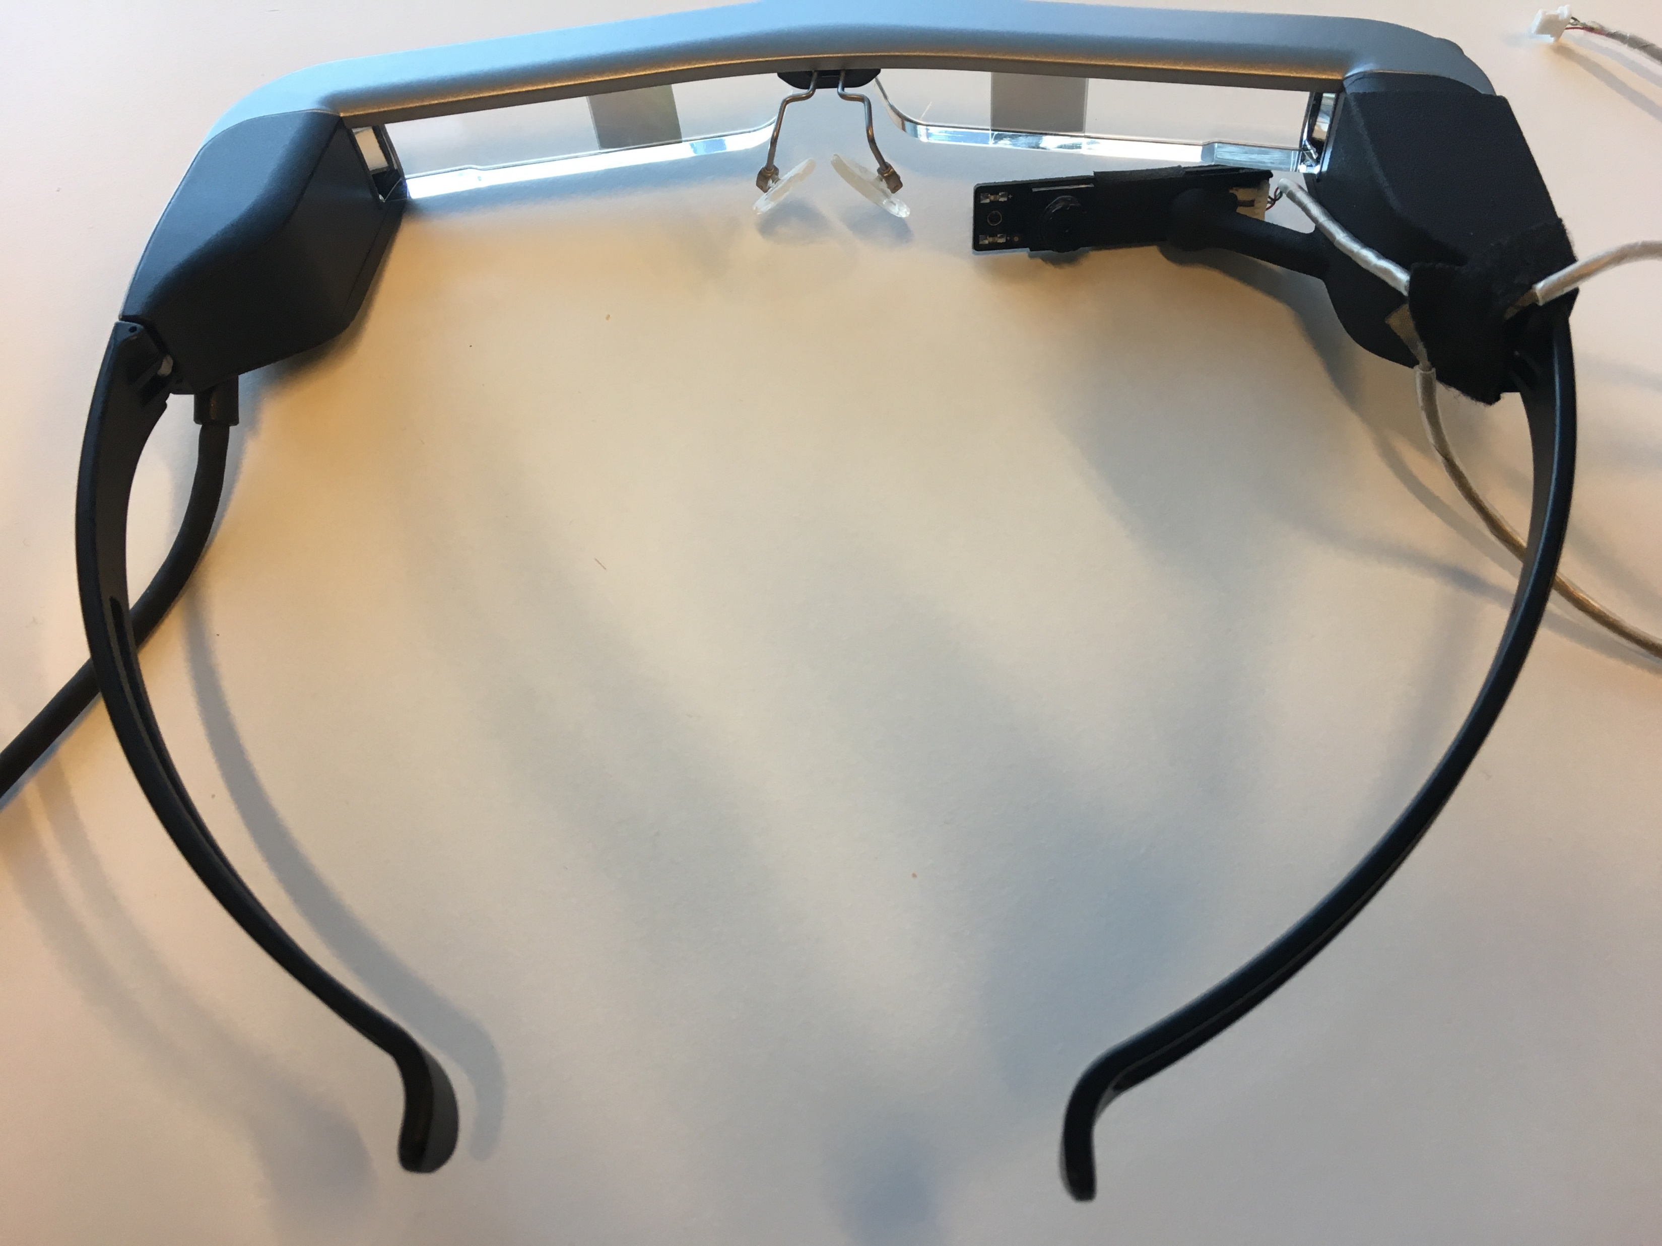
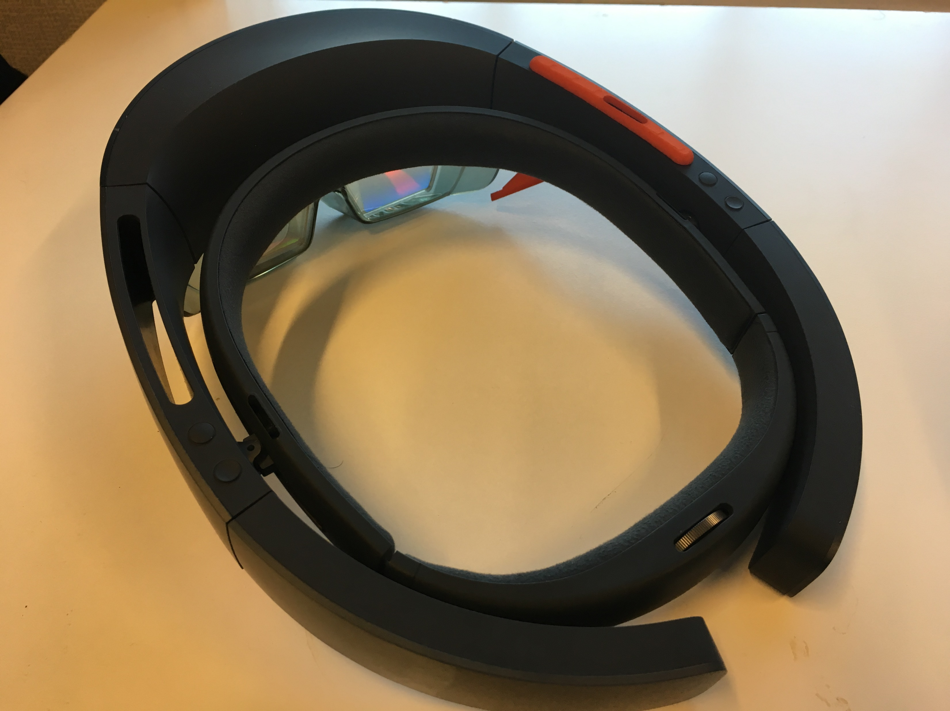
HMD-Based Eye-Gaze Analysis in Performing Medical Procedures
What Students Will Do:
Develop software platform that generates intensity heatmap of the user’s gaze for HoloLens on the 2D screen and in the 3D environment
Store and analyze gaze patterns for different users
Calibration and integration with the HMD (HoloLens)
(Optional) Perform a user-study to assess the correlation of gaze with expertise in a task

Slide 3
HMD-Based Eye-Gaze Analysis in Performing Medical Procedures
Deliverables:
Software that generates intensity heatmap based on the intensity of users’ eye-gaze in a time frame
Software that shows the surgeon’s eye-gaze while performing a task, to the trainees in real-time and saves it for possible synchronized playback.
(Optional): A user study to investigate the correlation of eye-gaze data with expertise
Size group: 2 (3 if user study is in the deliverables)
Skills: Experienced in at least one language: Python or C++ or C#, Unity3D
Mentors: Ehsan Azimi (eazimi1@jhu.edu), Dr. Chien-Ming Huang, Dr. Peter Kazanzides, Dr. Nassir Navab, Dr. Russ Taylor

