Slide 1
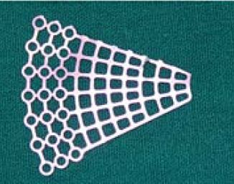
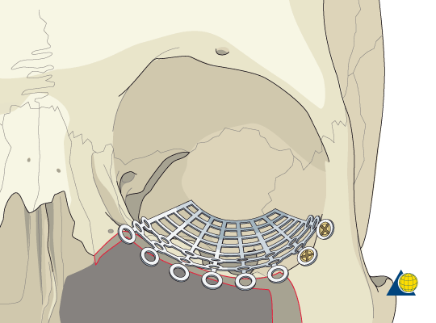
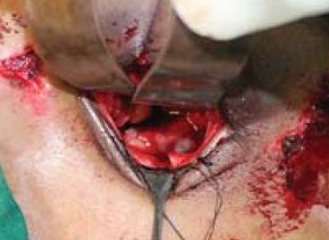
Navigation for Orbital Floor Fracture Repair
To reconstruct orbital floor fractures, the surgeon must compress and retract the eyeball and dissect through a small incision to place a metal plate beneath the eye
The goal is to introduce CT-guided navigation
What Students Will Do:
Develop registration method, using points collected from inferior orbital rim and posterior orbital floor (TRE < 2 mm)
Implement pivot calibration for hemostat/implant
Provide navigation guidance (implant wrt CT)

Slide 2
Navigation for Orbital Floor Fracture Repair
Deliverables:
Point/surface registration method for orbital socket
Calibration of implant wrt tracked hemostat
Application to visualize position of tracked implant wrt CT
Size group: 2-3 students
Skills: Programming registration, calibration, and visualization (e.g., C++ or Python modules in 3D Slicer, Unity on HMD)
Mentors: Ehsan Azimi (eazimi1@jhu.edu), Peter Kazanzides (pkaz@jhu.edu), Dr. Cecil Qiu, Dr. Sashank Reddy
Attach markers to track hemostat

