Slide 1
REMS Articulating Microvascular Needle Driver
The Robotic ENT Microsurgery System (REMS) is novel surgical robot developed in the LCSR for use in Head & Neck Surgery. We we wish evaluate its potential within microvascular surgery but lack adequate REMS-adapted instrumentation to do so.
What Students Will Do: Adapt a typical freehand microvascular needle driver for use with the REMS, or create a novel instrument utilizing parts from typically used microvascular needle drivers. May build on prior work and designs .
Deliverables:
Interval CAD drawings of potential designs for the instrument/adaptor
Working instrument at the completion of the course that integrates with the REMS and can manipulate microvascular grade suture.
Size group: 1-2
Skills: CAD, mechanical engineering
Mentors:
Christopher Razavi, MD & Shaun Desai, MD – Otolaryngology Head & Neck Surgery
crazavi1@jhmi.edu

Slide 2
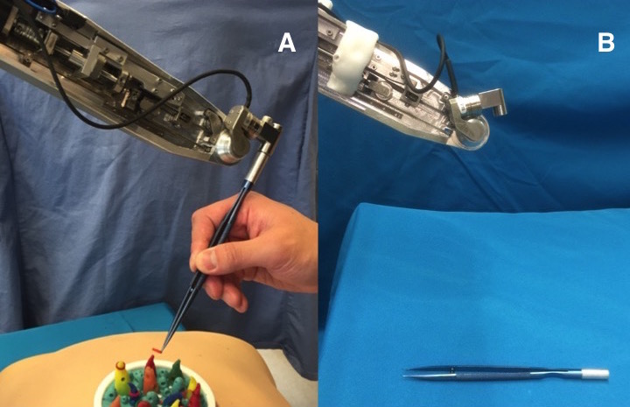
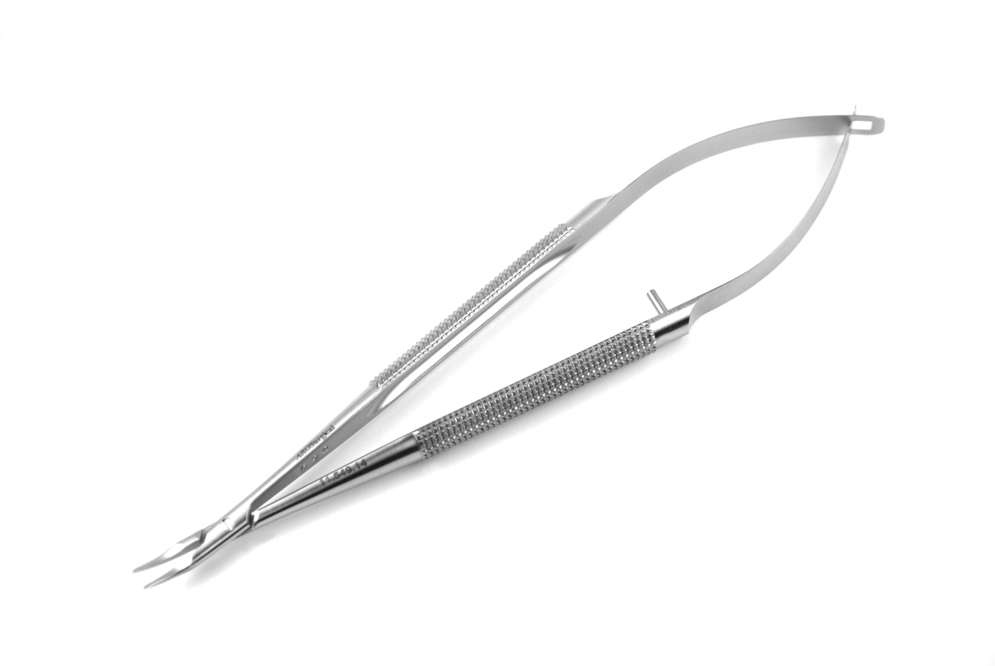
REMS Articulating Microvascular Needle Driver
Top image demonstrates a prior iteration of this tool. We would like to adapt the bottom tool to articulate with updated model of the REMS.

