Slide 1
Big Data Meets Medical Physics Dosimetry
Fumbeya Marungo, Hilary Paisley, John Rhee
Dr. Todd McNutt
Dr. Scott Robertson

Slide 2
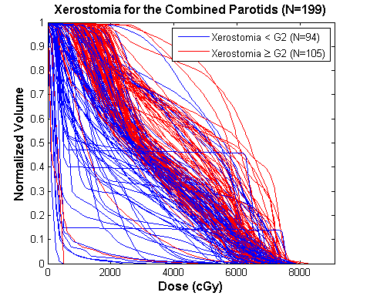
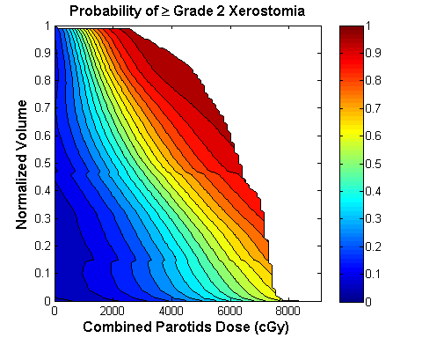
Topic
Radiation dosimetry is planning the placement and intensity of radiation doses for oncology treatment.
Often, planning uses many simplifying assumptions and does not include additional data within the patient’s record.
Uniformity assumption leads to a simplified view of side effect risk
Images courtesy of Dr. Todd McNutt,
Dr. Scott Robertson

Slide 3
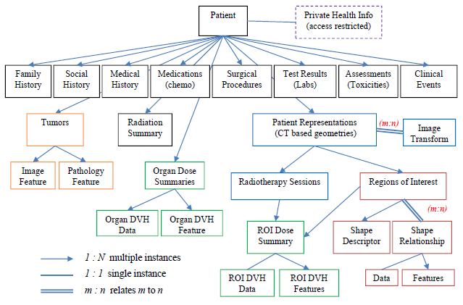
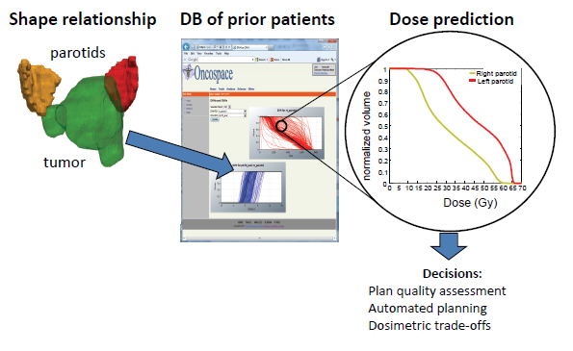
Goal
Use “Big Data” analytics techniques to create a toxicity (side effect) risk model(s) by exploring the diverse information within the Oncospace database.
Ultimately, patients benefit from the lessons of previous outcomes.
Big Data + Medical Physics = Safer, more effective treatments
Images courtesy of Dr. Todd McNutt,
Dr. Scott Robertson

Slide 4
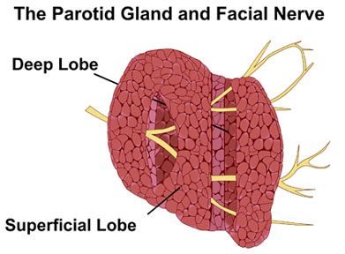
Importance and Relevance
Example – Irradiation of the parotid gland can lead to xerostomia, i.e. severe dry mouth.
The uniformity assumption does not account for the gland’s complex structure.
Big Data + Medical Physics = Safer, more effective treatments
Images courtesy of Dr. Todd McNutt,
Dr. Scott Robertson

Slide 5
Importance and Relevance
Example – Irradiation of the parotid gland can lead to xerostomia, i.e. severe dry mouth.
Oncospace has 3-D dosage data.
Big Data + Medical Physics = Safer, more effective treatments
Images courtesy of Dr. Todd McNutt,
Dr. Scott Robertson

Slide 6
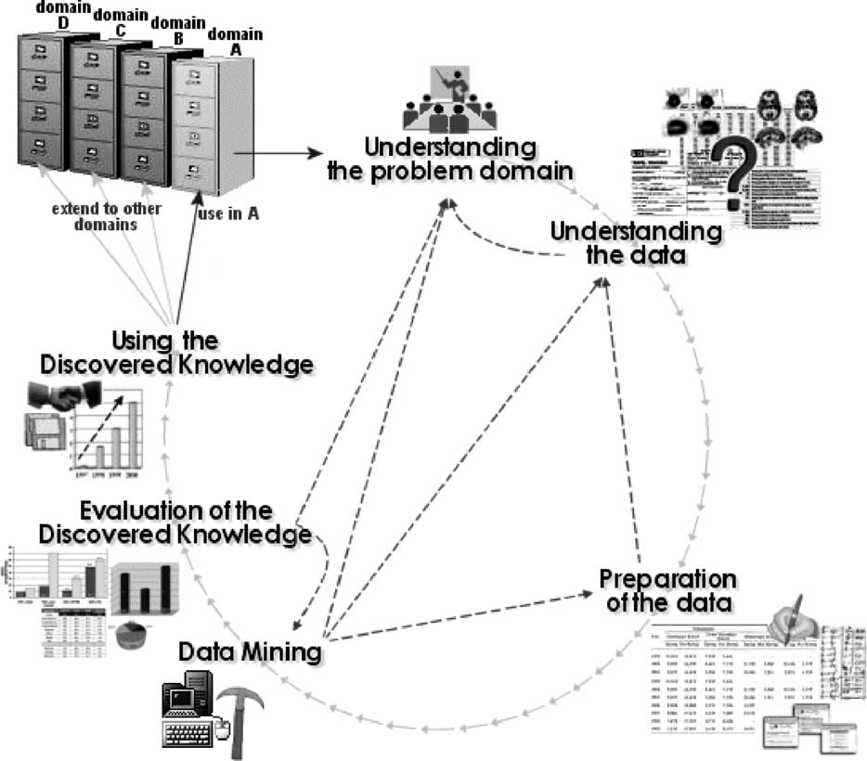
Technical Approach
We use a standard interactive Data Mining and Knowledge Discovery Process (Cios et al. 2002).
Early and late portions of the process requires a great deal of input from mentors.
Image from (Cios et al. 2002)

Slide 7
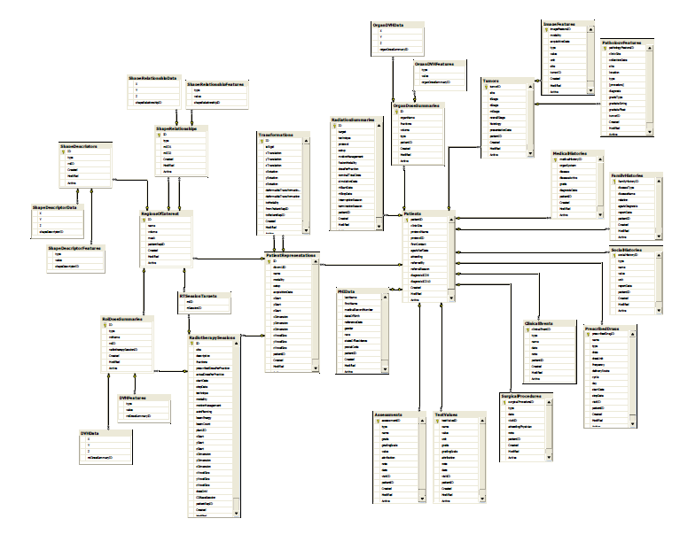
Technical Approach
Understanding the data, and the problem domain are key:
The data model chart is just the beginning.
Beware of terms of art.
The chart tells how, not what, to query
Not quite a histogram
Images courtesy of Dr. Todd McNutt,
Dr. Scott Robertson

Slide 8
Technical Approach
Primary Technologies:
Microsoft SQL Server – Database server for Oncospace and Data Sandbox.
Weka – Open-source data mining software.
Git – Source control software.
Matlab – Scientific software
Java 7 – Weka, and Matlab are native Java applications.
Javadoc – Software documentation
Secondary/Optional:
Python
Groovy and/or Jython --- Java-platform scripting languages

Slide 9
Deliverables: Block Diagram
Data Cleaning
Data Sandbox
Data Mining
Algorithm
Result
OncospaceB
Data Preparation
Deliverables:
Min
Expected
Max
Generalization

Slide 10
Deliverables
Minimum:
A data mining algorithm(s) that is callable from Matlab that accepts a treatment plan and additional clinical data and outputs a risk measure for a specific toxicity.
Software that cleans and transforms data from Oncospace into a format acceptable to the algorithm.
Performance assessment of the algorithm.
Expected:
Algorithm meets acceptable performance levels.
Maximum:
Generalize process to create risk measure on one or more additional toxicities.

Slide 11
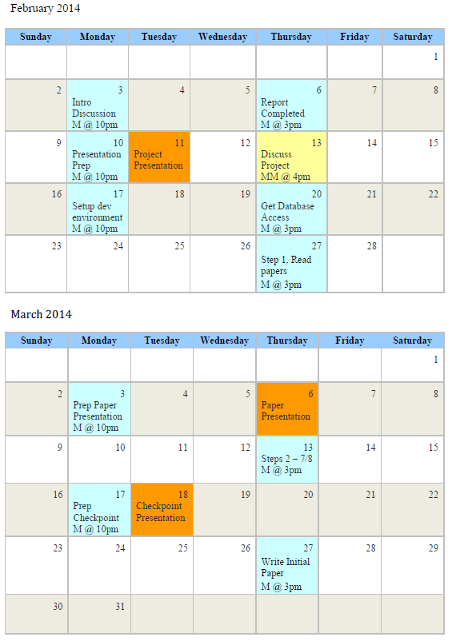
Key Dates (Feb-Mar)

Slide 12
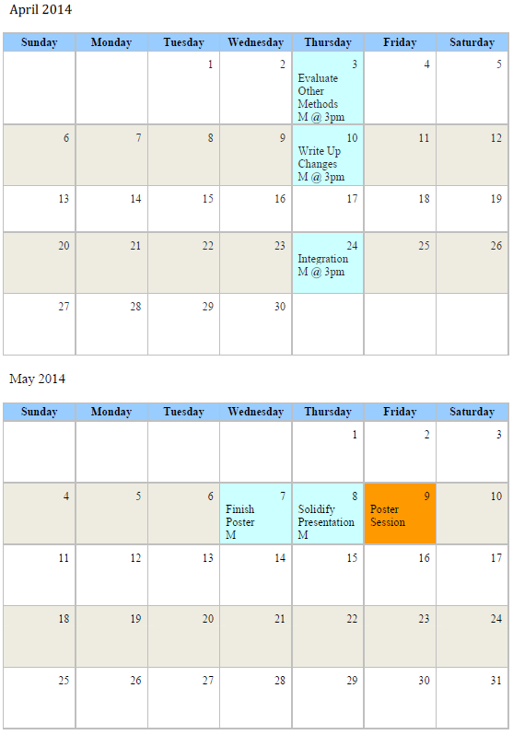
Key Dates (Apr-May)

Slide 13
Tasks and Critical Dependencies
Task No. | Task | Duration | Start | End | Critical Dependencies
1 | Select Project | 3 days | 28-Jan-14 | 30-Jan-14 | None
2 | Project Planning Presentation | 1 day | 11-Feb-14 | 11-Feb-14 | None
3 | Project Planning Report | 1 day | 17-Feb-14 | 17-Feb-14 | None
4 | Project Planning | 11 days | 3-Feb-14 | 17-Feb-14 | None
5 | Setup Development Environment | 6 days | 6-Feb-14 | 13-Feb-14 | None
6 | Literature Review | 14 days | 11-Feb-14 | 28-Feb-14 | Input from mentors
7 | Database Access | 1 day | 13-Feb-14 | 13-Feb-14 | Input from mentors, Support JHH IT
8 | Target Database Access | 1 day | 13-Feb-14 | 13-Feb-14 | Support JHH IT
9 | Develop Target Database | 14 days | 17-Feb-14 | 6-Mar-14 | Input from mentors
10 | Meeting with mentors | 1 day | 20-Feb-14 | 20-Feb-14
11 | Begin Preparing Paper Seminar | 10 days | 20-Feb-14 | 5-Mar-14 | Task 6, Input from mentors
12 | Data Clensing and Preprocessing | 9 days | 24-Feb-14 | 6-Mar-14 | Task 9, Input from mentors
13 | Meeting with mentors | 1 day | 27-Feb-14 | 27-Feb-14
14 | Paper Presentation | 1 day | 6-Mar-14 | 6-Mar-14 | Task 11
15 | Data Reduction and Transformation | 14 days | 6-Mar-14 | 25-Mar-14 | Task 12
16 | Meeting with mentors | 1 day | 10-Mar-14 | 10-Mar-14
17 | Meeting with mentors | 1 day | 14-Mar-14 | 14-Mar-14
18 | Data Mining | 11 days | 13-Mar-14 | 27-Mar-14 | Task 15, Input from mentors
19 | Check Point Presentation | 1 day | 18-Mar-14 | 18-Mar-14
20 | Assess Models | 16 days | 20-Mar-14 | 10-Apr-14 | Task 18, Input from mentors
21 | Writing Report | 37 days | 20-Mar-14 | 9-May-14 | Task 20
22 | Integrate Software | 17 days | 10-Apr-14 | 2-May-14 | Task 20
23 | Work on Poster | 21 days | 11-Apr-14 | 9-May-14 | Task 20
24 | Poster Day | 1 day | 9-May-14 | 9-May-14 | Task 23

Slide 14
Management Plan (Feb-Mar)

Slide 15
Management Plan (Apr-May)

Slide 16
Dependencies
Critical Dependencies:
Must be done. Team’s project manager responsible for insuring these are met.
Non-critical Dependencies:
Not necessary, but will speed progress.
Allotment of ~$750 per team member for book, software licenses, etc.
On site workstation(s)

Slide 17
Team Member Responsibilities
General Responsibilities:
Semi-weekly meeting.
Ad hoc meetings as necessary.
Roles:
Fumbeya Marungo, Team Lead.
Hilary Paisley, Project Manager.
John Rhee, Software Engineer.
Task Responsibilities:
A “Surgical Team” approach (Brooks, 1995). Tasks are assigned and agreed upon during the regular meetings.

Slide 18
Initial Reading List
Quantitative Analyses of Normal Tissue Effects in the Clinic (QUANTEC). Bentzen et al. 2010.
Use of Normal Tissue Complication Probability Models in the Clinic. Marks et al. 2010
Uniqueness of medical data mining. Cios et al. 2002.
Novel approaches to improve the therapeutic index of HN RT. Buettner et al. 2012
Volume effects and region-dependent radio-sensitivity of the parotid gland. Konings et al. 2005.
Predictive data mining in clinical medicine - Current issues and guidelines. Bellazzi et al. 2006.
Vision 20-20 - Automation and advanced computing in clinical radiation oncology. Moore et al. 2013.
Mythical Man-Month, The: Essays on Software Engineering, Anniversary Edition. Brooks 1995.

Slide 19
Thank You
Dr. Todd McNutt, Mentor
Dr. Scott Robertson, Mentor
Dr. Russell Taylor, Instructor
CIS II Classmates…

