Slide 1
Feasibility of Statistical Shape Analysis in Congenital Heart Disease (CHD)
Feasibility of Shape analysis in CHD to assess right and left ventricular mechanics and correlate with clinical outcomes.
Patient population
Tetralogy of Fallot
Bicommissural aortic valve
Project goal (role of students):
Develop efficient and automated RV and LV segmentation of existing cardiac MRI images
Use 10-15 patients in each patient group
Compare predictive model with outcomes:
Angiographic outcome data including stent size used in Tetralogy patients
Aortic regurgitation, need for valve intervention etc in bicommissural aortic valve
Develop models for virtual reality (VR) visualization for surgical planning

Slide 2
Feasibility of Statistical Shape Analysis in Congenital Heart Disease (CHD)
Deliverables:
Develop/utilize an efficient and automated segmentation tool utilizing existing cardiac MRI images
Develop a statistical shape atlas of LV and RV in BAV and Tetralogy of Fallot respectively
Size group: 3 students
Skills: MATLAB programming
Mentors:
Bharath Ambale Venkatesh (bambale1@jhmi.edu)
Lasya Gaur (lgaur1@jhmi.edu)
Shelby Kutty (skutty1@jhmi.edu)

Slide 3
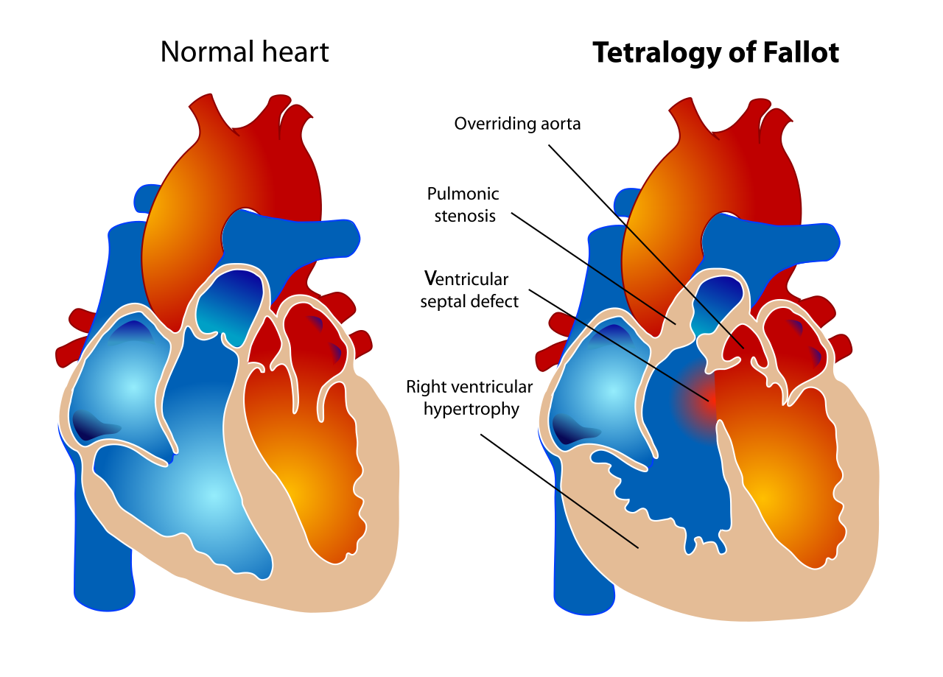
Tetralogy of Fallot (background)
Congenital heart defect
Defect primarily consists of a ventricular septal defect with various degrees or levels of right ventricular outflow obstruction
Correction is surgical repair in infancy: VSD patch closure. Relief of pulmonary outflow obstruction is expansion of the right ventricular outflow or the pulmonary valve annulus.

Slide 4
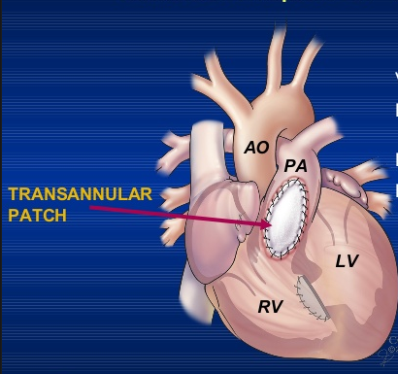
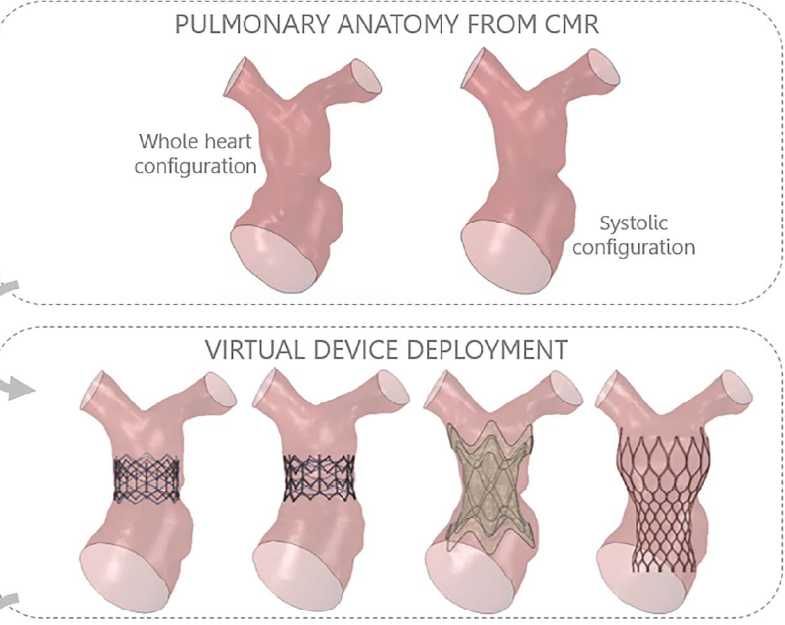
Tetralogy of Fallot – surgical repair
A patch placed across the annulus (transannular patch) relieves obstruction BUT results in pulmonary insufficiency (PI)
PI is well tolerated in childhood, but typically requires pulmonary valve replacement (PVR) in late adolescence/early adulthood.
Traditional PVR is surgical, however recent transcatheter approaches have been developed to avoid surgical risks/complications
Transcatheter approach is limited by appropriate patient selection – difficult to predict how the implanted stented valve will “fit” into RVOTs of different shapes/sizes
Bosi GM, Capelli C, Khambadkone S, et al. Patient-specific finite element models to support clinical decisions: a lesson learnt from a case study of percutaneous pulmonary valve implantation. Catheter Cardiovasc Interv 2015;86:1120–30.

Slide 5
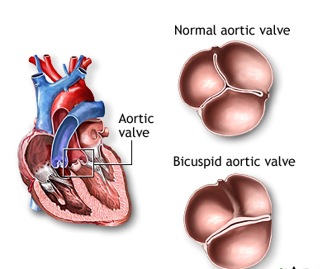
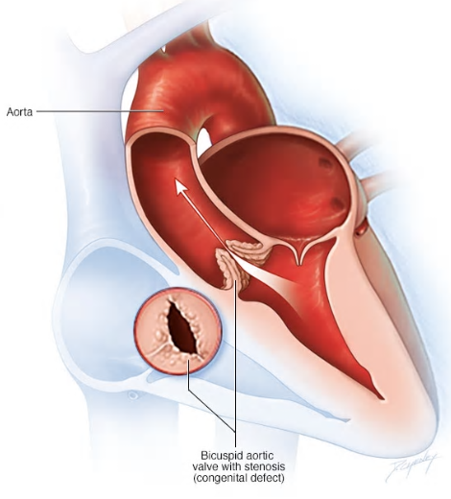
Bicommissural aortic valve (BAV) - background
Most common congenital heart abnormality, with 1–2% prevalence, and 3:1 predominance in males
Clinically heterogeneous disorder
Leads to Aortic valve stenosis (AS)/aortic regurgitation (AR) and progressive aortic dilation
Chronic pressure overload of AS and volume overload of AR are known to impair the left ventricular (LV) systolic and diastolic function
Effect on ventricular mechanics is unknown in the setting of normal ejection fraction, although subtle systolic markers of function (strain) may be impaired
Shape analysis may correlate with overall outcomes, including progression
2
3
3 leaflets
1
2 leaflets

Slide 6
References/Suggested reading
Al Habib, HF, Jacobs, JP, Mavroudis, C, et al. Contemporary patterns of management of tetralogy of Fallot: data from the Society of Thoracic Surgeons Database. Ann Thorac Surg 2010; 90: 813–819
Biglino G, et al. Computational modelling for congenital heart disease: how far are we from clinical translation? Heart 2017;103:98–103.
Jolley MA, Lasso A, Nam HH, et al. Toward predictive modeling of catheter-based pulmonary valve replacement into native right ventricular outflow tracts. Catheter Cardiovasc Interv. 2018;1–10
Sophocleous F, Biffi B, Milano EG, Bruse J, Caputo M, Rajakaruna C et al. Aortic morphological variability in patients with bicuspid aortic valve and aortic coarctation. Eur J Cardiothorac Surg 2018

