Slide 1
Prototype of a Microsurgical Tool Tracker
Team 5
Yejin Kim
Partner: Sue Kulason
Mentors: Marcin Balicki, Balazs Vagvolgyi, Russell Taylor
600.466 Advanced Computer-Integrated Surgery
Notes:
Hello I’m ____ and this is my partner _______
Our mentors are Marcin, Balazs, and Dr. Taylor.
We’re team 5, working on a prototype of a microsurgical tool tracker for eye surgery.

Slide 2
Outline
Result
Experiments
Paper Choice
Critique
Conclusion and Future Work
Background
Technical Summary
Project Summary
Specific Aims
Notes:
Update on our project
-refresh you with our project summary
-talk about project goals (specifically the deliverables, aims and significance)
-then move into our progress and revisions
-dependencies
-milestones
-key papers we’ve read

Slide 3
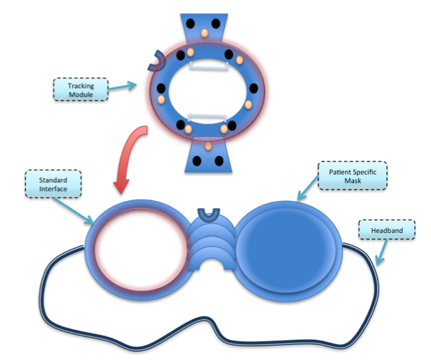
Project Summary
Problem: A need for tool tracker in eye surgery
Assess surgical performance
Ensure proper protocol
Project Goal: Micro-Surgical Tool Tracker
Build a prototype of a goggle
Provide positional feedback
Figure 1. Idea proposed by Marcin Balicki
Result
Relevance
Aims & Significance
Experiment
Anlaysis
Conclusion
Project Summary
Paper
Notes:
As you may remember, there is a need for a microsurgical tool tracker in eye surgery in order to
-assess surgical performance
-ensure proper protocol
There is a high number of incorrect procedures (1.8 in every 1000) due to a lack of a tool tracker specialized for micro-surgical needs.
Tool tracking has the potential to improve accuracy, precision, and efficiency of surgery.
The goal of this project is to build a prototype of this tool tracker that provides positional feedback.
On the right is a figure of the prototype concept provided by one of our mentors.
This project is meant to be a proof of concept for the advantages of such a micro-surgical tool tracker.

Slide 4
Aims & Significance
Specific Aims
Create a miniature tracking system for the eye
Track surgical instruments in real time
Utilize redundancy to reduce line-of-sight problems
Utilize fiducial markers on tools for identification
Evaluate tracking accuracy
Significance/Future Directions
Monitor surgical protocols
Surgical skill assessment
Improve surgical safety
Robot-assisted surgery
Adaptation to other micro surgeries
4
Result
Relevance
Aims & Significance
Experiment
Critiques
Conclusion
Project Summary
Paper
Notes:
The specific aims of this project is to create a miniature tracking system for the eye.
Specifically, we hope to track a surgical instrument in real time.
We will utilize redundancy to reduce line-of-sight problems by using 4 cameras.
We will utilize a fiducial marker on the tool and colored trocars to calculate orientation and identify objects
Finally, we will evaluate the tracking accuracy of the camera for
-static tool
-dynamic tool
-varying conditions such as occlusion and illumination
The positional feedback obtained from our microsurgical tool tracker has the following potential significance:
Monitor surgical protocol
incompatible tools
e.g. Lubricant must be added to eye during the surgery to keep the eye moist
Surgical skill assessment
increase efficiency of surgeons
Improve surgical safety
minimize tissue damage by providing collision warnings
e.g. novice surgeons hit lens (operating on retina) cataract
Robot-assisted surgery
provides info to robot to make safer and more precise
e.g. 2 robots rigid → tear eye: IRISS: Intraocular Robotic Inteventional and Surgical system
Adapt for cochlear surgery

Slide 5
Paper Choice
Title: Evaluation of the motion of surgical instruments during intraocular surgery
Authors: J-P Hubschman, J Son, B Allen, SD Schwartz, J-L Bourges
Published: Eye (2011) 25, 947-953. 2011 Marcilian Publishers
5
Result
Relevance
Aims & Significance
Experiment
Critiques
Conclusion
Project Summary
Paper
Notes:
Prototype Building
Milestones achieved

Slide 6
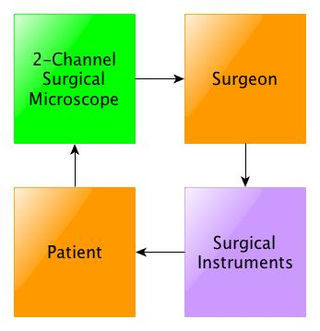
Traditional Ophthalmic Surgery
Disadvantages
Not very precise, accurate, or stable
Hand tremor
Narrow field of view
Poor decision making/judgment
Poor interpretation of qualitative data
Lack of information for OR staff
Based on schematics from [Pitcher et al]
Result
Relevance
Aims & Significance
Experiment
Critiques
Importance
Paper
Project Background
Notes:
Traditional ophthalmologic surgery consists of series of delicate surgical steps that require bimanual ability and great deal of concentration from surgeon.
During surgery, patient’s eye are amplified by the2-channel surgical microscope. Surgeon uses that information to make some decisions to move surgical instruments accordingly.
As you can imagine, there are some disadvantages to this standard technique.
Patient outcome is highly dependent on the surgeon’s skill. This is not very precise, accurate, or stable—particularly due to natural hand tremor.
Furthermore, the microscope provides a magnified view of the eye but limits the surgeon’s field of view.
This can lead to poor decision making and poor interpretation of data.
Ophthalmology surgery was found to have highest number of incorrect procedures occurring within the operating room in study connducted in 2009. It is also notable that ophthalmogoy is one of the few fields where robot assisted srgery have not been implmented yet.

Slide 7
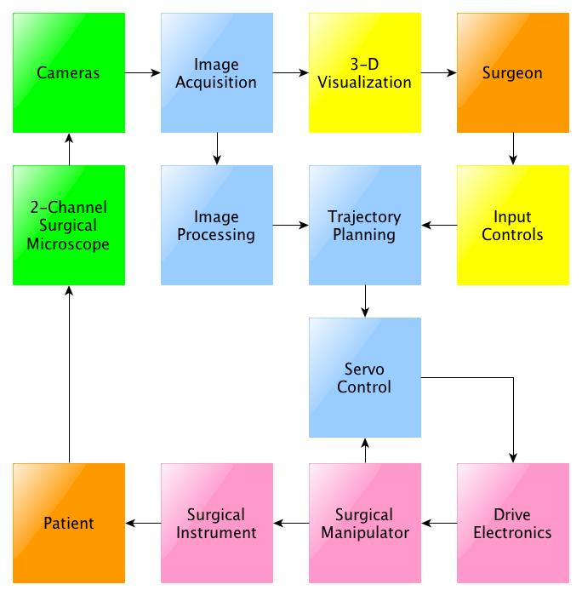
Robot-Assisted Surgery
Advantages
Precision, accuracy, stability
Amplified scale of motion
Reduced tremor
Automation
Association of imaging systems
Teleoperation
Based on schematics from [Pitcher et al]
Result
Relevance
Aims & Significance
Experiment
Critiques
Conclusion
Paper
Project Background
Notes:
Robot assited srugery where surgeons operates with the robotic surgical platform was proven to bebeneficial and has been a popular alternatie to traditonal method in many fields, such as cardiology and laparoscopy.
Some advantages of a robot-assisted surgery are
-increased precision, accuracy, and stability
-amplified scale of motion
-reduced tremor
-automation
-association of imaging systems
-teleoperation
Researchers in the study agrees that such robotic surgical systesecifcic to ophthalmologic proecuder could improve some limitations seen from a traditional method.
----- Meeting Notes (4/18/13 13:45) -----
Robot assisted surgery is already a popular aternatvie to traditonal method in many different fields such as cardiology and laparoscopy.

Slide 8
Technical Summary: Intent
Purpose: To analyze the motion of microsurgical tools and fulcrum during intraocular surgery.
Why: To determine the optimum remote center of motion for developing robotic surgical platform
8
Result
Relevance
Aims & Significance
Experiment
Critiques
Conclusion
Paper
Project Background
Notes:
The electromagnetic sensors were used to track the motion of all surgical tools and eye.
The team of researchers chose electromagnetic sensors over optic or inertial sensors because of their small size and their ability to provide data in a concentrated area. T
----- Meeting Notes (4/18/13 13:45) -----
Altho, the research team agrees on the benefits of surgical robots, there are several obstacles in making it reality.
The one main obstacle is determing a remote center of motion for the surgical syste. It is the point where all the tools will intersect. The first step to determine such point is analyzing the moition of surgical tools.

Slide 9
Technical Summary:
Electromagnetic Sensors
Used to track motion of five different surgical tools and fulcrum of the eye
Small in size
Works in a concentrated area.
9
Result
Relevance
Aims & Significance
Experiment
Critiques
Conclusion
Paper
Project Background
Notes:
The electromagnetic sensors were used to track the motion of all surgical tools and eye.
(Measures the magnetic field in one or more directions
Measures magnetic element that creates the magnetic field
The team of researchers chose electromagnetic sensors over optic or inertial sensors because of their small size and their ability to provide data in a concentrated area. T
----- Meeting Notes (4/18/13 13:45) -----
To move on to technical summary of the paper,
The research team uses..
fulcrum, which is the tool insert point at the eye,
concentrated area, such in eye environment duing surgery

Slide 10
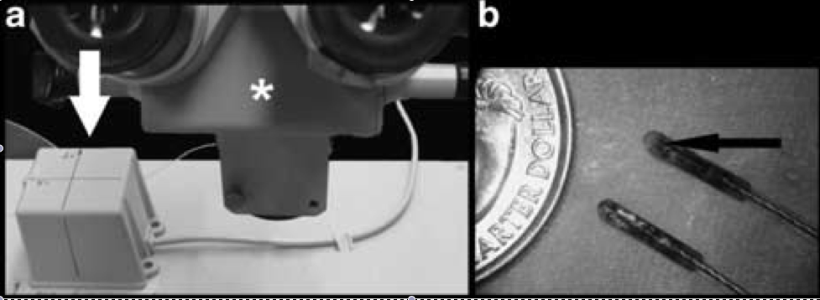
Technical Summary:
Reliability test to assure accuracy of result.
Short and long translation in all three axis.
Result were claimed near perfect.
Image from paper
10
Result
Relevance
Aims & Significance
Experiment
Critiques
Conclusion
Paper
Project Background
Notes:
--------
The sensors were tested for their reliability within the constrained box for short and long translations between two known pointes.
Each translation was performed 10 times to test repeatability.
Each set was repeated by two operators (O1: JLB; O2: JPH) within two separated sessions (A and B) to, respectively, test reproducibility across operators and reproducibility in time.
-----
Two sets of each translation was performed ten time. The result were claimed to be near perfect, hence reliable for evaluation.
Electromagnetic systems are sensitive when metallic objects are in the vicinity. Therefore, before carrying experimentations, the system was tested for reliability in order to obtain values, which served for further system calibration
The electromagnetic sensors were used to track the motion of all surgical tools and eye.
(Measures the magnetic field in one or more directions
Measures magnetic element that creates the magnetic field
The team of researchers chose electromagnetic sensors over optic or inertial sensors because of their small size and their ability to provide data in a concentrated area. T
----- Meeting Notes (4/18/13 13:45) -----
Before analyzing motion of tool, team conducted a...
test..withing a box..

Slide 11
Technical Summary: Set-up
Tools
Sensors
Control Unit
Porcine
Eyeball
1. Record raw data.
2. Convert raw data through Principal Component Analysis(PCA).
3. Outputs 90 positional measurement per second.
Magnet Source
To avoid magnetic field distortion.
11
Result
Relevance
Aims & Significance
Experiment
Critiques
Conclusion
Paper
Project Background
Notes:
The sensors were connected to the control unit, which outputs 90 positional measurements per secon
The active source of magnet used specific-pulsed DC signal to avoid any possible magnetic field distortion from metallic instrument near the testing environment.
In order to quantify performance of intraocular procedures,
The team set up a system where sensor will be tracking tools and fulcums, which is insert point of tool in eye.
The raw data are recorded from the sensor, and is converted through control unity by prinicpal component analysis.
The analysis then presents maximum range of rotational and translation angle that describes motion of toll and the eye.
----- Meeting Notes (4/18/13 13:45) -----
For motion analysis experiment,

Slide 12
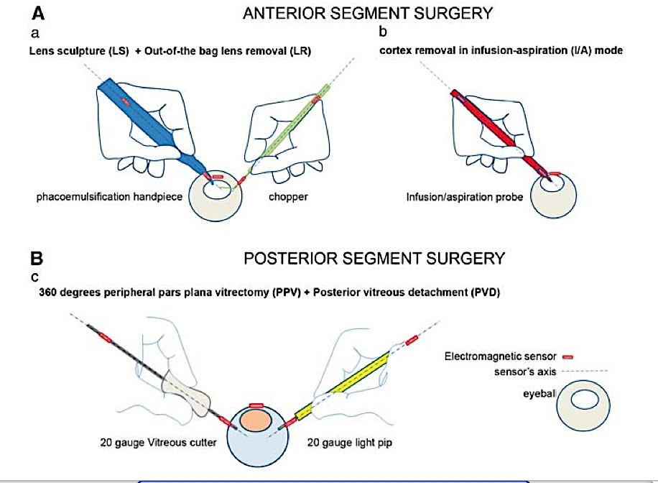
Technical Summary: Experiment
Image from paper
12
12
Result
Relevance
Aims & Significance
Experiment
Critiques
Conclusion
Paper
Project Background
Notes:
This test was done for two different intraocular procedures: anterior and posterior sement surgery. These two were divded into five different tasks for the measurement.
Total of five different tool were used and track, each had two electromagentic sensros attached 2.56cm and 7.5 cm away for the tip. The sensor was attached at the fulcrum to track motion of eyeball as well.
The study used fixated Styrofoam human head and porcine eye as phantoms.
Two intraocular procedures were divided into five surgical steps for the measurement. The recorded raw data from the sensors for each step were calculated through control unit by the principal component analysis (PCA) to find the angle of rotation and translation. Essentially, PCA, combined with the vector between the sensors and the calculated offset, presented a maximum range of rotational and translation angle for each microsurgical tools and the eye.
----- Meeting Notes (4/18/13 13:45) -----
The test was done in

Slide 13
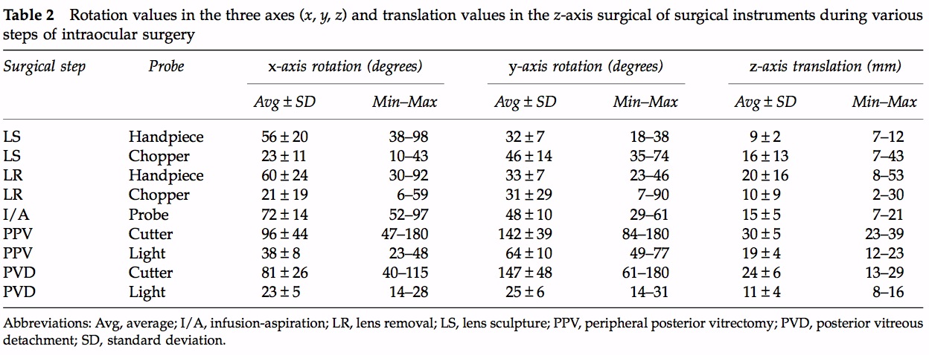
Technical Summary:
Result: Motion of Tools
Table from paper
13
Result
Relevance
Aims & Significance
Critiques
Conclusion
Paper
Project Background
Experiment
Notes:
The result showed that
the angle of rotation is dependent on a specific task among intraocular procedure, microsurgical tool used, and hand performing the task.
When using the same tool, maximum angle of rotation during the main task was always larger than during the ancillary task.
Furthermore, the dominant hand always had larger range of motion than the secondary hand.
These variations in range of motion imply that the optimum robotic surgical assistance should allow a different maximum range of motion for each instrument and surgical task.
----- Meeting Notes (4/18/13 13:45) -----
here is the tables of result, these lists angle of rotation/translation for all five tools and two procedures
i know this is a lot of information, i'll explain what it means later

Slide 14
Technical Summary:
Result: Motion of Eye
Table from paper
14
Result
Relevance
Aims & Significance
Critiques
Conclusion
Paper
Project Background
Experiment
Notes:
The result showed that
the angle of rotation is dependent on a specific task among intraocular procedure, microsurgical tool used, and hand performing the task.
When using the same tool, maximum angle of rotation during the main task was always larger than during the ancillary task.
Furthermore, the dominant hand always had larger range of motion than the secondary hand.
These variations in range of motion imply that the optimum robotic surgical assistance should allow a different maximum range of motion for each instrument and surgical task.
----- Meeting Notes (4/18/13 13:45) -----
this is a table of result for the movement of eyeball in x,y,z direciton

Slide 15
Technical Summary:
Conclusion
Optimum robotic surgical assistance should allow maximum range of motion for each instrument and surgical task.
Dependencies for Angle of Rotation &Translation
Microsurgical tool
Specific task Main task > Ancillary Task
Performing hand Dominant hand > Secondary hand
15
Relevance
Aims & Significance
Critiques
Conclusion
Paper
Project Background
Experiment
Result
Notes:
The result showed that
the angle of rotation is dependent on a microsurgical tool used specific task among intraocular procedure,, and hand performing the task.
When using the same tool, maximum angle of rotation during the main task was always larger than during the ancillary task.
Furthermore, the dominant hand always had larger range of motion than the secondary hand.
These variations in range of motion imply that the optimum robotic surgical assistance should allow a different maximum range of motion for each instrument and surgical task.

Slide 16
Future Work
More motion analysis with different intraocular procedures.
Comparison with motion analysis done with different sensors (optical, inertia, etc.)
16
Relevance
Aims & Significance
Critiques
Conclusion
Paper
Project Background
Experiment
Result
Notes:
As the next step, more motion analysis of different intraocular procedures may be beneficial because the range of motion seem to vary depending on tasks, tools and hand performing. Furthermore, tracking the motion using different sensors may be interesting. All results could be compared and verify the accuracy of collected range of angle in rotation. Finally, study in quantifying motion for extraocular procedures may be useful, to help determine remote center of motion of robotic system specific to eye surgery

Slide 17
Relevance
CIS Project Goal:
To build a device with sensors that output positional feedback of microsurgical tool during eye surgery.
Constraints for Design
Size of the camera
Field of view of the camera
Processing ability of the camera
Motion of the surgeon’s hands
Available area around the patient's eye
17
Relevance
Aims & Significance
Critiques
Paper
Project Background
Experiment
Result
Conclusion
Notes:
The goal of my project ‘prototype of microsurgical tool tracker’ is to provide a device with optical sensors rigidly attached that outputs positional feedback of the microsurgical tool.
Although optical sensors will be used, instead of electromagnetic sensor, to track surgical tools for my project, the paper is relevant in determining orientation of the optical sensors around the eye.
The placement of optical sensors, in my case mini endoscope camera with USB interface, is an important factor for effectively detecting the tool.
Sensors are required
to cover all necessary area around the eye but also
avoid any possible interference with the surgeon’s hand.
Therefore, the analysis in a motion of surgical tool and eyeball would have been useful for my project. Furthermore, the paper is relevant to my project because, in general, both foresee the potential and benefits of quantifying ocular surgical motions in improving quality of ophthalmic care. Such analysis could not only be used for designing highly useful robotic system but also could be used to determine surgical protocol that enhance surgical evaluation by allowing surgeons to assess and compare their performance.
----- Meeting Notes (4/18/13 13:45) -----
this paper is quite relevant to our project. as you know,
here are constraints for our design,

Slide 18
Relevance
CIS Project Goal:
To build a device with sensors that output positional feedback of microsurgical tool during eye surgery.
Constraints for Design
Size of the camera
Field of view of the camera
Processing ability of the camera
Motion of the surgeon’s hands
Available area around the patient's eye
18
Relevance
Aims & Significance
Critiques
Paper
Project Background
Experiment
Result
Conclusion
Notes:
The goal of my project ‘prototype of microsurgical tool tracker’ is to provide a device with optical sensors rigidly attached that outputs positional feedback of the microsurgical tool.
Although optical sensors will be used, instead of electromagnetic sensor, to track surgical tools for my project, the paper is relevant in determining orientation of the optical sensors around the eye.
The placement of optical sensors, in my case mini endoscope camera with USB interface, is an important factor for effectively detecting the tool.
Sensors are required
to cover all necessary area around the eye but also
avoid any possible interference with the surgeon’s hand.
Therefore, the analysis in a motion of surgical tool and eyeball would have been useful for my project. Furthermore, the paper is relevant to my project because, in general, both foresee the potential and benefits of quantifying ocular surgical motions in improving quality of ophthalmic care. Such analysis could not only be used for designing highly useful robotic system but also could be used to determine surgical protocol that enhance surgical evaluation by allowing surgeons to assess and compare their performance.
----- Meeting Notes (4/18/13 13:45) -----
our sensors need to cover all eye envirionmetn, but does not interfere with ....
analysis of the tool could give my team better idea to locate our four sensors.

Slide 19
Critique
Strength
Weakness
Clear purpose of the paper
High accuracy of the study
Repeatable method and set-up of the study
Result accounted for varying surgical tasks, tools and performing hand.
Tabulated result difficult to visualize.
Unhelpful in determining orientation of camera for my prototype.
Open-ended paper
19
Aims & Significance
Critiques
Paper
Project Background
Experiment
Result
Conclusion
Relevance
Notes:
Strength:
1. The purpose of the paper was very clearly explained.
2. Performing reliability testing for electro motion capture before the experiment is noteworth. It supports the accuracy of the result
3. The method and set-up for the study was thoroughly described. (repeatability)
4. Study took into account for more than one procedure, tool and hand.
Weakness:
The tables of angles are hard to visualize the motion to be useful for determining areas to avoid placing camera for my project.
The paper is very open-ended. It does not directly solve or lead to solve a problem that traditional ophtahlmologic surgery has
The quantified values listed were hard to visualize and did not help in determining the placement of camera for my project
----- Meeting Notes (4/18/13 13:45) -----
here is my critique on the paper.
i found ....

Slide 20
Questions?
20

Slide 21
Reference
Neily, Mills, et al. “Incorrect Surgical Procedures Within and Outside of the Operating Room.” Archives of Surgery 16 Nov. 2009: Vol. 144, No.11:1028-1034. Web. 12 Feb. 2013
J. D. Pitcher, J. T. Wilson, S. D. Schwartz, and J. Hubschman, “Robotic Eye Surgery: Past, Present, and Future,” J Comput Sci Syst Biol, pp. 14, 2012.
21
Notes:
Prototype Building
Milestones achieved

