Slide 1
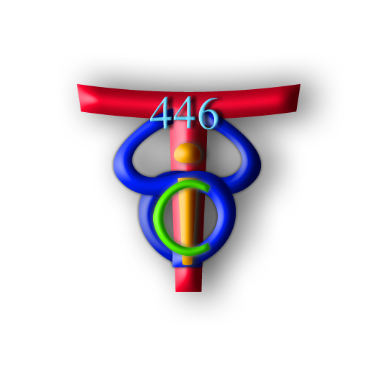
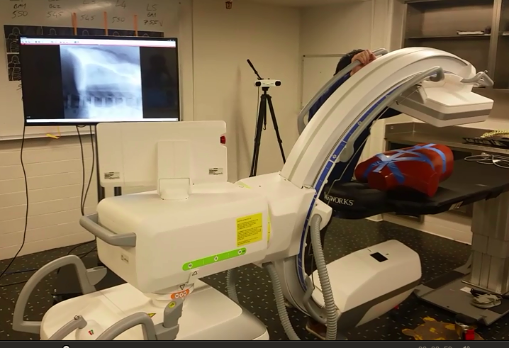
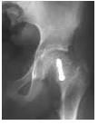
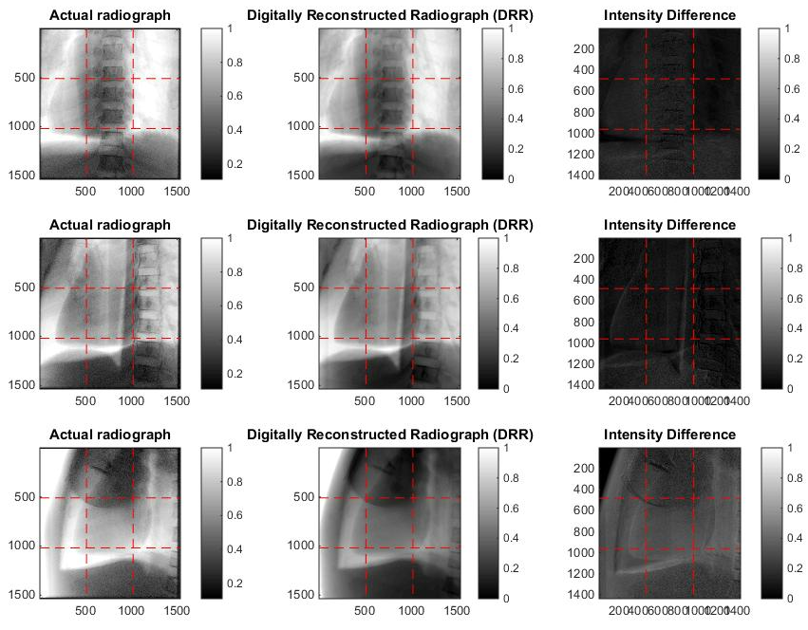
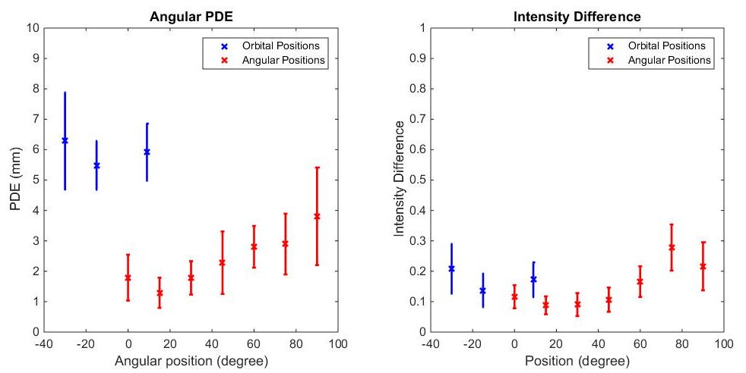
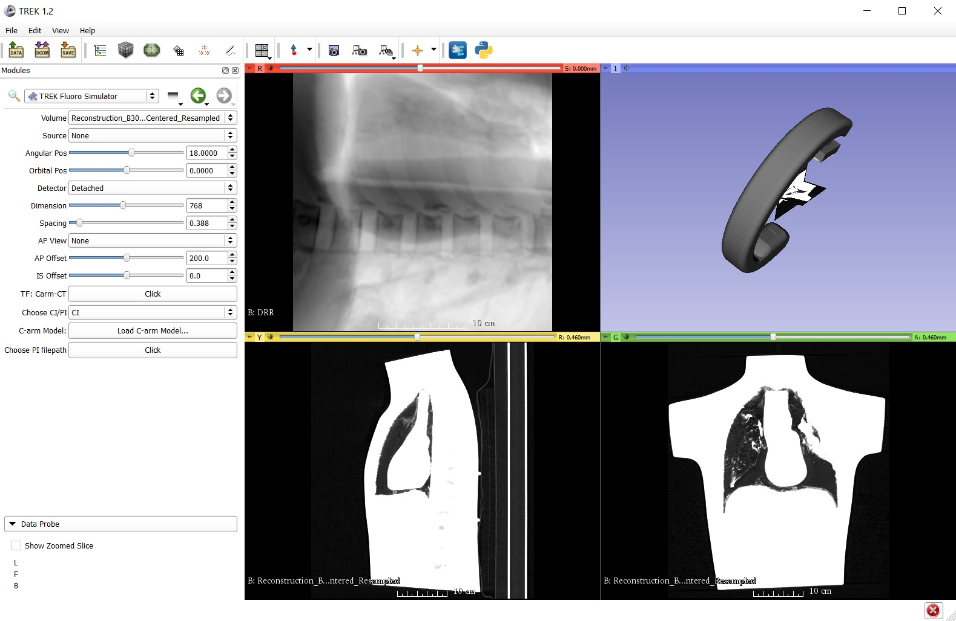
Fluoroscopy Simulation on a Mobile C-arm Computer Integrated Surgery II Spring, 2016 Ju Young Ahn, and Seung Wook Lee, (mentorship by Matthew Jacobson, Joseph Goerres, Tharindu De Silva, Ali Uneri, and Professor Jeff Siewerdsen)
Introduction
Use of a mobile C-arm in surgical procedures often requires surgeons to spend extra time and radiation to “hunting” for an optimal view of complex anatomy, joint spaces, and device trajectories.
Our solution is to develop a method to provide a real-time digitally regenerated radiograph (DRR) that accurately simulates the fluoroscopic view of a C-arm as it is positioned about the patient.
Outcomes and Results
Our system provides a simulated fluoroscopy similar to the actual view for purely angular and orbital movements over a broad range of orbit and angle.
Three main factors affect the geometric accuracy of the DRR view: (a) the registration of the patient and CT (computed via 3D2D registration); (b) the C-arm geometric calibration; and (c) the accuracy of the C-arm motors and encoders.
Results below show image similarity and projection distance error (PDE) for 10 orbital/angular positions. Overall positional accuracy is within a few mm.
(a)
(b)
Figure 1. (a) Example views of the femoral head from different views. (b) The mobile C-arm used in this project.
The Problem
In procedures involving C-arm fluoroscopy, such as orthopedic surgeries, surgeons need to position the C-arm to a view that captures well the anatomical features relevant to the surgical instrumentation and implants.
The process of “fluoro hunting” to find the optimal view is time-consuming, increases radiation exposure, and is dependent on individual skills.
Figure 3. Comparison between real radiograph (left), DRR (middle), and normalized intensity difference (right)
The Solution
We created a 3D Slicer module to compute a real-time DRR from a CT volume based on the C-arm position, defined digitally (by software UI) or physically (by moving the C-arm).
For the digital interface, when the user finds the preferred view, the C-arm pose is exported to the C-arm and driven to the desired pose via its motorized axes.
For the physical interface, the DRR is computed according to the pose read from the C-arm motor encoders.
Registration of the patient and CT volume is accomplished by 3D2D registration at the beginning of the case.
The DRR is computed using previously acquired geometric calibration of C-arm angular and orbital positions.
The Slicer interface shows the CT, DRR, and C-arm pose.
Figure 4. PDE (left) and intensity difference (right) as a function of angular/orbital positions of C-arm
Future Work
Provide accurate DRRs in mixed orbital/angular positions
Integrate registration algorithm and encoder output software with current module
Improve the accuracy of DRR generation with accurate geometric calibration.
Lessons Learned
Camera/CT projection geometry and experiences in software development using Python.
Importance of validation processes and communications
Importance of good documentation.
Credits
We worked together throughout the project.
All members participated in development of module within 3D Slicer, data collection, and validation of experimental results.
Support by and Acknowledgements
Thanks to staffs and mentors in I-STAR lab for valuable advices and providing 3D-2D registrations, geographical calibration, and software to read and write C-arm encoder values.
Figure 2. Module design with control panel, corresponding DRR, 3D rendering of the C-arm pose, and sagittal / coronal slices of the CT image.
Engineering Research Center for Computer Integrated Surgical Systems and Technology

