Slide 1
TEP Insufflator
Rahul Modi
Mentor: Dr. Jeremy Richmon
Project #10
February 6, 2014

Slide 2
Agenda
Background/Definition
Problem Overview
Project Goal and Next Steps
Deliverables
Dependencies
Management Plan
Assessment and Misc.
Key Dates
Technical Summary of Approach
Questions

Slide 3
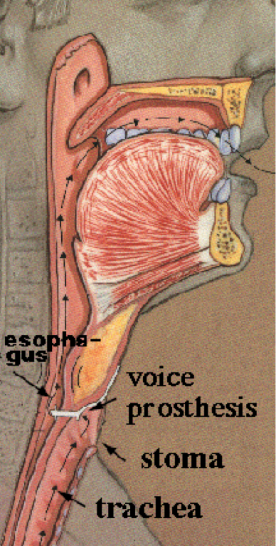
Background/Definition
Approximately 3,000 patients undergo laryngectomy annually in the U.S.
Laryngectomy is the removal of the larynx – common in smokers or those with oral cancer
General procedure calls for tracheostomy – a process where an incision is made in the patient’s neck. This is called the stoma
http://www.evmsent.org/trachesoph.asp

Slide 4
Background/Definition (Cont’d)
Tracheo-Esophageal Speech:
One of the most effective methods of generating speech in patients
During exhalation, air is diverted into esophagus, eventually flowing out of mouth, causing the esophagus to vibrate
To divert air into esophagus, a voice prosthesis is placed into the fistula to keep it open and prevent food from traveling down the trachea
http://www.evmsent.org/trachesoph.asp

Slide 5
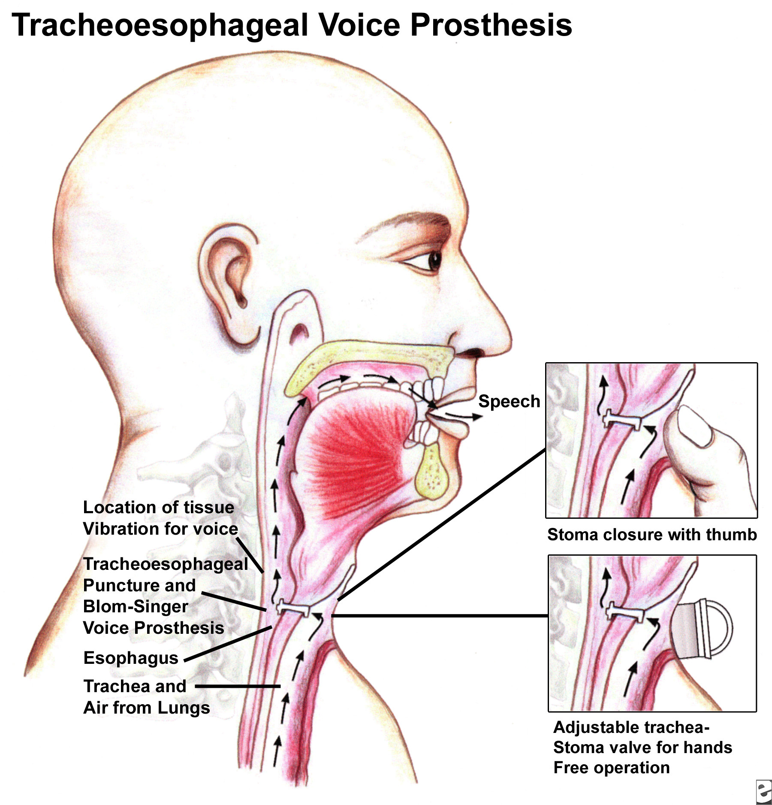
http://emedicine.medscape.com/article/2145329-overview

Slide 6
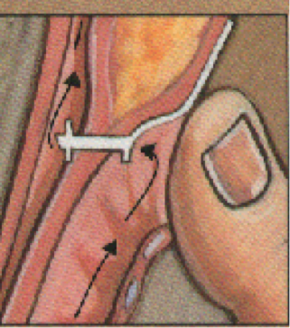
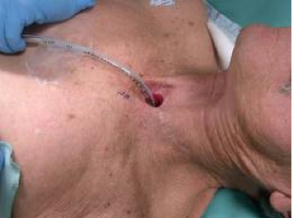
Problem Overview
Patient’s face difficulty for numerous reasons
Patient must cover the stoma when speaking. This has a social stigma and is uncomfortable
Not everyone’s anatomy allows for this as stoma walls could be too tight or loose
Food can easily travel into trachea causing issues
http://www.evmsent.org/trachesoph.asp

Slide 7
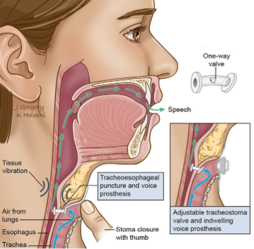
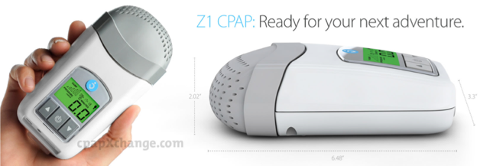
Project Goal and Next Steps
Develop an insufflator to allow patients to speak hands-free
This requires a constant air flow; hence, we will implement a CPAP device
Create a single on/off method for patient to enable/disable airflow
http://en.wikipedia.org/wiki/Laryngectomy
http://www.cpapxchange.com/cpap-machines-bipap-machines/z1-travel-cpap-machine-human-design-medical-hd60-1005.jpg

Slide 8
Deliverables
Minimum: create a method of attaching the CPAP device to the voice prosthesis
Expected: the minimum plus a method of constraining air flow via a valve on the CPAP device
Maximum: the expected plus a method of controlling the valve wirelessly

Slide 9
Dependencies
Dependencies
Access to mentor
Feedback from clinical trials on patients
Supplies
Connection adapters to connect CPAP to voice prosthesis
Purchased. Few modifications pending
Suction catheters
Sizing will depend on patient
Provided by Dr. Richmon
Money?

Slide 10
Management Plan
Weekly/bi-weekly meetings with Dr. Richmon
Clinical tests will allow for modifications
Adjustments to machine based on feedback
Completed
The minimum deliverable with few pending modifications
In process
The expected deliverable

Slide 11
Assessment and Misc.
Importance: project is of high importance as it helps patients rid of their discomfort and social barriers
Relevance: great for management purposes. Incorporates the invention, trial and error, and business application (such as patentability or IRB)
Good/Bad Points:
Intelligent logic that improves someone’s life using existing products
Minimal bad points: not fully customizable (yet)
Needs a method of changing suction catheter on device

Slide 12
Key Dates
Project start date of early December 2013
Expected deliverable due by end of this month
Dr. Richmon requires working prototype for clinical trials for IRB
Maximum deliverable due soon after

Slide 13
Technical Summary
Project currently midway in progress
Successfully connected CPAP to voice prosthesis
Next step is to implement a valve mechanism to allow the patient to enable/disable air flow from the CPAP using his thumb on the CPAP
Idea is that the patient’s thumb will cover at his/her waist level and eliminate need to cover stoma
To accomplish this, I will create a valve mechanism on the primary pipe attachment (grey cylinder) and occlude the suction catheter with a removable piece

Slide 14
Questions

