Slide 1
DVRK stereo camera calibration and model registration
Project Goal: Phantom placed in the camera view needs to be registered with the PSM robot.
First perform a hand-eye calibration to know the relationship between the camera and the robot.
Detect the phantom model in the camera view and register the model to the camera.
Final get the registration between the robot and the model.
Size group: 1-2
Skills:
C++, Matlab/Python.
Knowledge of ROS would be very helpful.
Image processing, Registration, Hand-Eye calibration
Mentors:
Preetham Chalasani (pchalas1@jhu.edu)
Anton Deguet (anton.deguet@jhu.edu)

Slide 2
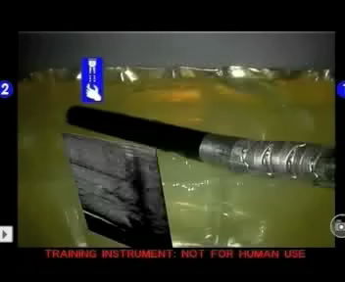
Force controlled elastography with DaVinci Toolkit
Project Goal: Use ultrasound elastography and Davinci Research Toolkit (DVRK) robot system to locate stiff features in a phantom.
Extend previous NIH-funded STTR with Intuitive Surgical
Incorporate force feedback & virtual fixtures based on current work
Deliverables
Integrate existing DaVinci ultrasound tool and ultrasound system to DVRK system in our laboratory (minimum deliverable)
Ultrasound imaging with force feedback (expected deliverable)
Ultrasound elastography with DVRK (maximum deliverable)
Size group: 2
Skills:
C++, ROS, Matlab/Python.
Prior experience in dvrk would be very useful.
Admittance Control, force motion control
Mentors:
Dr. Russell H Taylor (rht@jhu.edu)
Dr. Emad Boctor (eboctor@jhmi.edu)
Preetham Chalasani (pchalas1@jhu.edu)

Slide 3
Ultrasound Elastography with DaVinci (Boctor, Billings, Taylor)
Human-robotic collaboration for in-vivo detection of tumors
and monitoring of therapy
(Research DaVinci Application – Not for Human Use)

