Slide 1
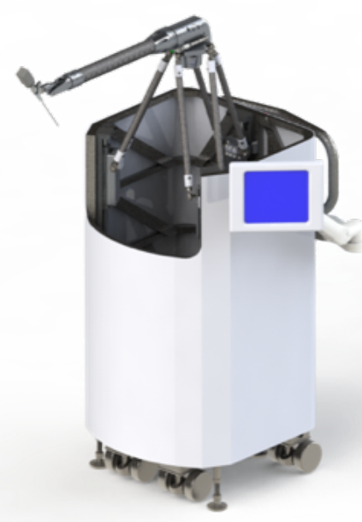
Surgical Tool Gravity Compensation for Galen Microsurgical Robot
What Students Will Do
Developing model (analytical or black-box) of the tool gravity in various configurations
If black-box modeling:
Data collection over the robot workspace
for various surgical tools
Developing a black-box model for
identifying the gravity model of the tools
Integrating the model into the control loop
of the Galen robot to compensate for the
tools’ dynamics

Slide 2
Deliverables
Minimum: Static model identification for surgical tools & demonstration on typical tool set for the Galen, i.e., given a tool and tool holder pose, predict the resulting 6 DoF forces and torques
Expected: Integration of gravity compensation into robot control software
Maximum: Development of methods for dealing with flexible tools or cable drag (e.g., adaptive modeling)
Group Size: 1-2
Skills: C++ and Python/MATLAB; Knowledge on ROS and shallow Neural Networks is a plus
Mentors: Dr. Mahya Shahbazi, Dr. Russell Taylor
Contact: mahya.sh@jhu.edu, rht@jhu.edu

