Slide 1
Project 11:Tool Tacking for Periacetabular Osteotomy using CamC
Presented by: Billy Carrington

Slide 2
Paper Title: Multi-modal Imaging, Model-based Tracking, and Mixed Reality Visualization for Orthopaedic Surgery
Written by: Sing Chun Lee, Bernhard Fuerst, Keisuke Tateno, Alex Johnson, Javad Fotouhi, Greg Osgood, Frederico Tombari, Nassir Navab
Chosen Because:
Deals with tool tracking
Uses an RGBD camera attached to a C-arm
Written by two of our mentors

Slide 3
Problem
Orthopedic Surgeries can be challenging due to reasons such as complex anatomy, limitations in screw starting point and trajectory and in some cases, slim margins of error. Therefore C-arms and fluoroscopic imaging is used to help surgeons. However sometimes multiple fluoroscopic images need to be taken during surgery which causes increased operation time and radiation exposure.

Slide 4
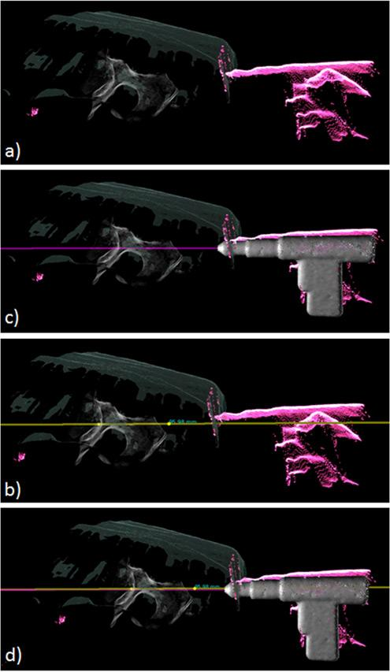
Solution
Intra-operative mixed reality visualization of 3D medical data, surgical site and tracked surgical tools.

Slide 5
Significance
Helps localize a starting point on their pre-operative planned trajectory
Reduces radiation to patient and operation time

Slide 6
Necessary Background
ICP
2D/3D registration
Image segmentation
calibration

Slide 7
The Process
Calibrate RGBD camera and cone-beam computed tomography (CBCT) space (find the frame transform between the two).
Use automatic 3D surface segmentation to get the tool segments
Use ICP to map the tool segments to the 3D model
Generate mixed reality to view the 3D model positioning from different angles
Tested using a pelvis phantom with radiopaque markers. Varied amount of occlusion to mimic clinical setting.

Slide 8
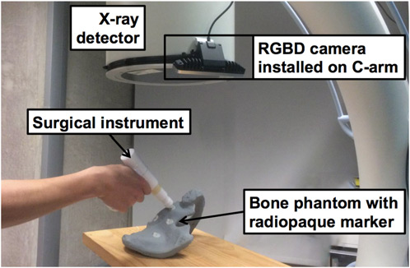
The Process

Slide 9
Assessment
Relevance
Tool tracking
Mixed Reality
Possible next steps
Improving accuracy of tracking so that it can be used for mor than just the starting point of the operation

