Slide 1
Efficient Global Mesh Alignment
Willis Wang - Group #12

Slide 2
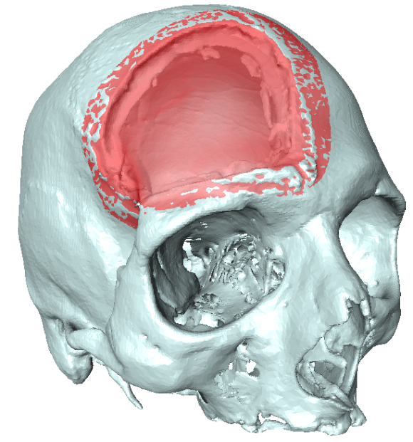
Project Review
Project Review
Overview
Background
Method
Results
Assessment
Conclusion
Using ground truth models of cranioplasty defects in order to determine accuracy, evaluate robustness, and improve upon patient registration.
Erica Schwarz - Group # 12
Mesh Simplification and Measures of Error

Slide 3
Seminar Overview
Project Review
Overview
Background
Method
Results
Assessment
Conclusion
Paper:
Yang, Jialong, Hongdon Li, and Yunde Jia. “Go-ICP: Solving 3D Registration Efficiently and Globally Optimally.” 2013 IEEE International Conference on Computer Vision (2013): n. Pag. Web.
Significance:
ICP is a very commonly used point set registration algorithm, but is incredibly prone to local minimas. As a result, the algorithm is not robust and cannot be fully automated.
Offers a robust algorithm that achieves global L₂ minima through use of Branch and Bound (BnB) implementation.
Relevance
Currently dealing with issues of local minima and initial seeding
Robustness and Automation are desired for streamlined operation during surgery

Slide 4
Background Information - ICP
Project Review
Overview
Background
Method
Results
Assessment
Conclusion
Iterative Closest Point is an algorithm for registering two point clouds under Euclidean transformation.
Minimizes L₂-error/point correspondence.
Error function defined as:
Can easily fall into a local minimum even if initialized closely to the global minimum.

Slide 5
Background Information - Branch and Bound
Project Review
Overview
Background
Method
Results
Assessment
Conclusion
Algorithm design paradigm for optimizing combinatorial problems
Creates possible decision branches and eliminates potential paths through bounding.
Before enumerating the candidates under each branch, the branch is checked against upper and lower bounds of current optimal solution.
Example: Trying to fit 10 pieces of luggage into the trunk of a car.
10! Combinations. Initially building the tree is clearly not a good idea.
Not all combinations are possible, so we prune the tree as we build it.
Set bounds. In this case it is the dimensions of the trunk.

Slide 6
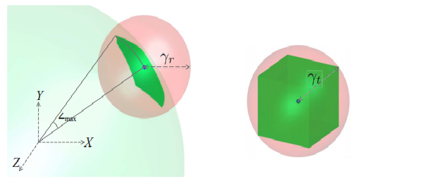
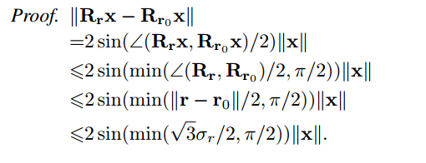
Method - Defining 3D bounds
Project Review
Overview
Background
Method
Results
Assessment
Conclusion
An area of uncertainty is first defined
A rotation cube and a translation cube are defined to enclose the domain of all feasible 3D motions.
This area is partitioned from an octotree into C_{r} and C_{t}.
||R_{r}x - R_{r0}x|| ≤ 𝛾_{r} = 2sin(min(sqrt(3)𝜎_{r}/2, 𝜋/2))||x||, where 𝜎_{r} is half of the side-length of the rotation cube
||t_{r} - t₀|| ≤ 𝛾_{t} = sqrt(3)𝜎_{t}

Slide 7
Method - Defining 3D bounds
Project Review
Overview
Background
Method
Results
Assessment
Conclusion
Upper Bound per-pixel error: Relatively trivial
This makes sense as we want to find a better solution than the one given.
Final Upper Bound:

Slide 8
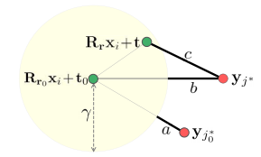
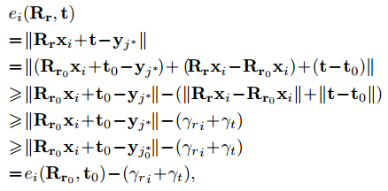
Method - Defining 3D bounds
Project Review
Overview
Background
Method
Results
Assessment
Conclusion
Lower Bound per-pixel error:
proof:
Final Lower Bound:

Slide 9
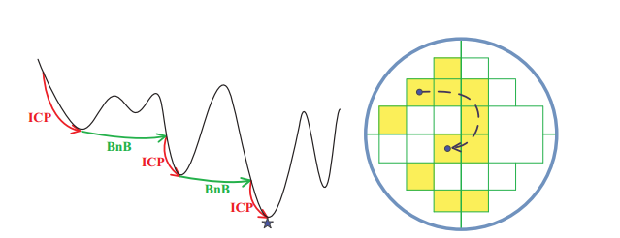
Method - Nested BnB
Project Review
Overview
Background
Method
Results
Assessment
Conclusion
The Branch-and-Bound algorithm is segmented into two parts: a rotation and translation aspect. A priority queue holds the cubes of uncertainty.
An outer BnB pulls the next lowest bounded cube from the priority cube and calls on an inner BnB to calculate its corresponding bounds and translation.
For a given C_{r}, the outer BnB uses the bounds listed above but with a lower bound of:
The inner BnB uses the original equations but with the uncertainty of rotation, 𝛾_{r}, set as 0.
If the returned upper bound is lower than the current optimal solution, then re-run ICP to retrieve new best point.
Continue until a minimum error threshold is reached.

Slide 10
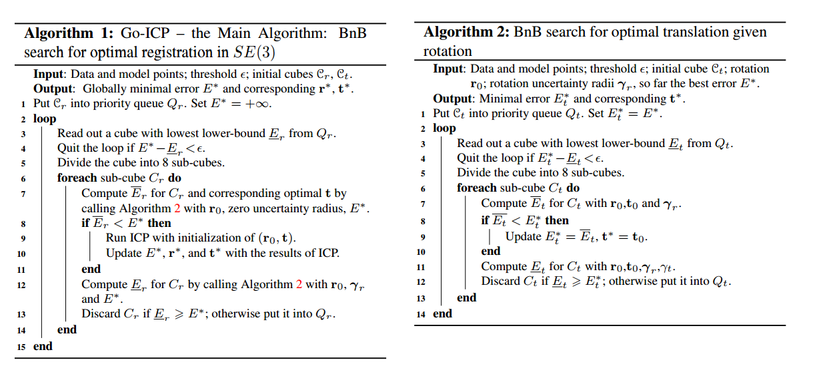
Method - Nested BnBs
Project Review
Overview
Background
Method
Results
Assessment
Conclusion

Slide 11
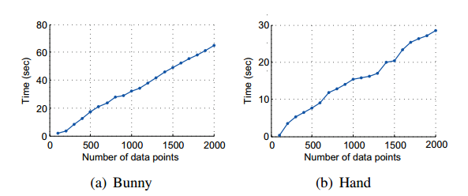
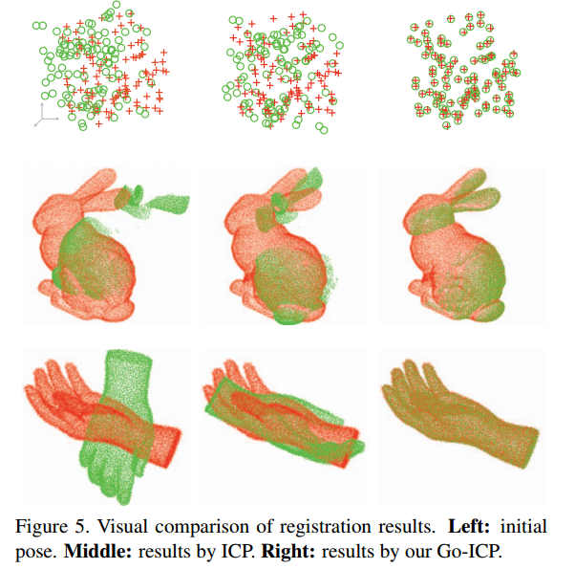
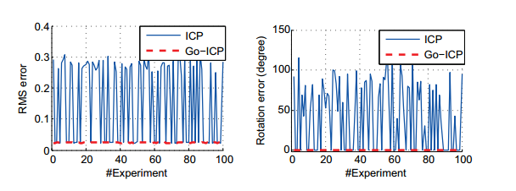
Results
Project Review
Overview
Background
Method
Results
Assessment
Conclusion
Linear scaling from the O(1) look up on the priority queue and the scaling convergence threshold , 0.001 * M
Registration Error
Rotation Error

Slide 12
Results
Project Review
Overview
Background
Method
Results
Assessment
Conclusion

Slide 13
Assessments and Conclusions
Project Review
Overview
Background
Method
Results
Assessment
Conclusion
Pros
Guaranteed to find global minimum
Deals with noise very well
Very detailed implementation
Includes code
Meshes very well with our current plan of attack
Cons
Requires manual tweaking of error minimum
Requires manual tweaking of translation range
Relatively slow due to multiple ICP calls
Limited to euclidian distance and may not be scalable to different dimensions

Slide 14
Questions?
Project Review
Overview
Background
Method
Results
Assessment
Conclusion

