Slide 1
The Robotic ENT Microsurgery System (REMS): Calibration and IRB Study, and Tool Holder Design Checkpoint Presentation
CIS II Spring 2015: Brian Gu, Barbara Kim, Kurt Lee

Slide 2
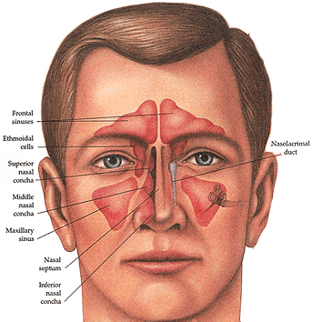
Background - Sinus Surgery
Traditionally performed "open" - entering through facial incision. Often associated with scarring and other complications.
Endoscopic sinus surgery is minimally invasive, in favor.

Slide 3
Background - Sinus Surgery
Challenges: -Many critical structures are in the surgical area (brain, eye orbit, carotid artery). These are closely intertwined with the sinuses. -Need to repeatedly remove operative instruments (cleaning, check CT position as tracking is poor) -Sinus tissue easily damaged, sensitive in general. Can occlude endoscopic view.

Slide 4
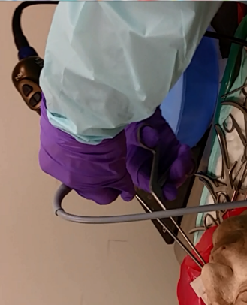

Slide 5
REMS - Robotic ENT Microsurgery System
Robotic system designed with the goal of addressing surgical challenges - specifically those encountered in OHNS (of which sinus surgery is a subset)
Assists in manipulation - eliminates unwanted movement from surgeon (i.e. hand tremor)
Assists in navigation - combines positional tracking information with registered pre-operative images to avoid sensitive anatomy ("barrier zones")

Slide 6
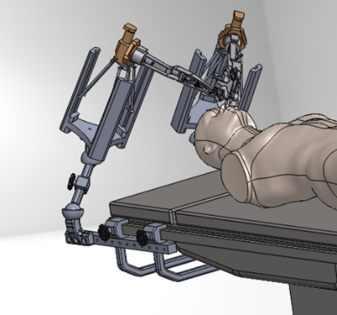
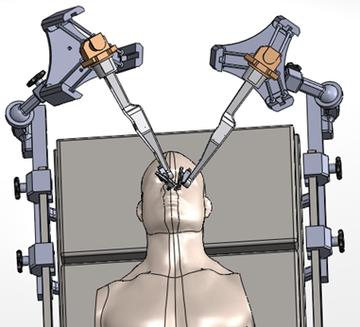

Slide 7
Subproject 1: REMS Sinus Validation Study
Primary goal is to determine if robotic surgical assistance with REMS improves surgical skill compared to conventional surgery.
Protocol:
20 students randomly separated into two groups
10 will "learn sinus surgery" with the REMS
10 with current learning protocol
An expert group will perform the task to gather data on how REMS affects professionals.

Slide 8
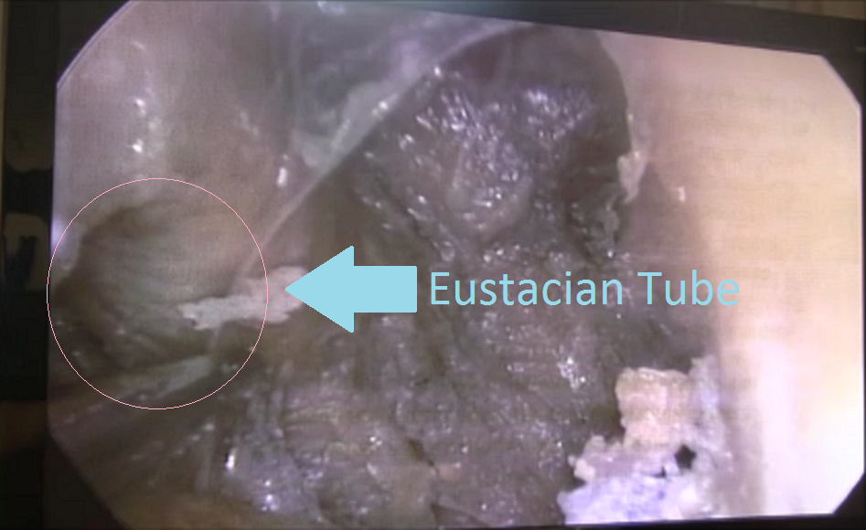
Subproject 1 Progress
Identified anatomies of interest for study:
Eustacian tube, carotid artery, optic nerve, middle turbinate
Created basic storyboard for training module
Recruited 35% of undergraduates needed for study

Slide 9
Subproject 1 Next Steps
Finish training module
Establish criteria for accuracy
Collect Data

Slide 10
Subproject 2: Additional Calibration
Tool holder not perfectly stiff
Leads to minor deflection of the tool when used admittance style
Error currently not accounted for in robot's kinematics
has a force sensor however!
Use computer vision approach to track tool tip
compare position from computer vision system to position/force in the REMS
Calibrate using AX=XB method
Do this for many different poses and forces
Fit polynomial to account for error

Slide 11
Subproject 2 Progress
Created and coded tracking system that tracks green ball in pixel coordinates of cameras
Currently working on creating a function to go from pixel coordinates to 3D world coordinates

Slide 12
Subproject 2 Next Steps
Create piece to rigidly attach green ball to tool
Calibrate green ball to tool tip
Gather deflection data
Fit deflection data to polynomial

Slide 13
Subproject 3: Modified Tool Holder
Current tool holder allows for free rotation of tool
Does not track this rotation
Not a problem for straight tools
Cannot accurately track tip of burred/angled tool tips
Two options: Motorized holder or free rotation with tracking
Must be accurate to a few degrees
Must leave small footprint (does not interfere with hand movements of doctor)

Slide 14
Subproject 3 Next Steps
Meet with Kevin to discuss feasibility of ideas today
Begin rapid prototyping

Slide 15
Old Deliverables
Minimum Expected Maximum
Completion of Completion of Completion of
one of the three two of the three all three sub-projects*
sub-projects sub-projects
Either IRB study IRB study *presentable prototype
OR calibration AND calibration of the tool holder

Slide 16
Updated Deliverables
Minimum Expected Maximum
Completion of Completion of Completion of
calibration calibration calibration
5 subjects done 10 subjects done all 20 subjects done
the study the study the study
At least one At least one
presentable prototype presentable prototype

Slide 17
Updated Dependencies
Meetings with Dr. Ishii, full correspondence
20 undergraduates with proper training for study
Cadaver head for REMS study

Slide 18
Old Timeline

Slide 19
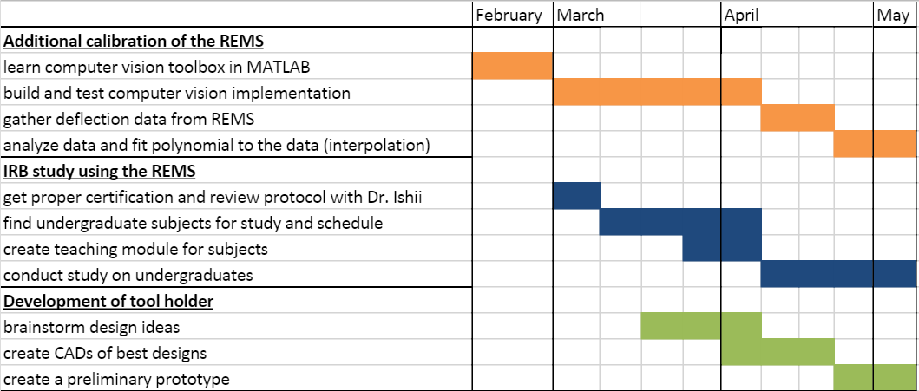
Updated Timeline

Slide 20
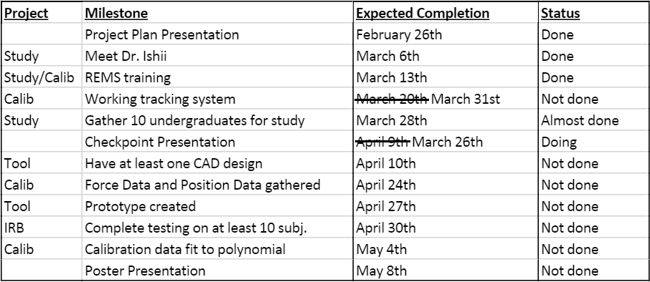
Milestones
Notes:
One week behind on subproject 2. Need assistance on computer vision system calibration.
1.5 weeks behind on subproject 1. Expectancy is difficult to meet (i.e. meeting with Dr. Ishii)

