Slide 1
Seminar Paper Presentation: A Computational Framework for
Complementary Situational Awareness (CSA) in Surgical Assistant Robots Dr. Chalasani et. al
Zhaoshuo (Max) Li
2019.02.28
Computer Integrated Surgery II

Slide 2
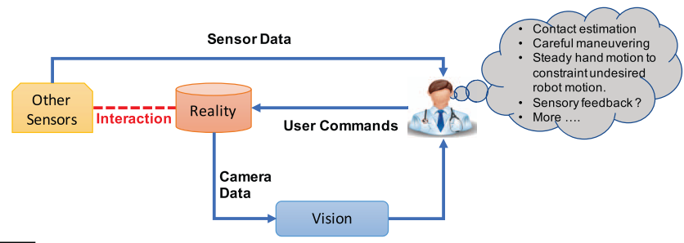
CSA Framework
Background:
Teleoperation is the most common human-in-the-loop system.
The slave robot follows a motion command given by the master device.
Notes:
completely dependent on the surgeon’s visual perception of the environment
impractical or extremely difficult to visualize the anatomical features

Slide 3
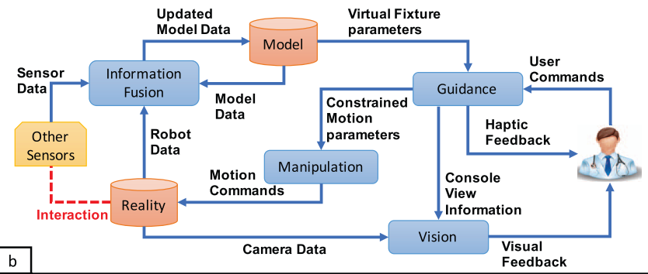
CSA Framework
Goal: Dynamically provide surgeons with information of the situational model
Manipulation mediated by a situational model
Situational model updated based on information from manipulation

Slide 4
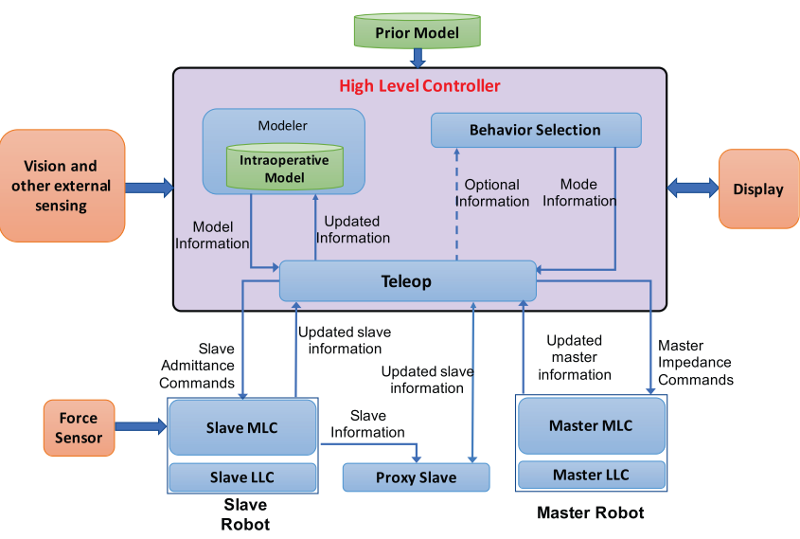
CSA Framework
Core components
Master Mid-level Controller
Slave Mid-level Controller
Proxy slave
Teleoperation High-level controller
MLC: mid-level controller
LLC: low-level controller
Notes:
Teleop is the central high level component managing communication between various components of the framework.
The Master mid level controller (MLC) sends position to the Teleop;
the Slave MLC receives these position commands from the Teleop and executes the motion.

Slide 5
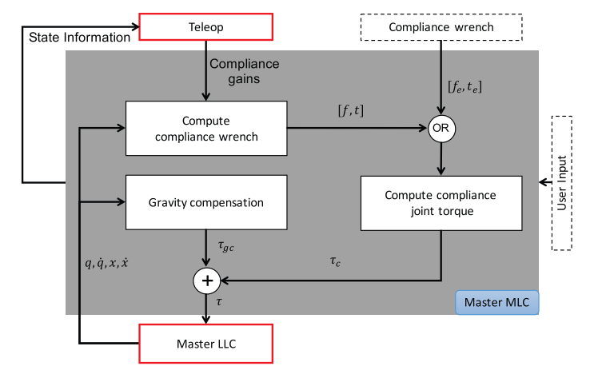
CSA Framework
Master MLC: Compliance control
Feedback haptics
Send movement information to teleop
Notes:
external source or computation based on LLC

Slide 6
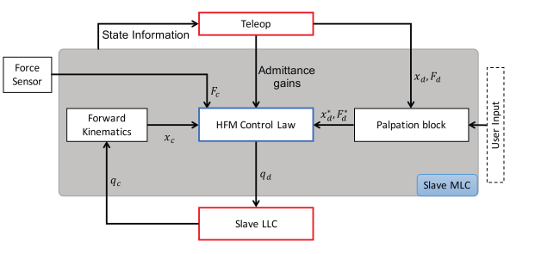
CSA Framework
Slave MLC Hybrid Force Motion (HFM) Control Law
Move slave

Slide 7
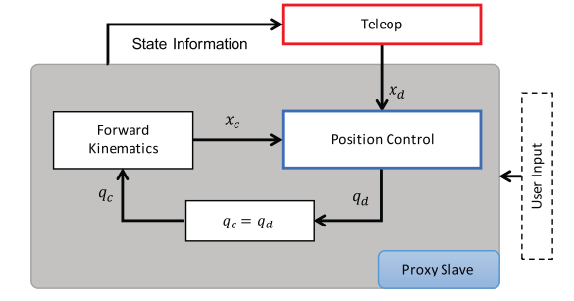
CSA Framework
Proxy Slave Position Controller
Provide compliance info needed for haptics
Notes:
Force sensor is noisy
Limited force F_d due to HFM, using a model can allow us to provide more force

Slide 8
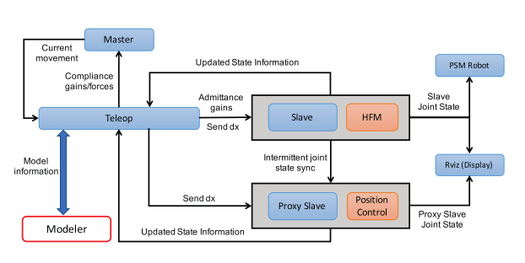
CSA Framework
Teleoperation
Information exchanger

Slide 9
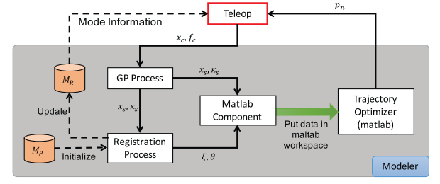
CSA Framework
Modeler
GP: estimate surface location and stiffness
Registration: updated model
Trajectory optimizer

Slide 10
Intelligent manipulation of surgical robots
Task: Trying to enhance the surgical flow by providing surgeons with necessary support
Benefit of CSA Framework: Information fusion Ability to add high-level primitives

Slide 11
Reference
Chalasani, P., Deguet, A., Kazanzides, P., & Taylor, R. H. (2018). A computational framework for complementary situational awareness (CSA) in surgical assistant robots. Proceedings - 2nd IEEE International Conference on Robotic Computing, IRC 2018, 2018–Janua, 9–16. https://doi.org/10.1109/IRC.2018.00011

