Slide 1
Project 8: Ultrasound-based Visual Servoing
Team Members: Michael Scarlett
Mentors: Bernhard Fuerst, Prof. Navab

Slide 2
Motivation
MRI or CT image differs from current anatomy due to deformations and organ movement
Ultrasound image provides real-time anatomical data
Clinical ultrasound is user dependent and requires special skills to acquire high quality images

Slide 3
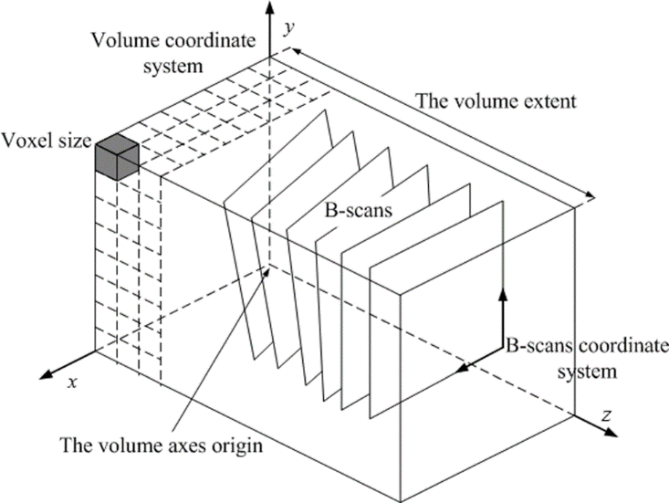
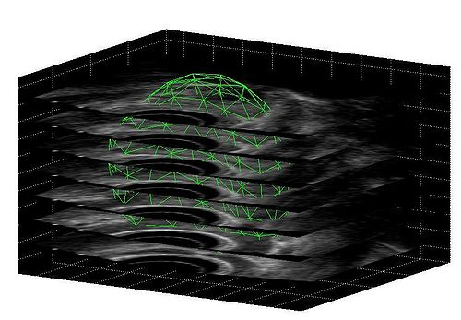
Motivation
By acquiring parallel 2D slices of B-mode scans, it is possible to obtain a 3D volume of an anatomical feature so that MRI or CT registration can be more effective

Slide 4
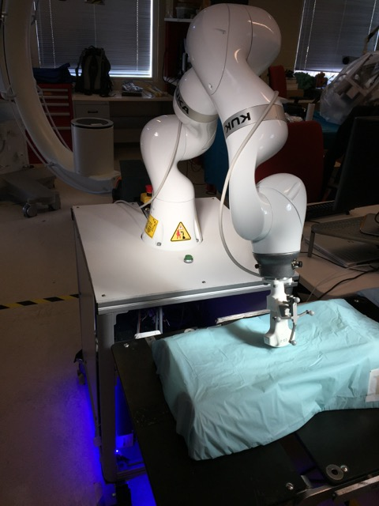
Motivation
Robotic ultrasound allows greater precision and dexterity than manual ultrasound, which can improve patient outcomes and shorten procedure times
Using a telemanipulation system a surgeon can control the robot from a workstation over LAN

Slide 5
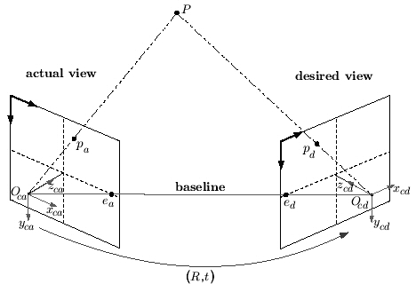
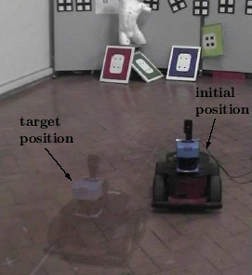
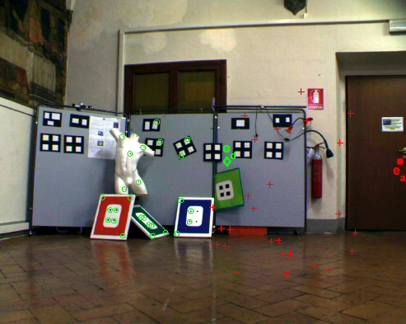
Visual servoing
Control robots using visual information
Given actual image and desired image, compute rotation and transformation between them

Slide 6
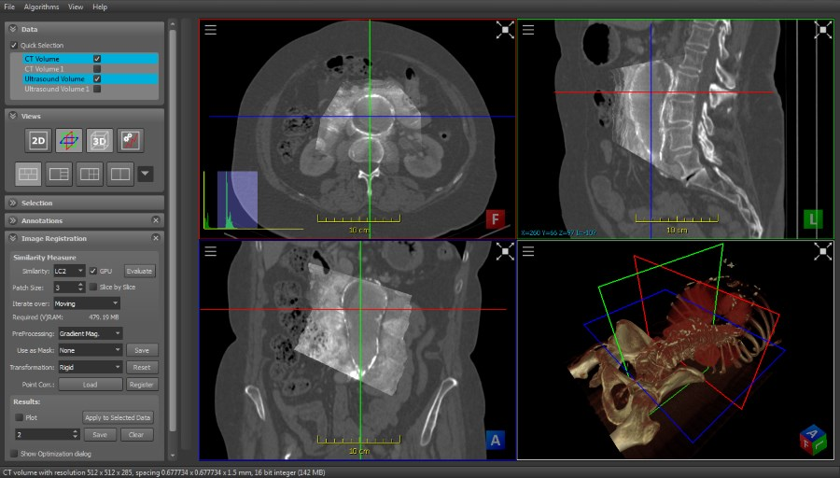
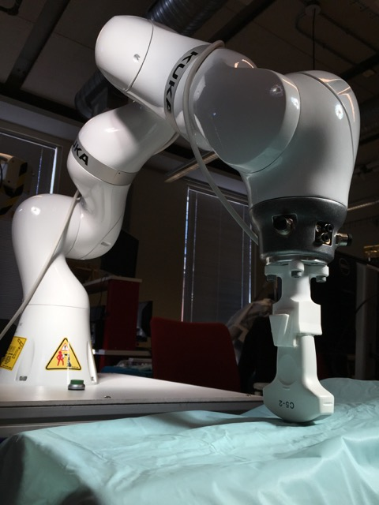
Project Goal
Design and implement a KUKA Sunrise application that uses patient MRI data of a predefined volume of interest to automatically find the ideal ultrasound scan at the same location

Slide 8
Technical summary of approach
Software
ImFusion provides an SDK that allows addition of new plugins, and it contains C++ modules for registration of ultrasound and MRI images and calculating transformation between images
The KUKA Sunrise.Connectivity framework provides a modular communication interface for control of the robot in Java
OpenIGTLink or ROS will be used to establish network communication with the robot to handle images and other custom-defined data types
OpenIGT

Slide 9
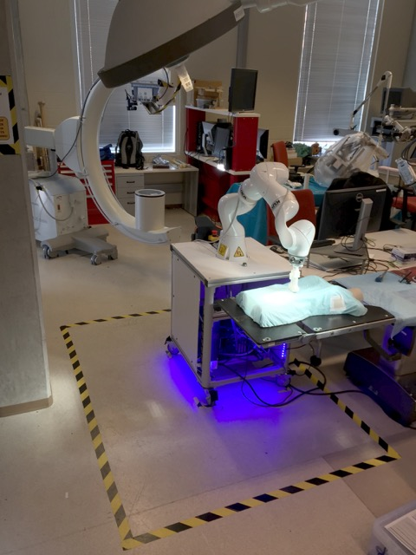
Technical summary of approach
Hardware
The KUKA IIWA lightweight robot will be used, which has 7 degrees of freedom
An ultrasound probe will be mounted onto the tool tip of the robot
A workstation will communicate planned movements to the robot using LAN

Slide 10
Image Analysis
A
A$≅$T(B)
MRI Reference image
Similarity measure
Optimizer
B_{i}
“Tracked” ultrasound slices
B
$$T=\left[\begin{matrix}R & t \\ 0 & 1\end{matrix}\right]$$
T(B)
3D ultrasound image compounding
Interpolator
Transform
Robot communication
Ultrasound probe
ROS master
ImFusion ROS node
no
Is |T| small?
Move KUKA
yes
KUKA Robot
Sunrise.Connectivity
Sunrise.Connectivity ROS node
END

Slide 11
Deliverables
Minimum:
ImFusion plugin for automated US-MRI registration and distance calculation
Enable communication between ImFusion and KUKA robot
Given an initial image and the reference image, find the transformation then move robot to location of reference image
Expected:
Perform validation of path planning on different ultrasound phantoms
Evaluate performance of different registration techniques
Maximum:
Given only the reference image, find the corresponding ultrasound image and move robot to location of reference image without knowing where to start

Slide 12
Dependencies
Access to mentors: Will be able to meet with Bernhard weekly, schedule meeting with or email Prof. Navab as needed
Permission to use ImFusion: Research agreement with CAMP which allows free usage of software for academic purposes and already have permission from Prof. Navab
Computer powerful enough to run ImFusion: Work with Bernhard to gain access to Dell Inspiron workstation which has sufficient GPU capabilities
KUKA robot in Robotorium and/or Mock OR: Sign form and obtain permission from lab manager
Ultrasound phantoms and ultrasound probe: Should be provided in Mock OR

Slide 13
Management plan
Basics
Weekly meetings with Bernhard (Wednesday 9am)
Spend 20 hours per week on project
Use Git for version control
Milestones
March 5: Move KUKA for first time using ImFusion plugin
March 12: First image registration that outputs transformation
March 24: First ultrasound acquisition using KUKA
April 2: Given initial and reference images, move robot to final position (Min Deliverable)
April 4: Begin validation with different ultrasounds
April 9: Evaluate performance of different registration techniques
April 17:
May 5: Given only reference image, move robot to final position (Max Deliverable)
May 9: Poster session

Slide 14
Timeline
Getting familiar with KUKA Sunrise and ImFusion
Registration of ultrasound and MRI (or CT) images
Re-calculation of a planned path based on registration
Develop reliable communication between imFusion and robot based on Sunrise.Connectivity framework
Validation on ultrasound phantoms – Evaluation of different registration techniques

Slide 15
Reading list
Abolmaesumi P, Salcudean SE, Zhu WH. Visual servoing for robot-assisted diagnostic ultrasound. Proc 22nd Annu Int Conf IEEE Eng Med Biol Soc (Cat No00CH37143). 2000;4:2532-2535. doi:10.1109/IEMBS.2000.901348.
Abolmaesumi P, Salcudean S, Sirouspour MR, DiMaio SP. Image-guided control of a robot for medical ultrasound. IEEE Trans Robot Autom. 2002;18(1):11-23. doi:10.1109/70.988970.
Bischoff R, Kurth J, Schreiber G, et al. The KUKA-DLR Lightweight Robot arm – a new reference platform for robotics research and manufacturing. In: Joint 41th Internatiional Symposium on Robotics and 6th German Conference on Robotics.; 2010:741-748.
Chaumette F, Hutchinson S. Visual Servo Control. IEEE Robot Autom Mag. 2007;1(March):109-118.
Chatelain P, Krupa A, Navab N. Optimization of ultrasound image quality via visual servoing. 2015.
Choset H. Principles of Robot Motion: Theory, Algorithms, and Implementation. (Choset HM, ed.). MIT Press; 2005:603. Available at: http://books.google.com/books?id=S3biKR21i-QC&pgis=1. Accessed October 27, 2014.

Slide 16
Reading list
Conti F, Park J, Khatib O. Interface Design and Control Strategies for a Robot Assisted Ultrasonic Examination System. Khatib O, Kumar V, Sukhatme G, eds. Exp Robot. 2014;79:97-113. doi:10.1007/978-3-642-28572-1.
Fuerst B, Hennersperger C, Navab N. DRAFT : Towards MRI-Based Autonomous Robotic US Acquisition : A First Feasibility Study.
Gardiazabal J, Esposito M, Matthies P, et al. Towards Personalized Interventional SPECT-CT Imaging. In: Golland P, Hata N, Barillot C, Hornegger J, Howe R, eds. Medical Image Computing and Computer-Assisted Intervention – MICCAI 2014.Vol 8673. Lecture Notes in Computer Science. Cham: Springer International Publishing; 2014:504-511. doi:10.1007/978-3-319-10404-1.
Janvier M-A, Durand L-G, Cardinal M-HR, et al. Performance evaluation of a medical robotic 3D-ultrasound imaging system. Med Image Anal. 2008;12(3):275-90. doi:10.1016/j.media.2007.10.006.
Krupa A. Automatic calibration of a robotized 3D ultrasound imaging system by visual servoing. In: IEEE International Conference on Robotics and Automation, 2006.Vol 2006.; 2006:4136-4141. doi:10.1109/ROBOT.2006.1642338.

Slide 17
Reading list
Nakadate R, Matsunaga Y, Solis J. Development of a robot assisted carotid blood flow measurement system. Mech Mach Theory. 2011;46(8):1066-1083. Available at: http://www.sciencedirect.com/science/article/pii/S0094114X11000607. Accessed August 25, 2014.
Schreiber G, Stemmer A, Bischoff R. The Fast Research Interface for the KUKA Lightweight Robot. In: IEEE Workshop on Innovative Robot Control Architectures for Demanding. ICRA; 2010:15-21.
Shepherd S, Buchstab A. KUKA Robots On-Site. McGee W, Ponce de Leon M, eds. Robot Fabr Archit Art Des 2014. 2014:373-380. doi:10.1007/978-3-319-04663-1.
Tauscher S, Tokuda J, Schreiber G, Neff T, Hata N, Ortmaier T. OpenIGTLink interface for state control and visualisation of a robot for image-guided therapy systems. Int J Comput Assist Radiol Surg. 2014. doi:10.1007/s11548-014-1081-1.

Slide 18
Questions?

