Slide 1
Redefining Neuroimaging Standard of Care： An Implantable Ultrasound for Real-Time Diagnosis of Brain Diseases
Goal: Develop the first implantable ultrasound probe for long-term post-neurosurgical monitoring. The primary aim is to monitor the potential regrowth of brain tumor in real-time using an app on the doctor and patient’s phones. The ultrasound smart device will also assist physicians to monitor bleeding, cyst, growing tumor, etc., of the over 11 million patients that are affected annually with brain diseases.
What Students Will Do:
Design, prototype, and test a miniature, flexible ultrasound probe to be implanted postoperatively for real-time imaging.
Design an app and transport images via Bluetooth to smart phone.
Invited to attend weekly Center for Neuroplastic Surgery lab meetings.
Deliverables:
Minimum: Develop a functional ultrasound probe.
Expected: Build a functional prototype and app and conduct benchtop testing.
Maximum：Build the functioning prototype and conduct cadaver, animal, or clinical trials

Slide 2
Redefining Neuroimaging Standard of Care： An Implantable Wireless Ultrasound for Real-Time Diagnosis of Brain Diseases
Design Requirements:
Miniature and implantable (skull embedded)
Wirelessly powered
Bluetooth and continuous monitoring
Rechargeable
MRI-safe
Group Size: 1-3
Skills:
Knowledge of the principles of ultrasonic imaging, app development, Bluetooth and wireless power charging, prototyping and testing, translation research
Mentors:
The Johns Hopkins Center for Neuroplastic Surgery
Dr. Liuhong Ma (lma28@jhmi.edu)
Prof. Mehran Armand (mehran.armand@jhuapl.edu)
Dr. Chad Gordon (cgordon@jhmi.edu)
Support from the Department of Neurosurgery and JHTV

Slide 3
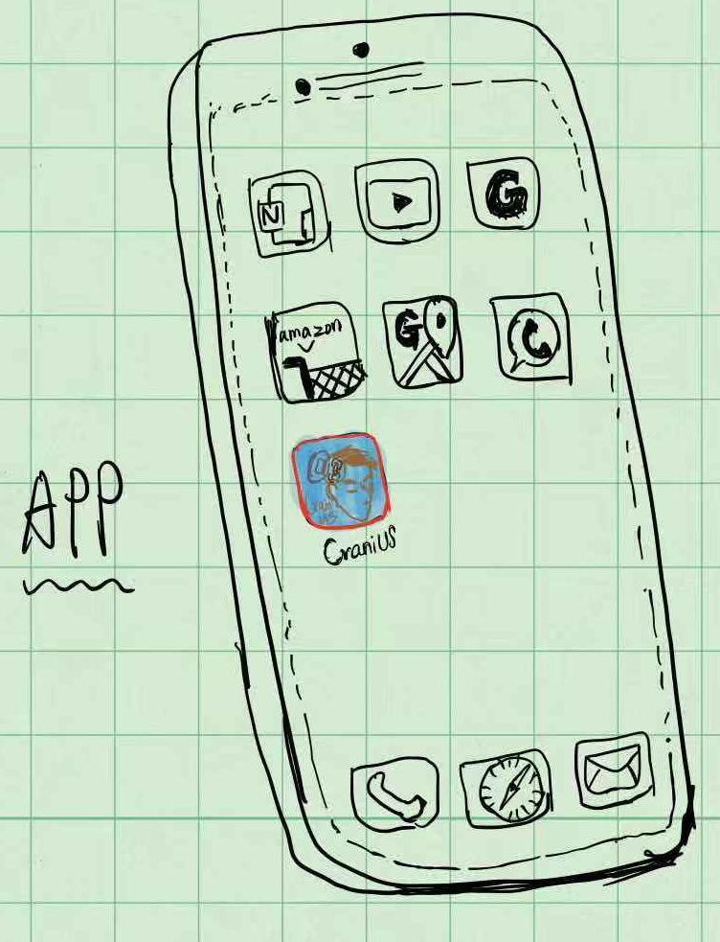
Redefining Neuroimaging Standard of Care： An Implantable Wireless Ultrasound for Real-Time Diagnosis of Brain Diseases
Ultrasound probe
Bluetooth
Battery
Coronal view ：Diagrammatic drawing
Micro-processor

Slide 4
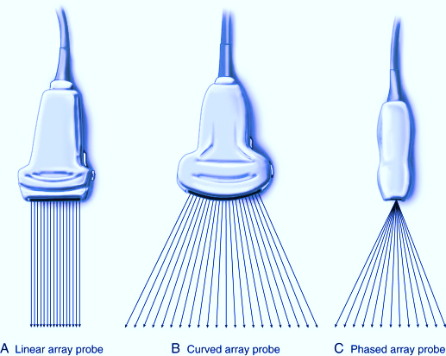
Redefining Neuroimaging Standard of Care： An Implantable Wireless Ultrasound for Real-Time Diagnosis of Brain Diseases
Coronal view of the skull
Investigate different type of probes,
And design a customized ultrasound probe to collect images of the brain

