Slide 1
Seminar
Vendor independent PA Imaging System Enabled with Asynchronous Laser source
Group 2: Yixuan Wu
Mentors: Haichong “Kai” Zhang, Emad Boctor

Slide 2
1
Recap - Background & Goal
Two Challenges to implement PA imaging on US platform
US systems beamform PA-derived signals incorrectly
New beamforming method is needed.
2. Synchronization between laser pulses and sampling of ultrasound probe
Frequency of the laser pulse is unknown.
Phase of the laser pulse is unknown.
My Project Goal
Develop an algorithm to solve the synchronization problem (challenge 2)
Notes:
2

Slide 3
2
Seminar Overview
For The First Challenge (Beamforming)
Solved: re-beamforming.
Paper: Synthetic-Aperture Based Photoacoustic Re-beamforming (SPARE) Approach Using Beamformed Ultrasound Data
Authors: Haichong K. Zhang, Muyinatu A. Lediju Bell, Xiaoyu Guo, Hyun Jae Kang, Emad M. Boctor
For The Second Challenge (Synchronization)
We are the very first to work on this problem.

Slide 4
Synthetic-Aperture Based Photoacoustic Re-beamforming (SPARE) Approach Using Beamformed Ultrasound Data
Problem Summary and Importance
3.1
Problem of US platform
Conventional US probes only provide beamformed data. US systems that provide pre-beamformed channel data are expensive. Most clinical US systems do not offer PA beamforming.
Problem of implementing PA on US
Channel data is needed. Time-of-Flight of US wave differs from US systems. Fixed data transfer rate of US systems prohibit high framerate, real-time imaging.
Goal
New PA image reconstruction approach based on ultrasound RF data that has already been beamformed by the system.
Significance
Any commercially available US platform can potentially be used to create PA images.
Notes:
4

Slide 5
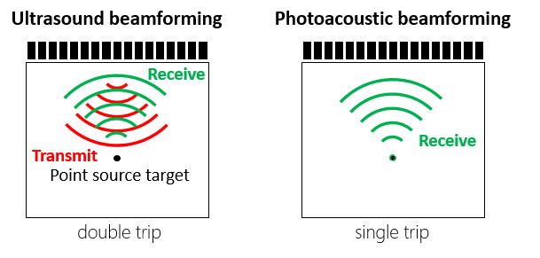
Synthetic-Aperture Based Photoacoustic Re-beamforming (SPARE) Approach Using Beamformed Ultrasound Data
Theory
3.2
Time-of-flight
Time-of-flight (TOF)
For fixed focusing, $r_{T}=r_{R}$
So $t_{US}≡2t_{PA}$
Notes:
5

Slide 6
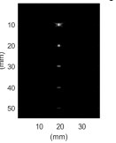
Synthetic-Aperture Based Photoacoustic Re-beamforming (SPARE) Approach Using Beamformed Ultrasound Data
Theory
3.2
Beamforming (delay-sum beamforming)
US beamforming for PA signals
Notes:
6

Slide 7
Synthetic-Aperture Based Photoacoustic Re-beamforming (SPARE) Approach Using Beamformed Ultrasound Data
Theory
3.2
Re-beamforming
Conventional PA imaging use channel data to beamform.
US probes only provide beamformed data.
Solution: re-beamform the beamformed data
US imaging
Synthetic aperture beamforming
PA imaging
Channel data
beamforming
Beamformed data
Notes:
7

Slide 8
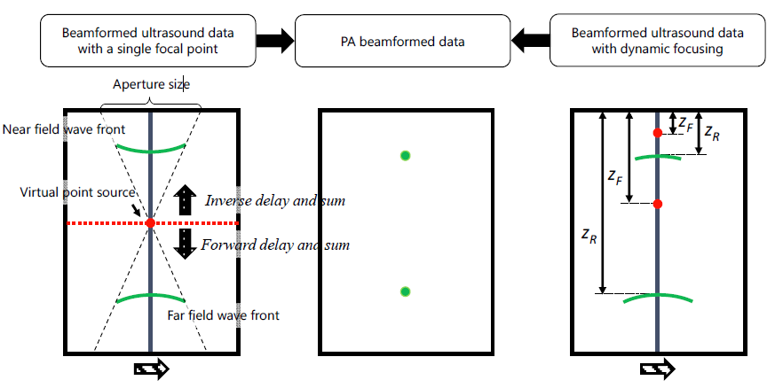
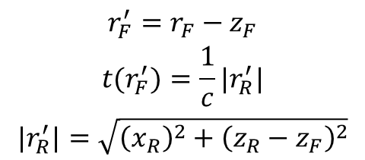
Synthetic-Aperture Based Photoacoustic Re-beamforming (SPARE) Approach Using Beamformed Ultrasound Data
Theory
3.2
Re-beamforming
Find the new focal point and do re-beamforming.
$$\begin{matrix}r_{F}^{′}=r_{F}−z_{F} \\ t(r_{F}^{′})=\frac{1}{c}|r_{R}^{′}| \\ |r_{R}^{′}|=\sqrt{{\left(x_{R}\right)}^{2}+{\left(z_{R}−z_{F}\right)}^{2}}\end{matrix}$$
Notes:
8

Slide 9
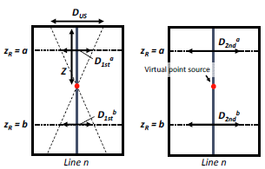
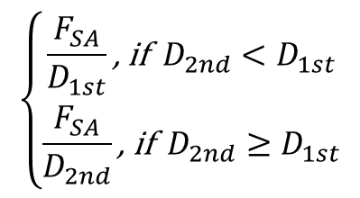
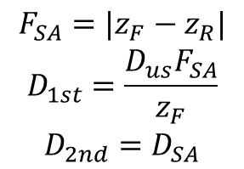
Synthetic-Aperture Based Photoacoustic Re-beamforming (SPARE) Approach Using Beamformed Ultrasound Data
Theory
3.2
Image quality: resolution and SNR
$$\begin{matrix}F_{SA}=|z_{F}−z_{R}| \\ D_{1st}=\frac{D_{us}F_{SA}}{z_{F}} \\ D_{2nd}=D_{SA}\end{matrix}$$
The overall effect on lateral resolution and SNR:
SNR = 20log10$\left(\frac{|A_{max}|}{σ_{noise}}\right)$
$$\left\{\begin{matrix}\frac{F_{SA}}{D_{1st}}\text{, }\text{if} { D}_{2nd}<D_{1st} \\ \frac{F_{SA}}{D_{2nd}}\text{, }\text{if} D_{2nd}≥D_{1st}\end{matrix}\right.$$
$$\begin{matrix}\text{W}\text{hen} \text{all} \text{parameters} \text{except} \text{f}\text{−}\text{number} \text{are} \text{fix}ed, \\ \left. SNR=f(F\#\right)\end{matrix}$$
Notes:
9

Slide 10
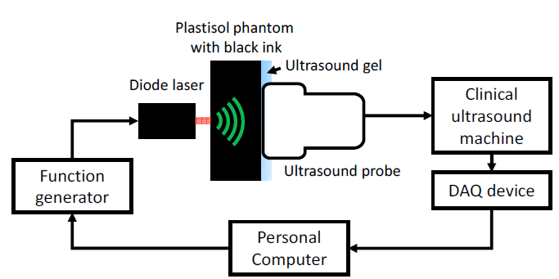
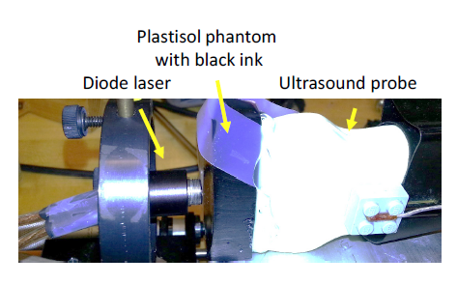
Synthetic-Aperture Based Photoacoustic Re-beamforming (SPARE) Approach Using Beamformed Ultrasound Data
Methods
3.3
Simulation & Experiment Setup
Simulation
Tool: field II
Settings:
five PA point sources were placed at 10 mm, 20 mm, 30 mm, 40 mm and 50 mm depth
128-element, 0.3 mm pitch, linear array transducer
Sampling rate: 40MHz
Parameter varied:
The fixed focal depth
The SPARE beamformer focal depth
The fixed focusing aperture size
The aperture size for the SPARE beamforming
Experiment
Notes:
10

Slide 11
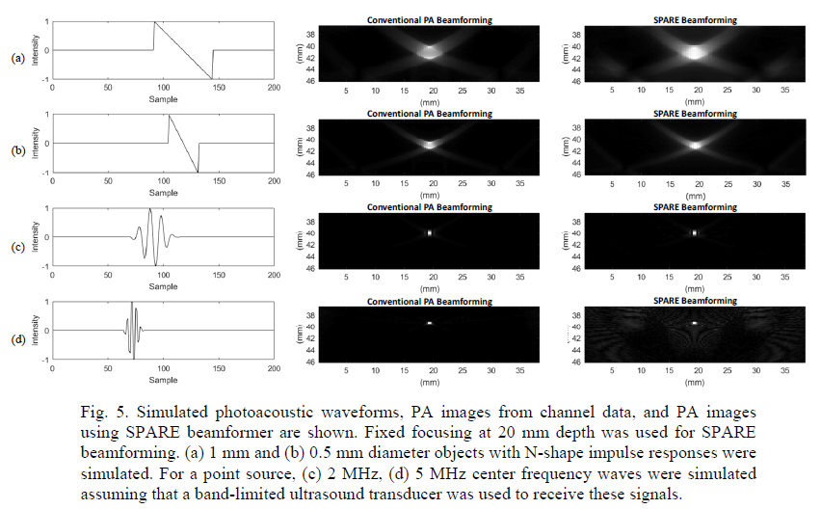
Synthetic-Aperture Based Photoacoustic Re-beamforming (SPARE) Approach Using Beamformed Ultrasound Data
Key Results
3.4
Simulated Waveform and Images
These results indicate that SPARE algorithm is independent of the impulse responses determined by the absorber size and the ultrasound probe.
Notes:
11

Slide 12
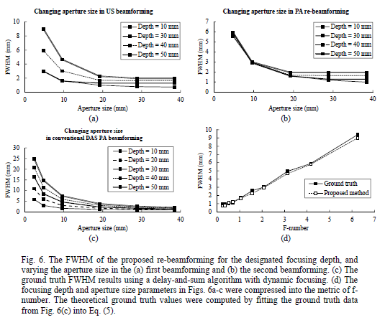
Synthetic-Aperture Based Photoacoustic Re-beamforming (SPARE) Approach Using Beamformed Ultrasound Data
Key Results
3.4
Resolution Evaluation
The smaller the depth and the larger the aperture size, the better the resolution.
The resolution of the proposed method agrees well with the ground truth
values with a correlation coefficient of 99.87%.
Notes:
12

Slide 13
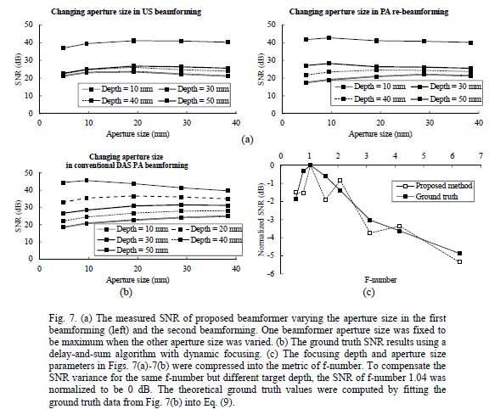
Synthetic-Aperture Based Photoacoustic Re-beamforming (SPARE) Approach Using Beamformed Ultrasound Data
Key Results
3.4
SNR Evaluation
the correlation coefficient conventional ultrasound beamforming and proposed method is 91.56%.
Notes:
13

Slide 14
Synthetic-Aperture Based Photoacoustic Re-beamforming (SPARE) Approach Using Beamformed Ultrasound Data
Results
3.4
Dynamically focused beamformed ultrasound RF data
(a) Ground truth. (b-c) the reconstructed image through ultrasound and SPARE beamforming. Grating lobe artifacts are visible in the near field. it is drastically reduced when a small aperture size is used (c).
Notes:
14

Slide 15
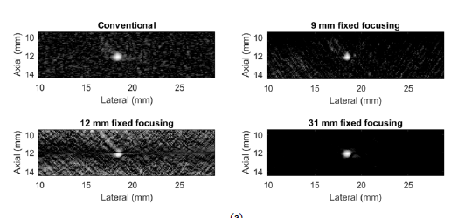
Synthetic-Aperture Based Photoacoustic Re-beamforming (SPARE) Approach Using Beamformed Ultrasound Data
Results
3.4
Experiment Evaluation
A phantom experiment to beamform a point source
Reconstructed photoacoustic images of conventional dynamic focusing for channel data, 9 mm, 12 mm, and 31 mm fixed focal depths
Notes:
15

Slide 16
Synthetic-Aperture Based Photoacoustic Re-beamforming (SPARE) Approach Using Beamformed Ultrasound Data
Assessment
3.4
This paper
Results demonstrate the feasibility of the algorithm under practical data acquisition.
Future work includes implementing the algorithm in real time.
SNR of the image can be further improved.
Only focused on beamforming instead of synchronization.
Our project
This paper provides theory guidance on PA imaging on US platform.
This paper demonstrates simulation methods and experiment approaches for testing.
The difference is I will focus on synchronization, the sampling process will be considered and new algorithms will be developed.
Notes:
16

Slide 17
Synthetic-Aperture Based Photoacoustic Re-beamforming (SPARE) Approach Using Beamformed Ultrasound Data
Conclusion
3.4
A synthetic-aperture based PA beamforming method utilizing ultrasound post-beamformed RF data is proposed.
It is validated through simulation, and experiments with different parameter definitions.
SPARE method is a big step to realize PA imaging on US systems. Next step is to overcome the synchronization between laser and signal received by US probe.
Notes:
17

Slide 18
4
References
Zhang, Haichong K., et al. "Synthetic-aperture based photoacoustic re-beamforming (SPARE) approach using beamformed ultrasound data." Biomedical Optics Express 7.8 (2016): 3056-3068
Harrison, Travis, and Roger J. Zemp. "The applicability of ultrasound dynamic receive beamformers to photoacoustic imaging." Ultrasonics, Ferroelectrics, and Frequency Control, IEEE Transactions on 58.10 (2011): 2259-2263.
Weebly. beamforming[EB/OL]. http://beamforming-noise-cancellation.weebly.com/beamforming.html (2017)

